Slide 1


1 편

Slide 2
AI + X
Exploring the Convergence of
AI and Various Industries

Slide 3
Broad Applications
Finance
Healthcare
Education
Manufacturing
Arts
X
AI applications in various fields

Slide 4
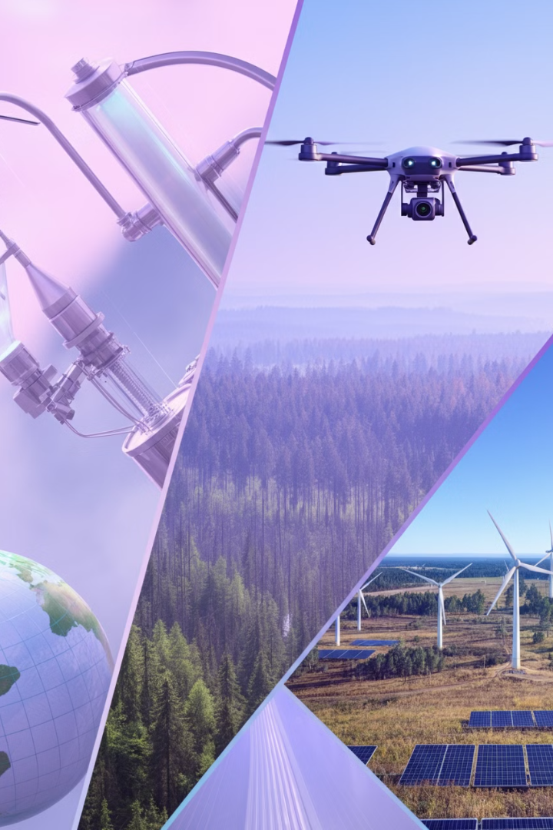
Increased Productivity and Efficiency
Automation of Routine Tasks
Rapid Analysis of Large Data Sets
Data-Driven Insights
Focus on High-Value Activities

Slide 5

Enhanced Problem Solving
Traditional methods may not lead to innovative solutions and insights that are not always clear.

Slide 6

Generative AI
Artificial intelligence systems that can create new content

Slide 7




Key Features of Generative AI
Content Generation Capability
Problem Solving
Adaptability
Creativity Enhancement

Slide 8
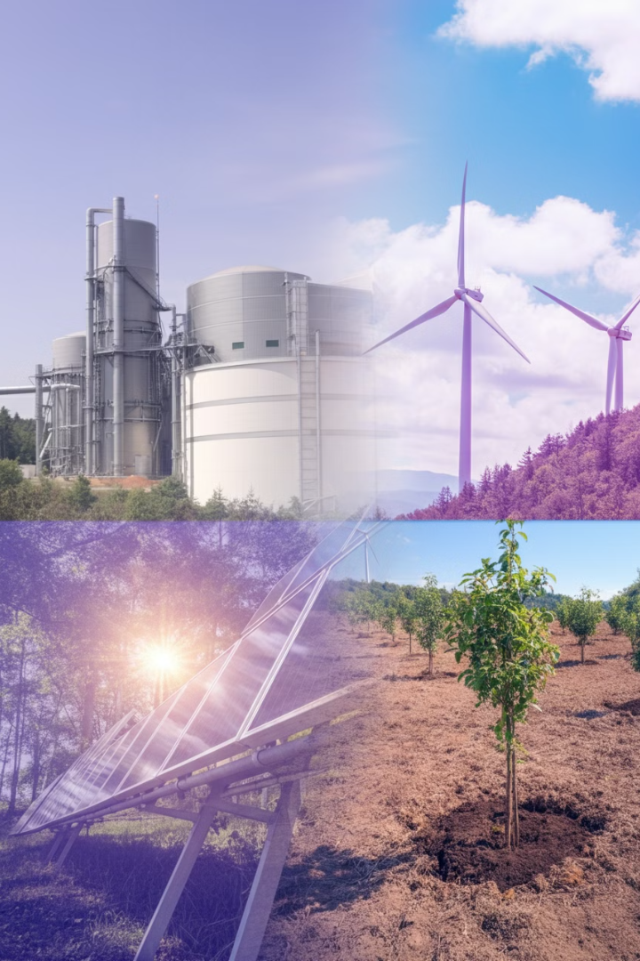
Definition of AI + X
The term "AI + X" represents the integration of artificial intelligence (AI) technology with various other fields and industries.

Slide 9
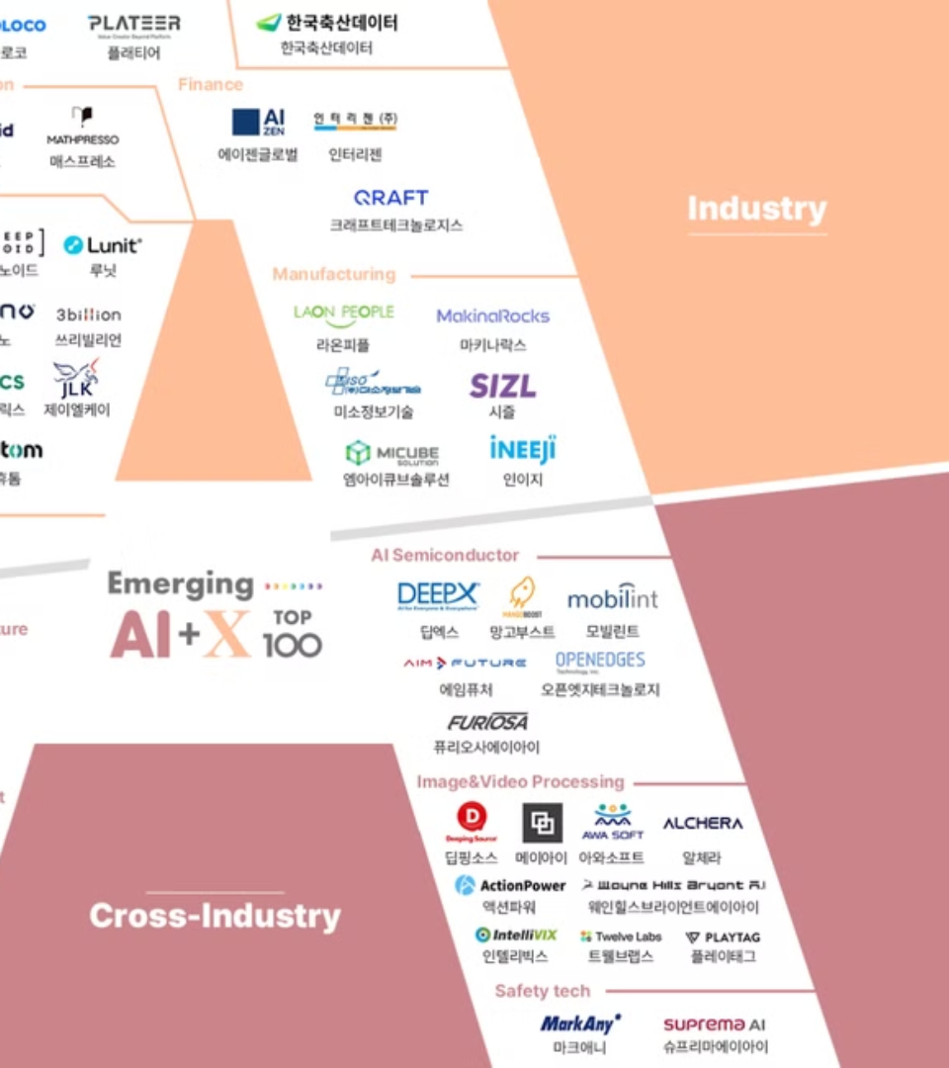

Industry-specific Solutions
Problem Solving
Applying AI technology to solve specific industry or domain problems.
https://www.ailandscape.net/main.php

Slide 10


Collaboration Framework
Establishing Collaboration between Government, Businesses, and AI Experts
Partnership between KEPCO and Hancom

Slide 11
2 편

Slide 12

Current Status of
AI + X Industries
in Korea

Slide 13
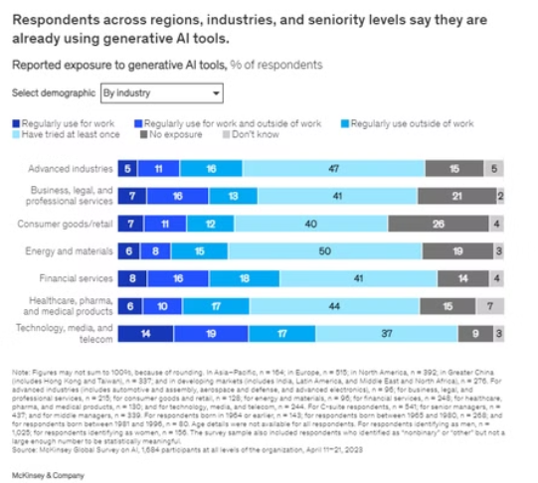
Generative AI has garnered interest across the business population: individuals across regions, industries, and seniority levels are using generative AI for work and beyond.

Slide 14
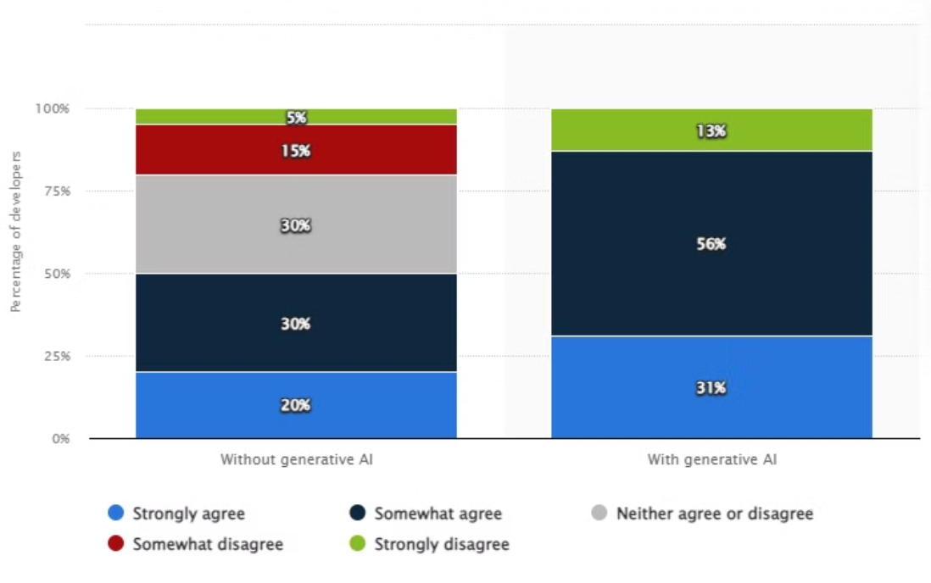
Developer Satisfaction with AI Tools
Developers’ work satisfaction with or without artificial intelligence (AI) tools worldwide in 2023

Slide 15

Government AI Initiatives
The Ministry of Science and ICT is accelerating the normalization of AI in the public sector in collaboration with 10 government ministries.
"In the full-fledged AI era, there will be no area where AI is not applied, and how much AI is integrated into daily life will determine national competitiveness." - Yum Yeol, Director of the AI Policy Bureau, Ministry of Science and ICT

Slide 16
Public Sector AI Projects
AI + Energy
AI + Transportation
AI + Environment
Korea Electric Power Corporation
Korea Expressway Corporation
Korea Water Resources Corporation
Power Demand Forecasting System
AI-based Traffic Control System
Smart Water Management System
Improved power supply efficiency and optimal equipment maintenance
Real-time traffic flow analysis and accident prevention, improved toll collection accuracy and efficiency
Water quality management and resource allocation optimization, addressing water scarcity issues

Slide 17
Public Sector AI Projects
AI + Medical
AI + Safety
AI + Public Services
Samsung Medical Center, Lunit, Acryln
Electronics and Telecommunications Research Institute
Electronics and Telecommunications Research Institute
COVID-19 Prognosis Prediction Solution
AI Mask-Wearing Face Recognition Technology
Avatar Sign Language, Interactive Police Civil Complaint Response System
Analyze early medical data to predict severe COVID-19 cases
Applied in public safety and security
Improve accessibility and efficiency of public services

Slide 18
Private Sector AI Projects
AI + Semiconductiors, Electronics
AI + Search, Personalization, Autonomous Technology
AI + Autonomous Driving, Manufacturing
Samsung Electronics
Naver
Hyundai Motor Company
AI-based semiconductor design and production optimization system
AI-based search engine optimization and personalized recommendation system
AI-driven Autonomous Driving Technology and AI-based Predictive Maintenance System
Improve semiconductor design and production productivity, integrate AI into smartphones and home appliances to enhance user experience
Strengthen search engine, personalized recommendation system, utilize NLP technology, apply AI to robot and autonomous driving development
Focused on AI-based autonomous driving, improved production efficiency, optimized vehicle management with AI-based predictive maintenance

Slide 19
Private Sector AI Projects
AI + Smart Factory, Energy Management
AI + Platform Services, AI Reserach
LG CNS
Kakao
AI-based smart factory solution and energy management system
AI-based platform services and AI research (AI Labs)
Leading the digital transformation of the manufacturing industry and improving efficiency through AI-based smart factory solutions and AI-based energy management
Leveraging AI to enhance platform services (KakaoTalk, KakaoPay, KakaoMap) and focus on AI-based conversational agents

Slide 20
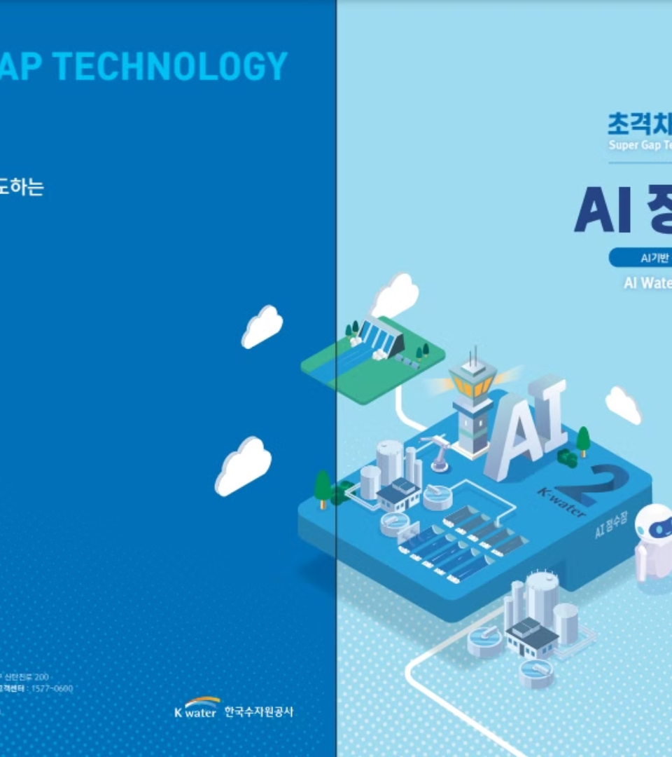
AI Water Treatment Plant

Slide 21





AI-Based Water Treatment Cycle Stages 1-4
Data Collection
Data Analysis
Decision Making
Action Implementation

Slide 22




AI-Based Water Treatment Cycle Stages 5-8
Monitoring and Feedback
Continuous Learning
Reporting and Visualization
Predictive Maintenance

Slide 23
3 편

Slide 24

AI Technology
in Everyday Life

Slide 25
Widespread Use of Generative AI
The use of generative AI is already widespread

Slide 26

Awareness and Adaptation
Recognizing the Impact of AI Technology
Ethical and Privacy Concerns

Slide 27

Employment and Technology
Employment and Technology
Empowering Consumers
Innovation and Opportunity

Slide 28






Transportation and Navigation
Taxi Booking App
Navigation and Travel
Voice Assistant
Chatbots
Smart Input Keyboard
Fall Detection

Slide 29






Security and Surveillance
Vehicle Collision Detection
Facial Recognition
Security and Surveillance
Financial Services
AI Image Generators
Wearables for Health Monitoring

Slide 30





Marketing and Social Media
Personalized Marketing
Social Media Algorithms
Productivity and Communication
Weather and Environment
Weather Forecasting
AI-based Voice Recognition
Email Filtering

Slide 31

South Korea's AI Competitiveness Ranking
Overall AI Competitiveness Ranking
6th
Number of Countries Evaluated
62 countries
Evaluation Year
2024

Slide 32
Government Policy and Development Sector Rankings
6th
390.1B
Government Policy Sector
AI Policy Investment
Ranking of South Korea
Unit: KRW
3rd
1.5M
Development Sector
Book Dataset
Following the US and China
Supporting private AI development

Slide 33



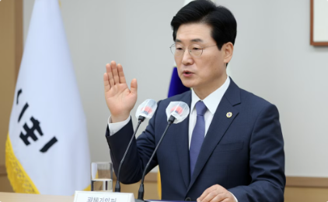
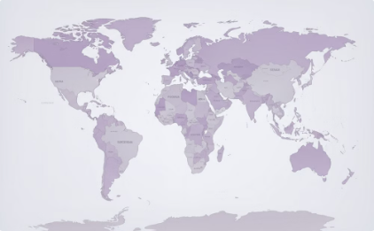
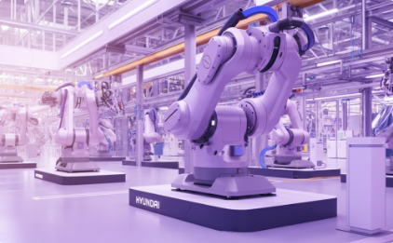
Key Milestones and Core Achievements
2005 - Establishment of the Korea Cognitive Robotics Center
2011 - Launch of ETRI Supercomputer
2016 - Development of AI-based Go Program "DeepZenGo"
2018 - Announcement of National AI Strategy
2020 - AI-based COVID-19 Tracking and Response System
2022 - Advancements in Modern Robotics Technology
https://zhukov.live/korean-artificial-intelligence-a-general-overview-b55d5613637a

Slide 34
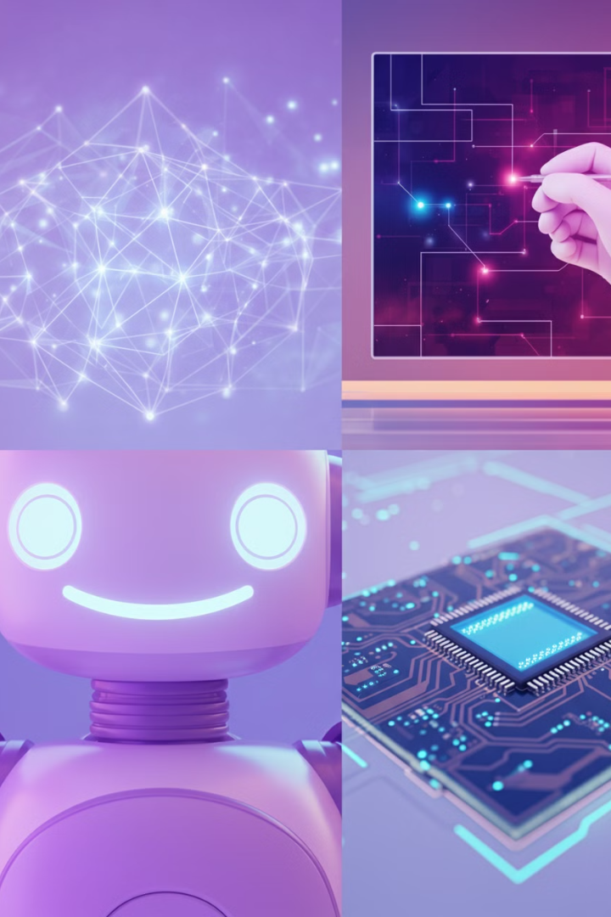
AI Research and Development in Korea
Natural Language Processing
Teams from KAIST and Seoul National University have developed models tailored to the Korean language, improving applications such as machine translation and sentiment analysis.
Computer Vision
Researchers from Yonsei University and POSTECH have developed super-resolution technology to enhance low-resolution images, which is being utilized in medical and security fields.
Robotics and AI
KIST has developed an emotion-responsive AI robot that has been successfully applied to elderly care and education and has achieved success in international competitions.
AI-Driven Semiconductor Design
Through collaboration between Samsung Advanced Institute of Technology and Seoul National University, AI-based semiconductor design technology has advanced, significantly improving process speeds and industrial competitiveness.

Slide 35
4 편

Slide 36
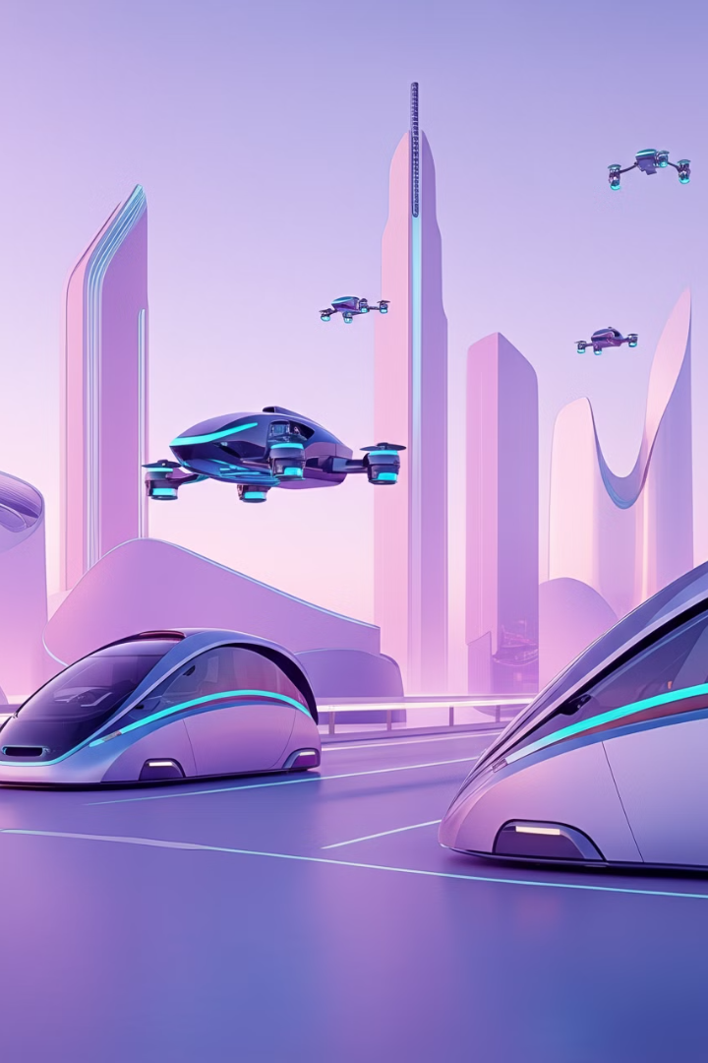
The Future of
Transportation Driven by
AI Innovation

Slide 37
Cars Preparing for Autonomous Driving
Cars are increasingly preparing for autonomous driving.

Slide 38





Benefits of Autonomous Driving
Improved Safety
Efficiency and Congestion Reduction
Accessibility
Environmental Benefits

Slide 39

Preparing for the Future of Transportation
Understanding these technologies can help prepare for the future changes in transportation, and anticipate the impact on urban planning, lifestyle, and work dynamics.

Slide 40
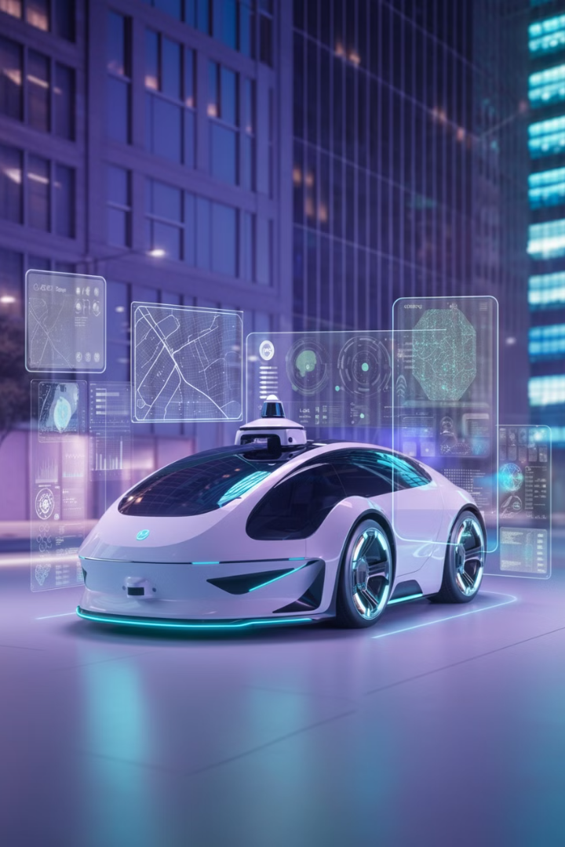
Autonomous Driving and AI Technology
Environmental Perception
Real-time data analysis from sensors such as cameras, LiDAR, and radar.
Path Planning
AI algorithms to calculate and continuously update the optimal route.
Decision Making
AI systems that make quick and accurate decisions in various driving situations, such as lane changes, overtaking, stopping, and turning.
.
Learning and Improvement
Autonomous driving AI continuously learns and improves through actual driving experience and simulation.

Slide 41
Mobility and AI Technology
Traffic Flow Optimization
Public Transportation Management
Parking Management
Accident Prevention
AI-based risk detection system
AI-based traffic signal control system
AI-based parking guidance and reservation system
Real-time demand forecasting and route optimization
Vehicle Management
AI-based predictive maintenance system

Slide 42
Global Autonomous Driving Projects
Waymo (Google)
Tesla Autopilot
Project: Advanced autonomous vehicle technology.
Project: Semi-autonomous driver assistance system.
Impact: Significant road testing to improve reliability and safety.
Impact: Continuous software updates to enhance autonomy.
Uber Advanced Technologies Group
Baidu Apollo
Project: Autonomous technology for ridesharing.
Project: Open-source autonomous driving platform.
Impact: Contributed to urban autonomous mobility research.
Impact: Powering autonomous public shuttles and taxis in urban environments.
NVIDIA DRIVE
Navia Autonomous Shuttle
Project: AI platform for autonomous vehicles.
Project: Autonomous shuttle for controlled environments.
Impact: Used by automakers for autonomous capabilities.
Impact: Solution for last-mile transportation issues.

Slide 43
South Korea's Autonomous Driving Projects
Hyundai Motor Group
Samsung Electronics
Kakao Mobility
Project: Development of Level 4 autonomous driving vehicles.
Impact: Improvement of technology through testing in urban environments.
Project: AI technology for automotive applications.
Impact: Enhancing vehicle connectivity and driving safety.
Project: Autonomous driving ride-hailing service.
Impact: A pilot project to test the feasibility of autonomous taxis.
Seoul Robotics
KAIST Urban Robotics Lab
Project: Advanced 3D perception software for autonomous vehicles.
Impact: Improved navigation in complex environments.
Project: Autonomous vehicles for dense urban areas.
Impact: Addressing the challenges of urban driving through AI.

Slide 44
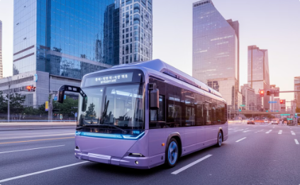

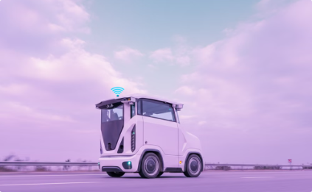
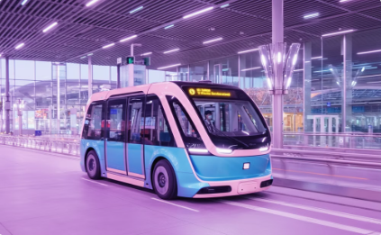
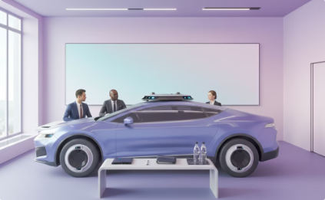
South Korean Public Sector Projects
Seoul Metropolitan Government
Korea Railroad Research Institute (KRRI)
Korea Expressway Corporation
Incheon International Airport
Project: Autonomous bus and shuttle testing.
Impact: Expansion of autonomous public transportation within the city.
Project: Autonomous technology for highway maintenance.
Impact: Enhanced safety and operational efficiency of expressways.
Project: Autonomous shuttle for passenger transport.
Impact: Streamlined operations and improved passenger experience.
Project: Autonomous train technology.
Impact: Improved safety and efficiency of rail transportation.
Ministry of Land, Infrastructure and Transport
Project: Integrated support for autonomous vehicles.
Impact: Regulatory support to facilitate widespread adoption of autonomous technology.

Slide 45
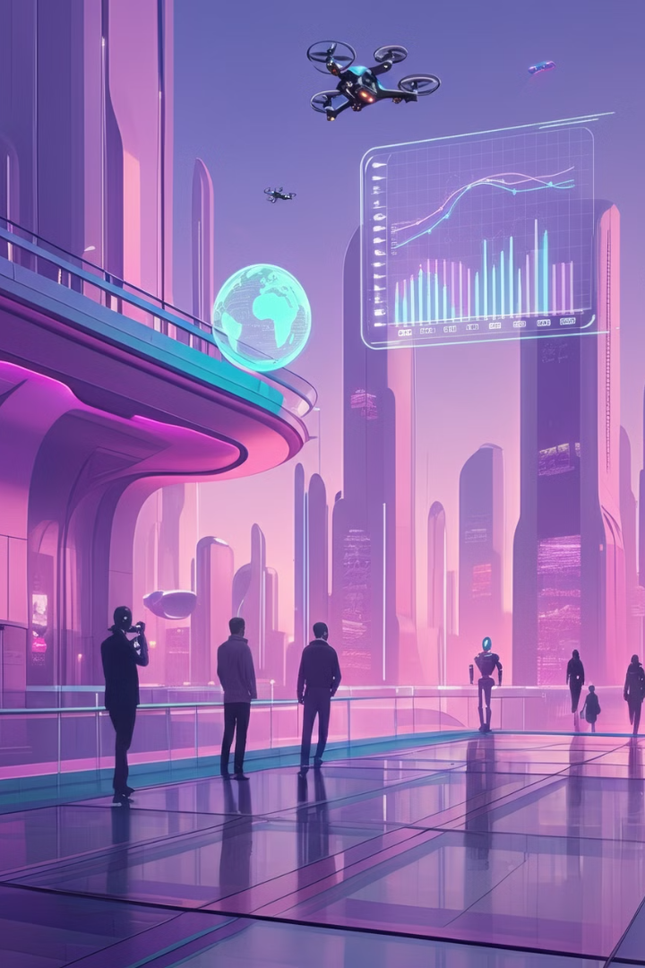
To understand how to introduce and utilize AI technology in fields such as mobility, disaster management, and climate control, it is important to examine the use cases of AI in these industries and the resulting benefits. These industries play a pivotal role in solving social and environmental problems, and AI technology provides innovative solutions to these issues.

Slide 46

Utilizing AI Technology
1
Industry-Specific Solutions
2
Strengthening Government and Business Collaboration
3
Ethical Issues and Privacy Protection
AI technology can be used to solve specific problems in various fields. For example, in the mobility sector, it can be used to address traffic congestion, and in the public safety and disaster management sector, it can be used to build disaster response systems.
The Korean government operates various AI support programs, and companies are working with the government on AI technology-based projects. Collaboration between the public and private sectors promotes data sharing and technology development.
As the use of AI technology increases, data privacy and ethical issues are also important considerations. Regulations should be established to ensure that AI-based systems operate transparently and fairly, and the responsible use of AI should be encouraged.

Slide 47
Industrial Application of AI Technology
Mobility
Safety and Disaster Management
Climate Management
AI technology can be used to optimize traffic flow and build smart transportation systems.
AI technology can be used to predict climate change and develop response strategies to create a sustainable environment.
AI can improve disaster prediction and response systems, enabling more effective safety management.
Utilizing AI in the fields of mobility, safety and disaster management, and climate management can be a powerful tool to innovatively solve problems in each area. This can help increase efficiency, address social issues, and provide various solutions to build a sustainable future.

Slide 48
5 편

Slide 49
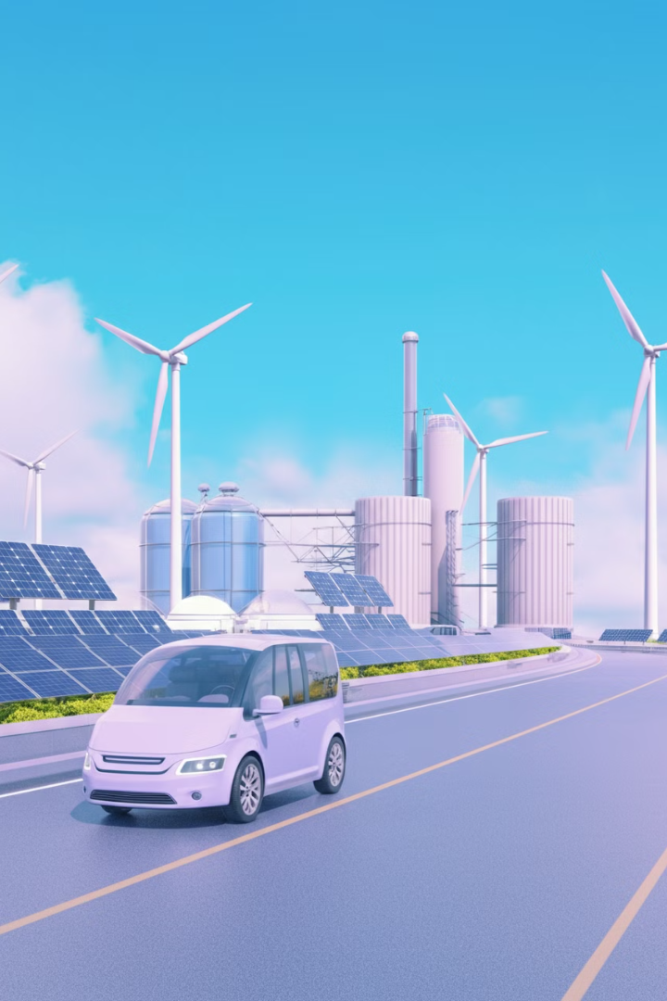
Overview of ClimateTech
ClimateTech is technology specifically designed to address and mitigate the impacts of climate change.
ClimateTech includes advancements in renewable energy, carbon capture and storage, smart grid technology, electric vehicles, and more.
It aims to not only help adapt to and mitigate climate change, but also to promote a more sustainable and low-carbon future.

Slide 50

Overview of ESG
ESG stands for Environmental, Social, and Governance. It is a framework used by investors and companies to evaluate how a business operates in environmentally conscious, socially responsible, and ethically governed ways.

Slide 51

The Importance of ClimateTech and ESG Management
Providing a Sustainable Environment
Strengthening Social Responsibility
Key Elements
Addressing climate change
Strengthening social responsibility
Sustainable economic growth
Regulatory compliance and risk management
Meeting investor and consumer demands

Slide 52



AI in Environmental Technologies
Carbon Capture Technology
Ecosystem Restoration
Renewable Energy Optimization

Slide 53

Applying AI to ESG Aspects
Environment
Social
Governance
AI is used to optimize energy usage, manage waste, and track carbon emissions. AI-based predictive models can forecast a company's future carbon emissions and suggest strategies to reduce them.
AI strengthens a company's social responsibility by monitoring employee well-being, analyzing diversity and inclusion, and detecting human rights issues in the supply chain. AI chatbots can improve customer service and enhance community engagement.
AI contributes to the transparency and efficiency of corporate governance. It is applied to risk management, regulatory compliance monitoring, and fraud detection. AI-based analytical tools can identify biases in board decisions and support better decision-making.

Slide 54



Global Environmental AI Projects
Carbon Capture Technology
Ecosystem Restoration
Renewable Energy Optimization
Climeworks (Switzerland) operates direct air capture plants that use AI to optimize the process of capturing CO2 from the atmosphere. Their system integrates advanced machine learning algorithms to improve efficiency and adapt to various atmospheric conditions.
Conservation International (Global) uses AI to analyze satellite imagery and drone data for large-scale environmental restoration. Their projects include monitoring deforestation and reforestation efforts in critical habitats around the world.
DeepMind (UK) collaborated with Google to apply machine learning algorithms to predict wind power generation. The AI system can forecast wind energy production up to 36 hours in advance, enabling better grid integration.

Slide 55

South Korea's Environmental AI Projects
Carbon Capture Technology
The Korea Carbon Capture and Storage R&D Center (KCRC) is working to develop advanced carbon capture technologies. AI is used to optimize and improve the efficiency of the process of capturing CO2 emissions from industrial sources.
Ecosystem Restoration
The Korean government and various NGOs are using AI to analyze satellite and drone imagery to monitor and manage nationwide forest restoration projects. AI helps identify degraded areas in need of reforestation and assess the health of existing forests.
Renewable Energy Optimization
The Korea Institute of Energy Research (KIER) is using AI to optimize the operation of renewable energy sources. This includes using AI to forecast weather conditions and adjust the operation of solar and wind power plants accordingly.

Slide 56




Global ESG AI Applications
Environment: Microsoft
Microsoft uses AI to reduce its carbon footprint. This includes AI and machine learning tools to optimize data center efficiency and reduce energy consumption.
Social: IBM
IBM uses AI to promote diversity and inclusion in the workplace. Their AI systems analyze hiring, employment practices, and internal promotions to ensure fairness and eliminate bias.
Governance: HSBC
HSBC leverages AI to strengthen corporate governance by improving compliance, risk management, and fraud detection across its global banking operations.

Slide 57
Korean ESG AI Applications
Environment: LG Electronics
Social: SK Telecom
Governance: Samsung Electronics
LG utilizes AI to enhance energy efficiency in its appliances and operations. They have implemented AI-based solutions to reduce energy consumption in manufacturing processes and developed smart home appliances that minimize energy usage.
SK Telecom uses AI to monitor and improve employee well-being, enhance customer interactions through an AI-based platform, and ensure diversity and inclusivity within the company.
Samsung employs AI across its global operations for risk management and regulatory compliance monitoring. AI is also used in finance and management departments to detect potential fraud or irregularities.

Slide 58
6 편

Slide 59
AI technology is already being applied to many aspects of our daily lives. For example, voice assistants on smartphones, online shopping recommendation systems, and automatic translation services are using AI. In the medical field, AI is helping with disease diagnosis and treatment planning, and in the financial sector, it is being used for fraud detection and investment analysis. In the transportation sector, AI is contributing to the development of autonomous driving technology and optimization of traffic flow.

Slide 60

The Transformative Potential of AI
Fundamentally, AI is expected to become a transformative technology with far-reaching impacts. Understanding the potential implications allows stakeholders at all levels to not just react to changes as they occur, but to proactively prepare for and shape that future.

Slide 61





Economic and Social Impact of AI
1. Economic Impact
2. Disruption to Job Market
3. Social Changes
4. Ethical Considerations
5. Technical Readiness

Slide 62



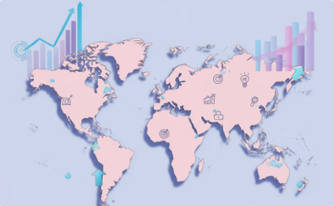

Economic and Social Impact of AI
6. Policy and Regulation
7. Education and Skill Development
8. Innovation Opportunities
9. Global Competitiveness
10. Long-term Planning

Slide 63

Emerging AI Technologies in the Foreseeable Future
AI has already deeply permeated many aspects of our lives. However, in the future, AI has the potential to revolutionize our lives even further. This will open up new possibilities beyond the advancement of existing technologies.
AI will drive innovation in various fields such as manufacturing, energy, education, and finance. This will increase productivity and efficiency, create new job opportunities, and contribute to the overall development of society. However, as AI advances, serious discussions are needed on ethical issues, data security, and job displacement.

Slide 64


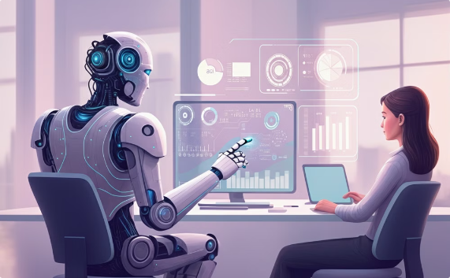
Emerging AI Technologies for a Feasible Future
New Business Models and Social Interactions
Solutions for Sustainable Development
Enriched Life and Ethical Challenges

Slide 65
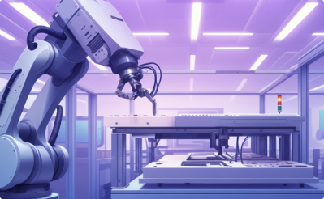







Will AI be a help or a fear?
Productivity Improvement
Problem Solving
Personalized Services
Creating New Opportunities
Job Replacement
Privacy and Security Issues
Uncontrollability
Ethical Issues

Slide 66

What can we do?
AI can be helpful, but it can also be a source of fear. The key is to establish appropriate regulations and ethical guidelines to ensure AI has a positive impact on society. The outcome depends on how we design and use AI technology, and it is important to explore ways for AI and humans to coexist in a complementary manner.

Slide 67
본 과목에서 반드시 전달하고 싶은 내용을 질문/답변/해설로 작성해주세요(6편에 해당)
1. What does the term "AI + X" represent in the context of AI's application across various industries?
A) AI's focus on healthcare
B) The convergence of AI with different industries
C) AI technology in government projects
D) AI's limitation to the tech sector
Answer: B) The convergence of AI with different industries
Explanation: "AI + X" signifies the convergence of AI with various industries, creating opportunities for innovation across sectors such as healthcare, finance, manufacturing, and the arts. By integrating AI into specific fields, businesses can enhance problem-solving, automate tasks, and generate new insights from large datasets. This approach enables industries to address unique challenges with AI-powered solutions tailored to their specific needs.

Slide 68
본 과목에서 반드시 전달하고 싶은 내용을 질문/답변/해설로 작성해주세요(6편에 해당)
2. Which sector is using AI to improve real-time traffic flow and accident prevention in Korea?
A) Healthcare
B) Energy
C) Transportation
D) Public services
Answer: C) Transportation
Explanation: The transportation sector in Korea utilizes AI to optimize real-time traffic flow and predict potential accidents. By analyzing data from road sensors and traffic cameras, AI can help control traffic lights, prevent accidents, and improve toll collection efficiency. This not only enhances road safety but also reduces congestion and travel times for commuters.

Slide 69
본 과목에서 반드시 전달하고 싶은 내용을 질문/답변/해설로 작성해주세요(6편에 해당)
3. What is a key concern regarding AI in everyday life?
A) Increased efficiency
B) Ethical and privacy concerns
C) Better voice assistants
D) Improved email filtering
Answer: B) Ethical and privacy concerns
Explanation: Ethical and privacy concerns are major issues when it comes to AI's integration into daily life. AI systems often rely on vast amounts of personal data, raising concerns about how this data is collected, stored, and used. Ensuring that AI operates transparently and ethically, with appropriate privacy protections, is essential to gaining public trust and avoiding misuse of sensitive information.

Slide 70
본 과목에서 반드시 전달하고 싶은 내용을 질문/답변/해설로 작성해주세요(6편에 해당)
4. What is a significant benefit of autonomous driving technology?
A) Increased fuel consumption
B) Improved safety and congestion reduction
C) Less accessibility for the elderly
D) Slower decision-making
Answer: B) Improved safety and congestion reduction
Explanation: One of the major benefits of autonomous driving technology is improved safety on the roads, as AI systems can react faster and more consistently than human drivers. Autonomous vehicles use real-time data from sensors like cameras and LiDAR to make precise driving decisions, such as avoiding collisions and maintaining safe distances from other vehicles. In addition, AI-driven cars can optimize routes to reduce traffic congestion and improve fuel efficiency, leading to a better overall driving experience.

Slide 71
본 과목에서 반드시 전달하고 싶은 내용을 질문/답변/해설로 작성해주세요(6편에 해당)
5. Which of the following is an example of AI being used for carbon capture technology?
A) DeepMind’s weather forecasting
B) Climeworks' direct air capture plants
C) IBM’s AI in employee diversity
D) Autonomous vehicle development
Answer: B) Climeworks' direct air capture plants
Explanation: Climeworks, a company based in Switzerland, operates direct air capture plants that use AI to optimize the process of capturing CO2 from the atmosphere. AI plays a crucial role in adjusting the system's operations based on environmental data, ensuring maximum efficiency in various atmospheric conditions. This application of AI in carbon capture is part of a larger global effort to reduce carbon emissions and mitigate the effects of climate change.

Slide 72
본 과목에서 반드시 전달하고 싶은 내용을 질문/답변/해설로 작성해주세요(6편에 해당)
6. What is necessary to ensure AI's positive impact on society?
A) Complete automation of all industries
B) Developing regulations and ethical guidelines
C) Replacing all human labor with AI
D) Limiting AI development to only certain sectors
Answer: B) Developing regulations and ethical guidelines
Explanation: To ensure AI's positive impact on society, it is crucial to establish comprehensive regulations and ethical guidelines. These frameworks should address concerns about data privacy, job displacement, and the potential misuse of AI technologies. By promoting responsible AI use, society can benefit from AI's potential while mitigating risks related to fairness, security, and transparency.

Slide 73
End Of Document

