Slide 1

7슬라이드
Why Cross culture
▣ The Cultural Iceberg
Easy to See
Language, Food, Clothing, Literature, Greetings, Holidays and festivals, Folklore etc
Not Easy to See
Beliefs, Manners, Family roles, Serf-concept, Work ethic, Core values, Interpretations, Humor, Gender roles, Body languages, Gestures, Beauty ideals, Aesthetics, Attitude to education, Thought patterns etc

Slide 2
29슬라이드
Characteristics of the Tobacco Industry
Capital intensive equipment industry
Monopoly and Oligopoly Market Structure
Strong brand power and economies of scale are important
Requires high technology and marketing, distribution, and sales capabilities
Raw material
procurement
R&D
Production
Marketing
Sales
Service
Requires a large amount of raw material purchase and aging process
Requires expertise in securing raw materials
Technology becomes important due to consumer needs and strengthened regulations
Organic collaboration with marketing is required
Requires large-scale facilities
Requires high-level quality control capabilities
Marketing investment and brand management are important
Brand growth takes a long time
Requires strong distribution network and sales force
Entails high costs
Responding to customer claims is very important
Collaboration in each field is important
Notes:
다음으로는 담배산업의 특징에 대해서 알아보겠습니다.
신규 기업이 진출하기 어려운 산업입니다. 큰 자본과 장비가 필요하기 때문입니다. 그래서 담배시장은 자연스럽게 독과점 구조가 형성됩니다.
또한, 원료조달부터 개발, 생산, 판매에 이르기까지 전체 단계를 수행하는 형태입니다.
Next, let's look at the characteristics of the tobacco industry.
It is a difficult industry for new companies to enter. This is because it requires large capital and equipment. Therefore, the tobacco market is naturally monopolized.
In addition, the entire process from raw material procurement to development, production, and sales is carried out.

Slide 3
30슬라이드
Cigarette Market Trend
Global Smoking Population 1.3B(17%) / Annual Global Market Value $965B(USD)
【 Total Market Value by Product Type(2021) 】
1
2
3
Total Market
Category 1
Category 2
$935B
(100%)
Conventional Cigarette(CC)
Cigarette
Cigar &
Cigarillos
Smoking
Tobacco
Smokeless
Tobacco
$881B
(94.2%)
$779B
(83.3%)
$49B
(5.2%)
$40B
(4.3%)
$13B
(1.4%)
Next-Generation
Product(NGP)
Heat-Not-Burn
(HNB)
E-Vapor
Oral Nicotine
$55B
(5.9%)
$29B
(3.1%)
$23B
(2.5%)
$3B
(0.3%)
*Source : Euromonitor(2021)
*Smoking Tobacco : Pipe, RYO tobacco
*Smokeless Tobacco : Snuff, Chewing Tobacco
Notes:
전세계 인구 중 약 17%가 흡연을 하는 것으로 예측되며, 시장규모는 9000억달러입니다.
그래프에서 보시는 것처럼 재래식담배가 94%를 차지하고 있으며, NGP가 6%를 차지합니다. 하지만 NGP는 앞으로 지속 성장하고 있습니다.
즉, 아직까지는 재래식담배가 시장의 대부분을 차지하지만 향후에는 NGP로 시장이 재편될 것입니다.
우리회사는 재래식담배 그리고 NGP 모두 우수한 브랜드와 기술력을 보유하고 있습니다.
An estimated 17% of the world's population smokes, representing a $900 billion market.
As you can see in the graph, conventional cigarettes make up 94% of the market, while NGPs make up 6%. However, NGPs are set to continue to grow in the future.
In other words, conventional cigarettes still make up the majority of the market, but in the future, the market will shift to NGPs.
We have excellent brands and technology for both conventional cigarettes and NGP.

Slide 4
31슬라이드
Cigarette Market Trend
  The total market size is about 5.6 trillion cigarettes
  (declining trend after e-cigarettes)
unit: cigarette
Notes:
전체 담배시장의 규모는 그래프에서 보시는 것처럼 약 5.6조개비 입니다.
전체적으로 조금씩 규모가 감소하고는 있습니다.
The total size of the cigarette market is about 5.6 trillion cigarettes, as shown in the graph.
Overall, the market is slowly declining.

Slide 5

32슬라이드
E-Cigarette(NGP) Market Trend
unit: $B
26% average annual growth expected
Notes:
하지만 전통적인 담배와는 다르게 NGP시장은 성장하고 있다고 볼 수 있습니다.
우리 회사도 NGP시장을 선도하기 위해 많은 노력을 하고 있습니다.
But unlike traditional cigarettes, the NGP market is growing.
Our company is also making a lot of efforts to lead the NGP market.

Slide 6


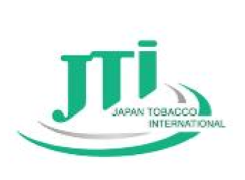

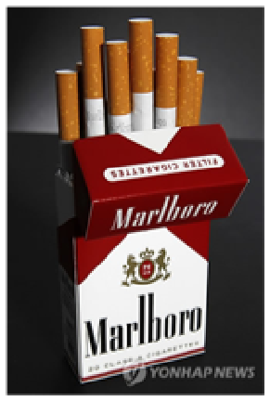
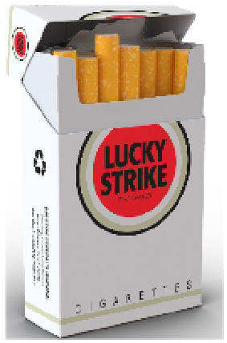
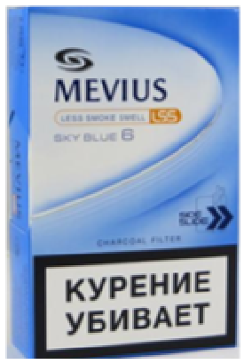
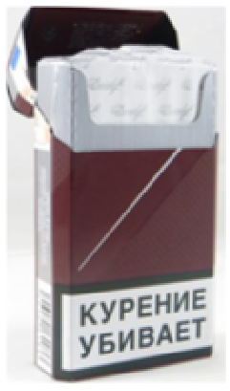
38슬라이드
Top 4 Tobacco Companies
Philip Morris
International
British American
Tobacco
Japan Tobacco
International
Imperial
Brands
Notes:
잘 아시다시피 세계적인 담배회사는 총 네 개가 있다고 볼 수 있습니다.
말보로로 대표되는 PMI.
던힐, 럭키스트라이크로 대표되는 BAT.
메비우스로 대표되는 JTI.
다비도프로 대표되는 Imperial Brands
이들이 우리의 목표입니다.
As we know, there are four major global tobacco companies.
PMI, represented by Marlboro.
BAT, represented by Dunhill and Lucky Strike.
JTI, represented by MEVIUS.
Imperial Brands, represented by Davidoff.
These are our targets.

Slide 7
39슬라이드
Market Trend - Market Share Trend by Manufacturer
[ Market Share Trend by Manufacturer ]
’16
’17
’18
’19
’20
*Source : Euromonitor(2021)
*Except for China
KT&G has about 3% of total market in Global cigarette market
Notes:
KT&G has about 3% of total market in Global cigarette market.
I think the future is bright for this company.

Slide 8


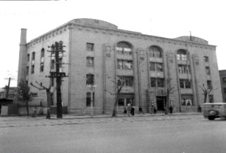
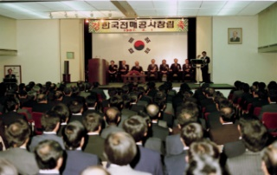

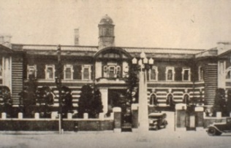
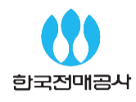

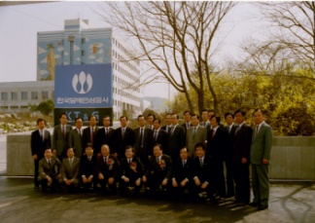
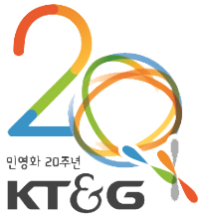
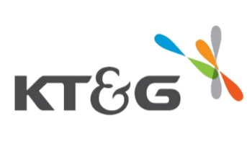

47슬라이드
1
History of KT&G – At a glance
1883
1952
JeonMaeCheong
SunHwaGuk
(The Monopoly Bureau)
a tobacco company
Established
in late Joseon Korea
SamJeongGwa
Korea Monopoly Office
Installed at Deahan empire
1899
1987
2012
1989
KT&G Corporation
Korea Tobacco and
Ginseng Corporation
2022
2002
Notes:
영상이 언급한 것처럼 우리회사는 역사가 깊은 기업입니다.
1883년부터 시작된 KT&G는 많은 위기가 있었지만 그 위기를 항상 이겨내었다.
우리는 이러한 강한 정신의 DNA를 가지고 있다.
As mentioned in the video, we are a company with a long history.
Starting in 1883, KT&G has seen many crises, but we have always overcome them.
We have this strong spirit in our DNA.

Slide 9
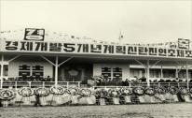
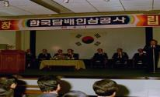

48슬라이드
1
History of KT&G
Step 01
Step 02
Step 03
Start of Korean Tobacco History
Innovation and Leap
Superlative Global Company
2002 Rename (KT&G)
2004 Taeah Industry acquired
2006 Export $300 million award
2008 Iran/Russia local corporation founded
2011 Somang Cosmetics and 3 companies acquired
2013 Capsule for low ignition tobacco filter developed
2015 SangSang Stay started
2016 Seoul Namedaemun Hotel open
2020 Sangsang Stay, Sangsang Madang Busan open
2022 lil AIBLE launched
2023 KT&G-PMI Global Collaboration Contract
1883 Tobacco company Sunhwaguk established in late Joseon
1899 Gungnaebu Naejangwon Samjeonggwa installed at Daehan Empire (36th reign of King Gojong)
1952 Reorganized to Monopoly Bureau
1987 Korea Monopoly Office founded
1988 Tobacco market open
1989 KT&G founded
1997 Incorporated
1998 Red ginseng business separated
2002 Whole sale of share under privatization
“
”
Korea’s No.1 and global top 5 tobacco company
with 135 years of history
Notes:
Korea’s No.1 and global top 5 tobacco company with 135 years of history.
KT&G는 Korea Tomorrow & Global 이라는 뜻입니다.
이 뜻은 2002년에 새롭게 만든 것입니다.
이전에는 Korea Tobacco & Ginseng 이었습니다.
위에서 보이는 것처럼 우리는 KT&G의 역사 중 하나가 될 것입니다.
KT&G stands for Korea Tomorrow & Global.
It was created in 2002.
Previously, it was Korea Tobacco & Ginseng.
As you can see above, we are going to be a part of KT&G's history.

Slide 10
49슬라이드
2
Identity of KT&G
The only company that continues the legitimacy of the tobacco / red ginseng business, the Korean representative company with the symbolism as a successful case of privatization
Company with unlimited potential based on high profitability, financial stability and transparent corporate culture
1
Representative company of Kore with long history
3
Representative company with successful privatization
More than 100 years of tobacco / red ginseng business
Maintain domestic brand recognition
Public Goods with DNA of Korea
Exports to more than 40 countries
Owned and distributed privatized Company with POSCO and KT
The most successful cases of monopoly abolition and privatization
Improved productivity and profitability after privatization
Excellence at home and abroad with exemplary management
2
Company with the highest reliability and transparency
4
Company with high potential such as
globalization and diversification
Over 30% of operating profit margin
Maintain good cash flow
Complete separation of ownership ↔ dominance, simple investment structure, etc.
Corporate culture that emphasizes
ethics and transparency
Investment capability based on abundant liquidity and financial stability
Tobacco and red ginseng export and establishment of local base
Steady investment in health related fields such as bio-pharmaceuticals
Promotion of real estate development / leasing and financial investment
Notes:
The only company that continues the legitimacy of the tobacco / red ginseng business, the Korean representative company with the symbolism as a successful case of privatization
Company with unlimited potential based on high profitability, financial stability and transparent corporate culture.
We are a Representative company of Kore with long history.
And we are a Company with the highest reliability and transparency.
also we are a Representative company with successful privatization.
Plus we are a Company with high potential such as globalization and diversification.

Slide 11
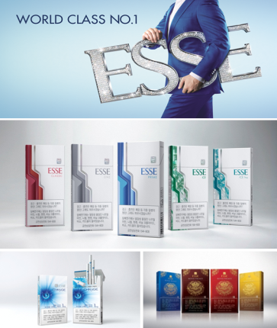

66슬라이드
9
World Class No.1 Superslim Cigarette Brand ‘ESSE’
Brand overview
1st tobacco brand power in Korea
1st tobacco market brand power in Korea
(K-BPI for 10 consecutive years, 1st in NBCI for 8 consecutive years) : Domestic tobacco mark`et 27%, domestic super slim tobacco market 80%
'World Class No.1' super slim tobacco brand
Exports to more than 50 countries including France and Italy
Top in the world for Super slim Tobacco Category (1 out of 3 super slim tobacco ' selection)
ESSE (ESSE) on November 1, 1996
: A Niche brand that aims at professionals in their 20s and 30s → Nicely designed for smokers in their 40s who weigh decent taste and emotion
Representative product
ESSE PRIME, ESSE SOO, ESSE CHANGE 1mg, ESSE CHANGE LIN and ESSE SPECIAL GOLD
※ Warning picture omitted as it is AD to show brand image
Notes:
다음으로는 세계적으로 유명한 브랜드 "ESSE" 입니다.
Next up is the world famous brand "ESSE".

Slide 12
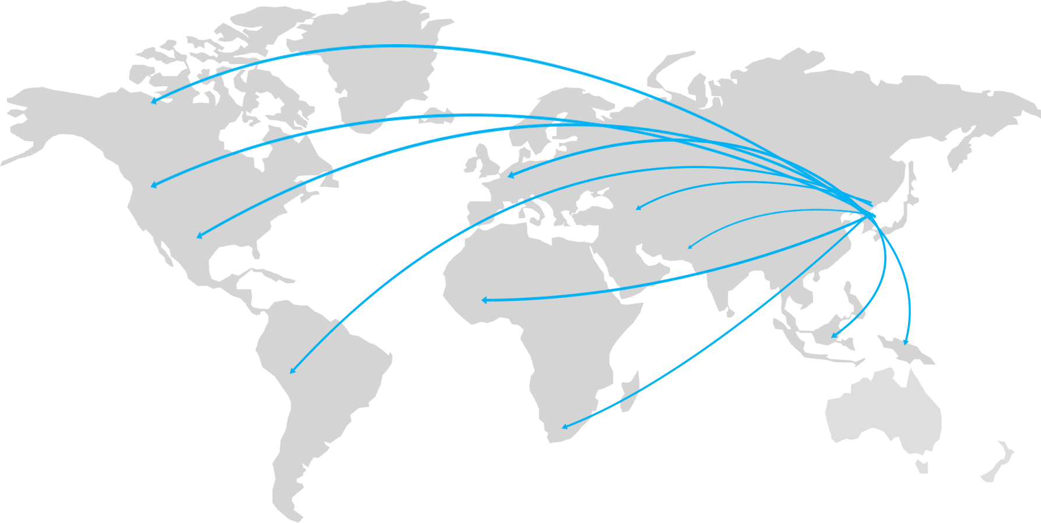





69슬라이드
11
KT&G global tobacco business overview
Global Business Network
Russia
Turkiye
Korea
SALES
[Unit : Billion USD]
4.38B
3.75B
3.44B
Indonesia
2.9B
1.9B
Exporting to 126 countries
2006
2010
2014
2018
2021
Exporting 50 billion cigarettes per year

Slide 13
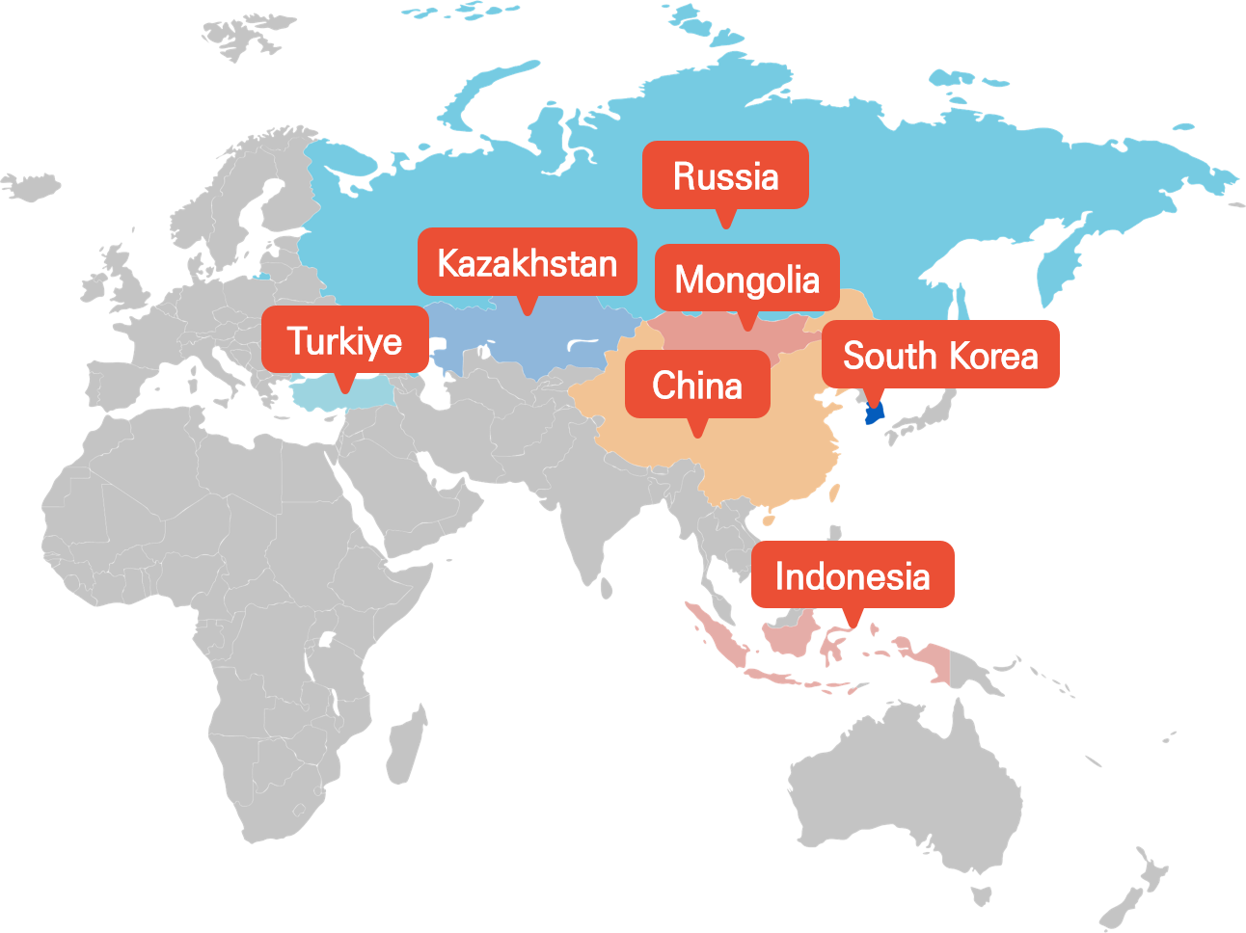


70슬라이드
12
KT&G global tobacco business network
Global network
KT&G operates total 8 overseas corporation and branches
Global brands such as ESSE and PINE are produced through ESSE and PINE Factories (Indonesia, Russia and Turkey).
Uzbekistan
Taiwan
KT&G
Factory
KT&G TSPM (Indonesia)
KT&G
Sales
Office
KT&G Indonesia
KT&G Taiwan
KT&G Russia
KT&G China
KT&G Russia
KT&G Mongolia
KT&G Turkiye
KT&G Turkiye
KT&G Kazakhstan
KT&G Uzbekistan

Slide 14

73슬라이드
15
Brand Portfolio
Top sales global brand of super slim tobacco
exported to more than 50 countries
To satisfy various needs of customers
ESSE
Differentiated and competitive Brand
Portfolio operation
For the 14th consecutive year, the leading brand
of regular tobacco sales of domestic tar
less than 1mg
TheOne
Raison
Creative emotion brand that is loved by young
people with unique personality and
differentiated taste
Based on its superior quality and
competitive brand name
No. 1 in National Customer Satisfaction Index (NCSI)
for the 6th consecutive year ('12~'17)
Bohem
Brand with deep and dense flavor and exotic
and romantic brand of Cuba (South America)
containing cigar leaf
Africa
Africa's unique fragrance leaf tobacco and space
filter applied, delightful brand with a variety
of flavors, aromas and fun

