Slide 1
DX, Digital Transformation
1장, DX, 디지털 전환의 개념

Slide 2
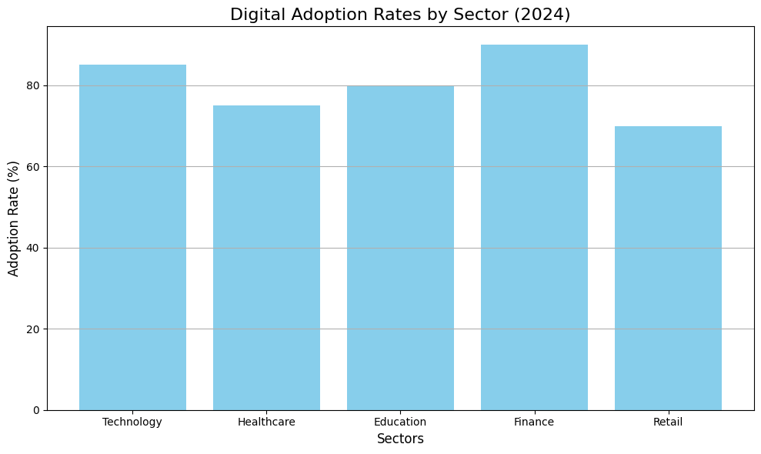
Global Shift Toward Digitalization
Notes:
We are currently witnessing a global digital revolution that is transforming industries, governments, and societies at an unprecedented pace. Technological advancements in fields such as the Internet of Things, Big Data, and Artificial Intelligence are not only reshaping how we interact with the world but also fundamentally altering the structure of the global economy. These innovations are no longer optional but necessary for any country or business that wishes to remain competitive in today’s environment.
In sectors like healthcare, finance, and education, digital adoption has accelerated significantly. For example, healthcare is leveraging AI for predictive diagnostics, finance is using Big Data for real-time decision-making, and education is increasingly moving towards digital platforms. This widespread adoption is driving efficiency, innovation, and growth across the globe. To succeed in this new era, governments and organizations must adapt, evolve, and embrace these technological changes.

Slide 3
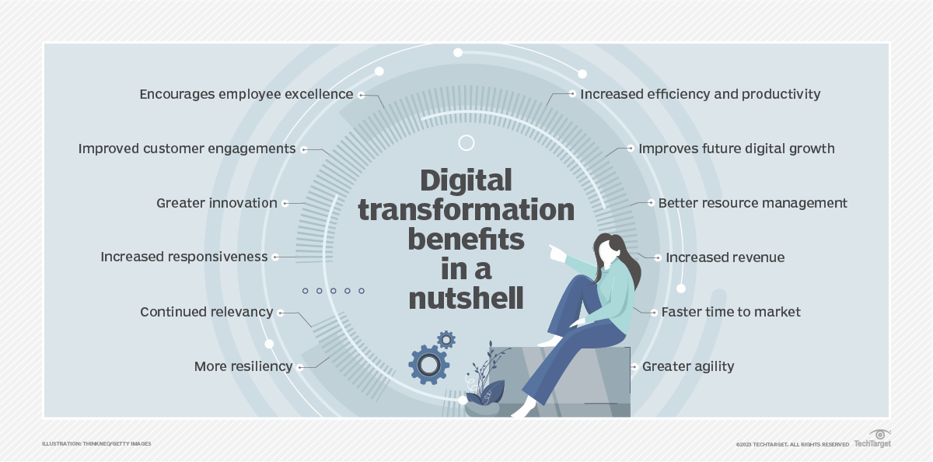
Digital transformation is crucial for:
- Growth
- Efficiency
- Sustainability
Provides better citizen services:
- E-government
- Smart cities
DX
is crucial
Supports:
- Innovation.
- Resilience
Enhances:
- Operational efficiency
- Cost reduction
- Decision-making accuracy
Notes:
Digital transformation is not just an option anymore—it’s essential for growth, efficiency, and long-term sustainability. By integrating digital technologies into core operations, organizations can significantly enhance operational efficiency, reduce costs, and improve the accuracy of decision-making processes.
One of the most immediate benefits of digital transformation is the ability to provide better services to citizens. We see this in the rise of e-government platforms and smart cities, which enable more efficient public services, better resource management, and a higher quality of life for residents.
Moreover, digital transformation is key to fostering innovation and growth, while also building resilience in the face of global challenges like pandemics and climate change. As we saw during the COVID-19 pandemic, the countries and organizations that were digitally prepared were able to adapt and thrive, highlighting the importance of this shift in ensuring both current and future success

Slide 4
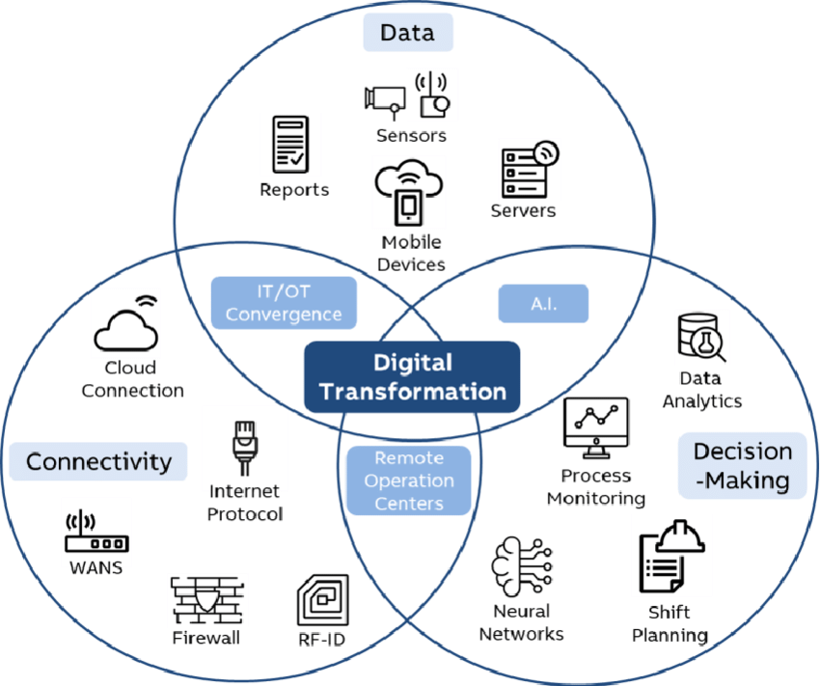
Digital transformation is the integration of
digital technology into all areas of:
Organizations
Countries.
Individual.
Notes:
Digital transformation refers to the integration of digital technology into every area of an organization, an Individual or even an entire country. It’s not just about adopting new tools or platforms—it’s about fundamentally changing how operations are conducted and how value is delivered to citizens. This shift goes far beyond just the technical side; it requires rethinking strategies, business models, and processes to align with a digital-first mindset.
One of the most significant aspects of digital transformation is the cultural change that accompanies it. Organizations and governments need to cultivate a culture of innovation, adaptability, and continuous learning to truly harness the power of digital technologies. By doing so, they can create more efficient, responsive, and citizen-focused systems that can meet the demands of the modern world

Slide 5
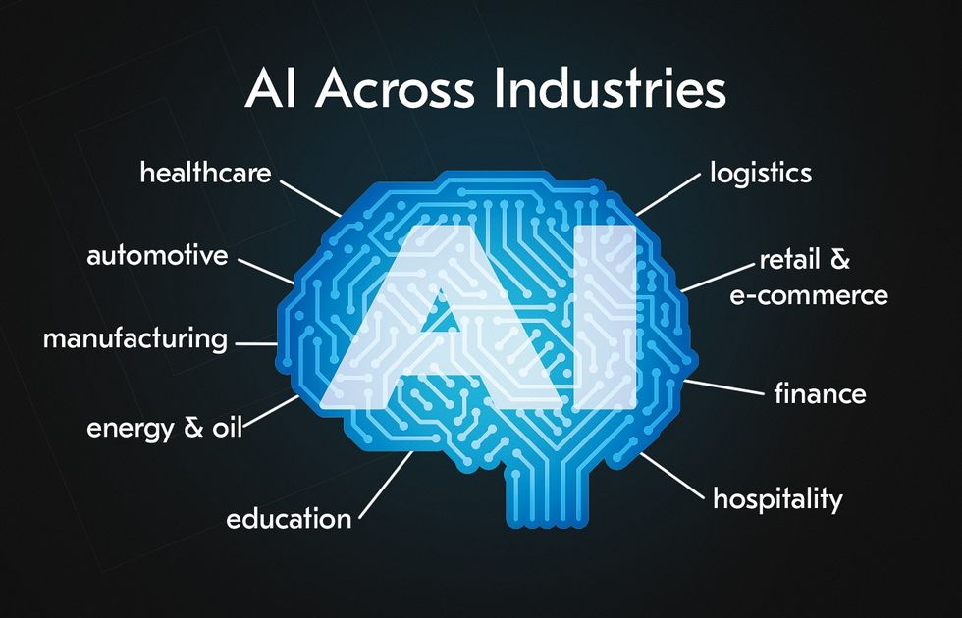
AI, the Key Driver of DX
Notes:
Artificial Intelligence is one of the primary drivers of digital transformation. It plays a crucial role in enabling organizations and governments to automate processes, predict outcomes, make more informed decisions, and deliver highly personalized services to citizens and customers.
For instance, in healthcare, AI is being used for predictive analytics, helping doctors and healthcare systems predict patient outcomes or potential outbreaks before they happen. In governance, AI-driven systems are making data-driven decisions to improve public services. We’re also seeing autonomous systems in smart cities, such as AI-powered transportation networks that optimize traffic flow and reduce congestion.
These applications of AI demonstrate how its integration into different sectors is transforming industries and helping nations build smarter, more efficient, and more responsive infrastructures.

Slide 6
Clustering
Notes:
Clustering is a fundamental technique in Artificial Intelligence used to group data points with similar characteristics. It’s particularly useful when dealing with large datasets where patterns and relationships might not be immediately obvious. By grouping similar data points together, clustering helps to identify patterns, segment populations, or classify objects based on shared traits.
For example, in the business world, clustering can be used to segment customers based on their purchasing behavior, enabling companies to design more targeted marketing strategies or develop personalized product recommendations. This method not only improves decision-making but also optimizes resource allocation. Clustering is one of the most widely used tools in AI because it can be applied across various industries to drive more effective outcomes

Slide 7
Clustering is used to:
Identify patterns
Segment Populations
Classify Objects
Notes:
Clustering is a fundamental technique in Artificial Intelligence used to group data points with similar characteristics. It’s particularly useful when dealing with large datasets where patterns and relationships might not be immediately obvious. By grouping similar data points together, clustering helps to identify patterns, segment populations, or classify objects based on shared traits.
For example, in the business world, clustering can be used to segment customers based on their purchasing behavior, enabling companies to design more targeted marketing strategies or develop personalized product recommendations. This method not only improves decision-making but also optimizes resource allocation. Clustering is one of the most widely used tools in AI because it can be applied across various industries to drive more effective outcomes

Slide 8
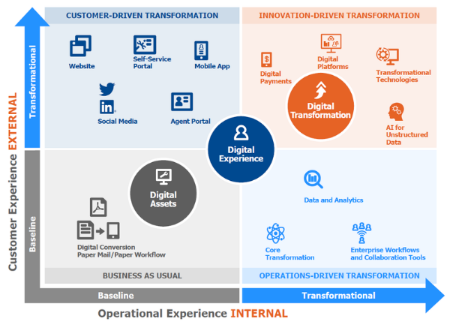
6 Steps to Implement
Digital Transformation
1. Assess Current Digital Capabilities
Notes:
The first step in digital transformation is to assess your current digital capabilities, whether you’re a government, business, or individual. Understanding where you stand helps identify the right direction for your digital journey. For organizations and governments, this involves identifying existing technology gaps, evaluating workforce skills, and assessing how ready your organizational culture is for change. Are your technologies outdated? Does your team have the necessary digital skills? Is your organization open to adopting new digital processes? These questions help set the foundation for transformation.
For individuals, this means assessing your own digital skill set and your adaptability to new technologies in your work and daily life. It’s about understanding how comfortable you are with digital tools and how effectively you can integrate them into your routines. By accurately assessing your current digital maturity, you can set clear, achievable goals that guide your transformation efforts, ensuring you are prepared for the next steps

Slide 9
2. Set a Vision and Strategies
Notes:
The next step in digital transformation is to set a clear vision and strategy. This means defining specific goals that align with your broader objectives. For businesses, focus on aligning transformation efforts with growth, customer engagement, and competitiveness. It’s about using digital tools to enhance operations and stay ahead.
For individuals, set goals to develop digital skills and improve efficiency, such as mastering new technologies or increasing productivity. Organizations and governments should prioritize AI, automation, and smart city initiatives to enhance services. Setting a clear vision ensures your transformation is targeted and effective, guiding your next steps

Slide 10
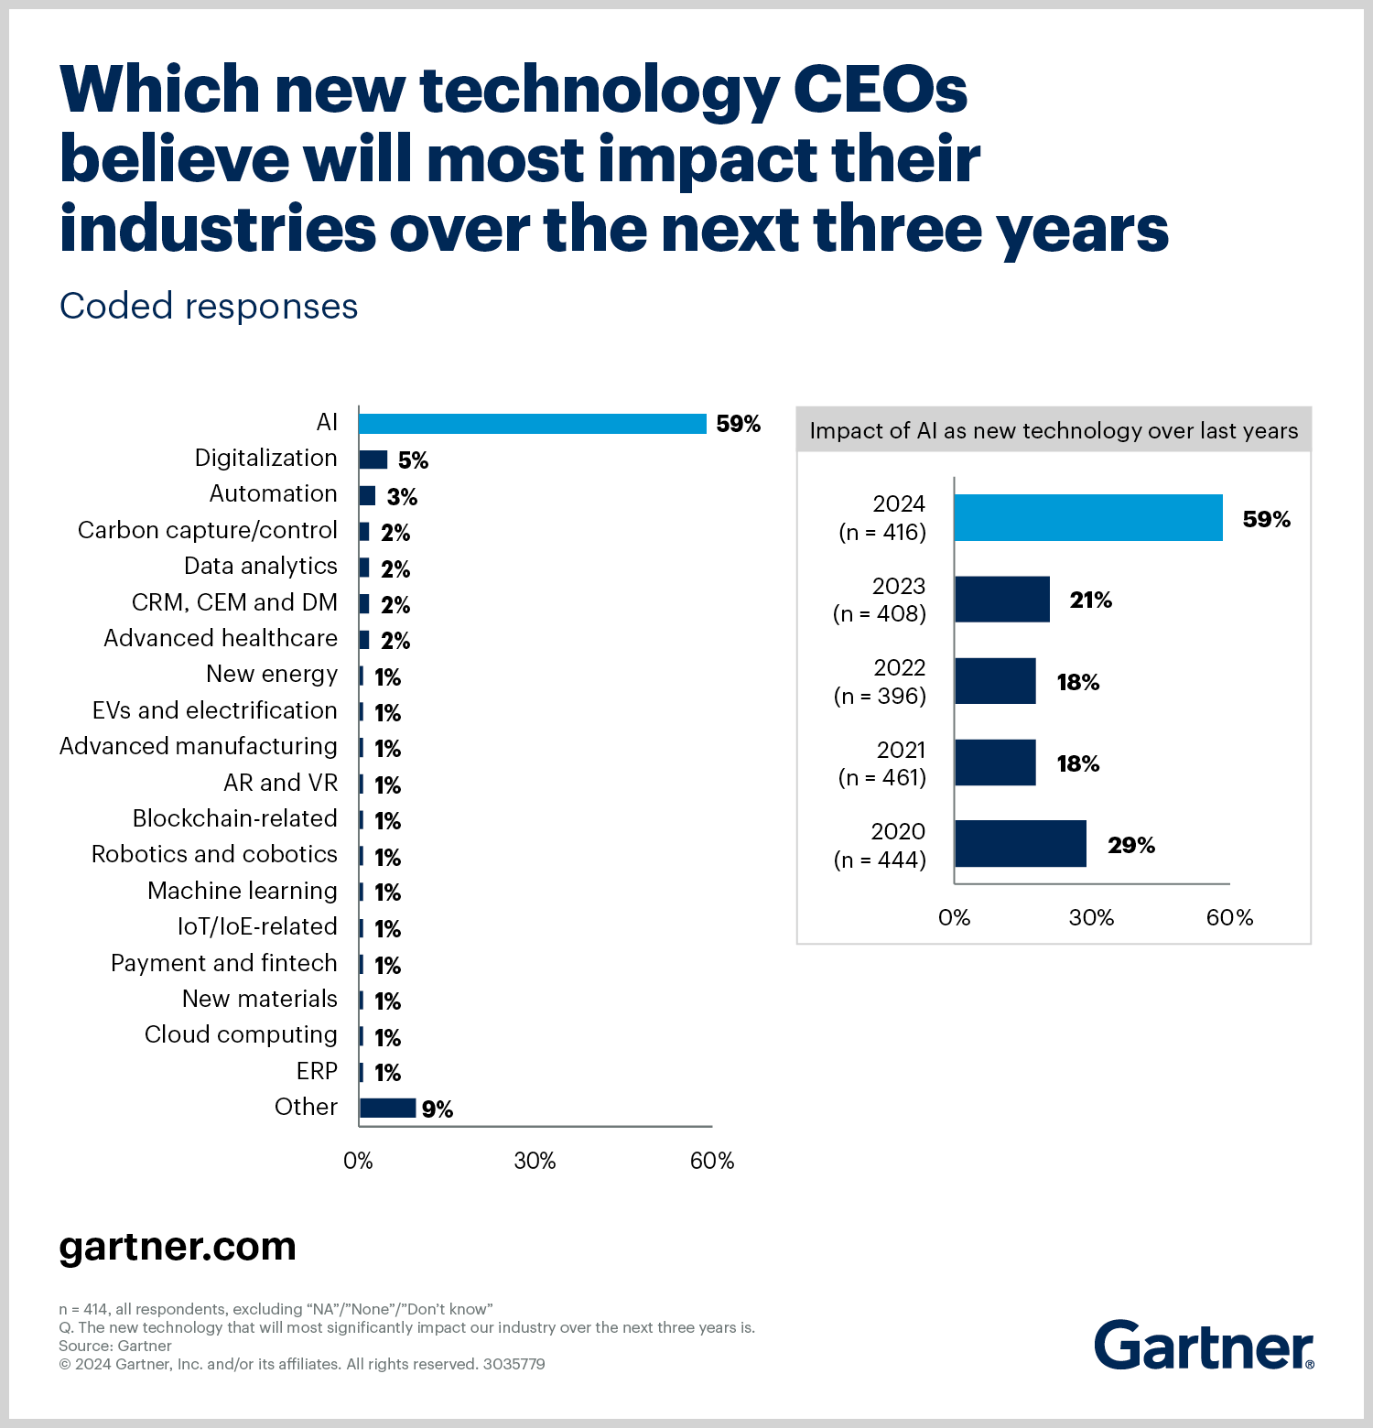
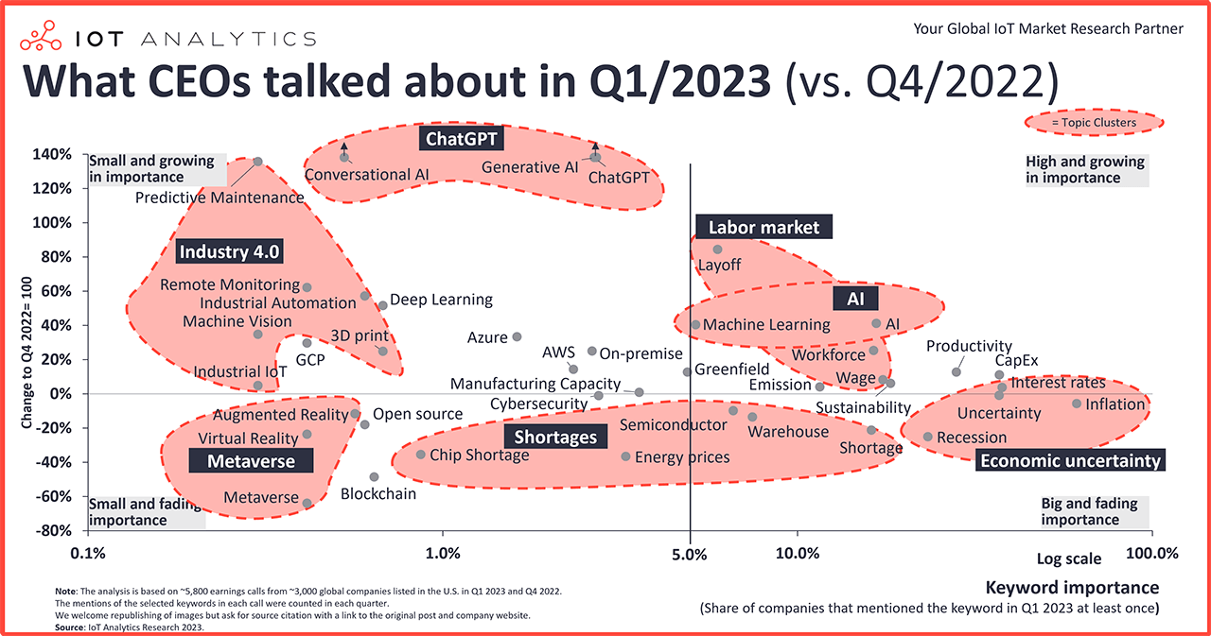
3. Invest in Infrastructure and Talent
Notes:
Investing in infrastructure and talent is essential for digital transformation. For businesses, this means investing in cloud computing, data analytics, and AI systems to boost efficiency and decision-making. These technologies help automate processes and provide valuable insights. As you can also see in the image, the CEOs of global enterprises has already been mainly discussing about the importance of ChatGPT, AI and Industry 4.0, which proves why investment in technology is important.
For individuals, focus on learning digital skills like data literacy, AI, and using digital tools to enhance productivity and adaptability. Governments should invest in digital infrastructure and human capital, ensuring public services are efficient and future-ready. By investing in the right technologies and skills, all stakeholders can effectively drive digital transformation.

Slide 11
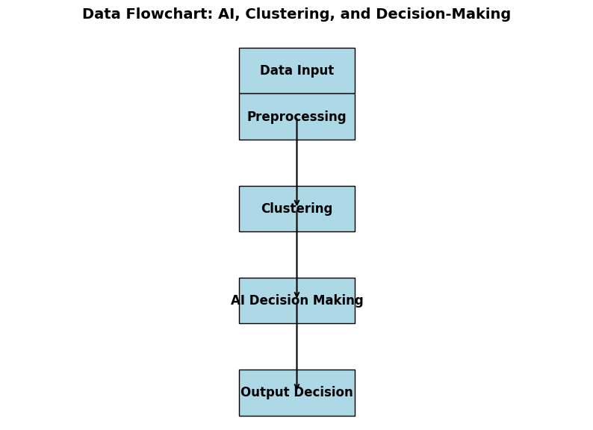
4. Leverage in AI and Data Analytics
Notes:
Artificial Intelligence (AI) and data analytics are essential tools for driving innovation and improvement in today’s digital landscape. Businesses can apply AI for automation and decision-making, such as using clustering algorithms to analyze customer behavior. This enables personalized marketing and more effective business strategies.
For governments, AI plays a crucial role in analyzing large datasets to improve policy-making and optimize resource allocation. AI helps governments make data-driven decisions that better serve the public.
Individuals can also benefit from AI and data analytics by using these tools to improve personal productivity or guide career decisions. For example, data insights can help you understand your work habits and identify areas for growth.
By leveraging AI and data analytics, all stakeholders can make smarter, more informed decisions that lead to innovation and progress in their respective fields.

Slide 12
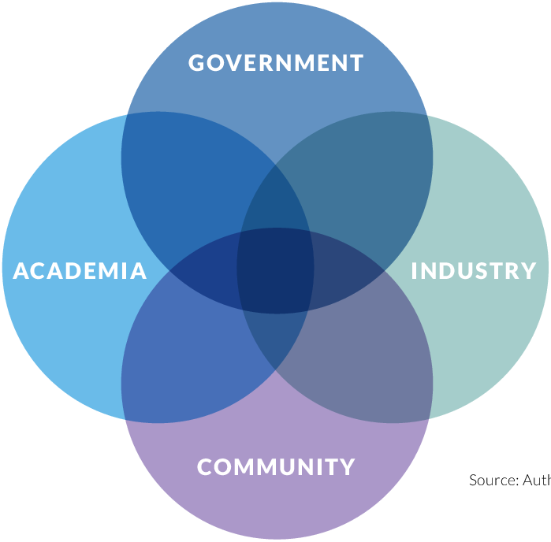
5. Embrace Partnership and Collaboration
Notes:
Collaboration is essential for successful digital transformation across all sectors. Governments can collaborate with the private sector, international organizations, and academia to pool resources and expertise, driving innovation in public services.
For businesses, partnerships with technology providers and research institutions keep them at the forefront of technological advancements, enabling them to stay competitive.
Individuals can join professional networks to stay connected with digital trends and collaboration opportunities, which helps in continuous learning and skill development. Across all sectors, embracing collaboration accelerates progress and drives innovation.

Slide 13
6. Monitor and Adapt
Notes:
Digital transformation is ongoing and requires continuous monitoring and adaptation. Governments and businesses need to use feedback loops and data-driven decisions to regularly refine their strategies and stay effective.
For individuals, it’s about continuously updating skills and adapting to new technologies in work and daily life. Staying flexible and open to new tools is key to personal growth.
Overall, staying adaptable and responsive to technological changes ensures long-term success for all stakeholders—governments, businesses, and individuals—as the digital landscape evolves.

Slide 14
End Of Document

Slide 15
The importance of Future DX
미래 DX의 중요성

Slide 16
Why DX Matter in Today’s world?
Market Growth
Pandamic Impact
Top Priority
Business Benefits
Investment Focus
Notes:
Digital transformation (DX) is no longer an option—it's a necessity. The global DX market is projected to grow to $880.28 billion by 2024, highlighting the rapid pace at which industries are adopting these technologies.
The COVID-19 pandemic has further accelerated this shift. In fact, 97% of companies have fast-tracked their digital transformation initiatives by an average of 6 years due to the challenges posed by the pandemic. This shows that digital transformation is essential for businesses to stay resilient and agile in a changing world.
Furthermore, 74% of organizations now consider DX to be a top priority for remaining competitive. Companies that have successfully implemented digital transformation are seeing significant benefits, with 26% higher profits on average compared to those lagging behind.
Key areas of investment driving this transformation include cloud computing (45%), artificial intelligence (AI) (39%), and the Internet of Things (IoT) (36%). These technologies are critical to ensuring that businesses stay relevant and efficient in the face of future challenges.
In short, embracing digital transformation today is crucial for not only staying competitive but also thriving in a rapidly evolving digital landscape.

Slide 17
$880.25Billion
Notes:
Digital transformation (DX) is no longer an option—it's a necessity. The global DX market is projected to grow to $880.28 billion by 2024, highlighting the rapid pace at which industries are adopting these technologies.
The COVID-19 pandemic has further accelerated this shift. In fact, 97% of companies have fast-tracked their digital transformation initiatives by an average of 6 years due to the challenges posed by the pandemic. This shows that digital transformation is essential for businesses to stay resilient and agile in a changing world.
Furthermore, 74% of organizations now consider DX to be a top priority for remaining competitive. Companies that have successfully implemented digital transformation are seeing significant benefits, with 26% higher profits on average compared to those lagging behind.
Key areas of investment driving this transformation include cloud computing (45%), artificial intelligence (AI) (39%), and the Internet of Things (IoT) (36%). These technologies are critical to ensuring that businesses stay relevant and efficient in the face of future challenges.
In short, embracing digital transformation today is crucial for not only staying competitive but also thriving in a rapidly evolving digital landscape.

Slide 18
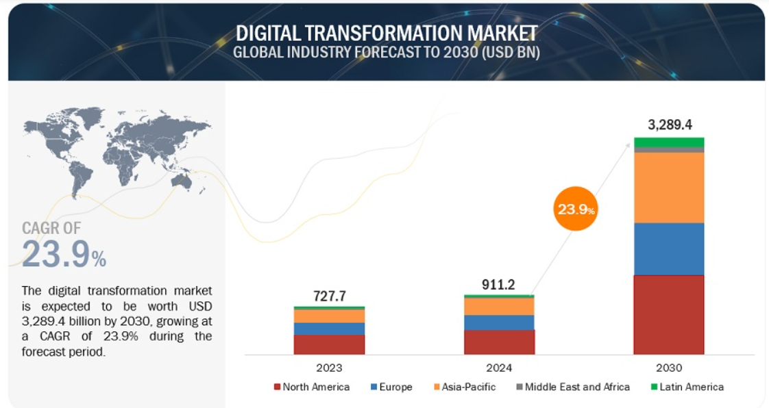
The Importance of Preparing
for Future DX
Notes:
The future of digital transformation is closely tied to advancements in artificial intelligence (AI), the Internet of Things (IoT), 5G, and edge computing. These technologies will play a critical role in shaping how industries operate and deliver value. As we can see in the projection, the global digital transformation market is expected to reach an impressive USD 3289.4 billion by 2030.
For organizations, investing in future-proofing their operations will be key to their survival and growth. Those that embrace these technologies will remain competitive, while those that do not may struggle to keep up with the rapidly changing landscape.
Furthermore, digital transformation is projected to contribute trillions to the global economy, reshaping job markets, business models, and government services worldwide. It’s clear that staying ahead of these technological advancements is crucial for long-term success in today’s digital economy.

Slide 19
Digitization (Pre-2000s): Converting analog to digital (e.g., paper to digital records)
Digitalization (2000s–2010s): Streamlining business processes using cloud, mobile, and social media
Digital Transformation (2010s–2020s): Integrating AI, IoT, big data, and cybersecurity to transform operations and customer value
Hyper-Digitalization (2020s+): Full-scale AI, automation, AR/VR, and blockchain driving market growth, projected to exceed $3 trillion by 2030
Clustering is used to:
Notes:
The digital transformation market has evolved through several key phases. The initial phase, before the 2000s, focused on digitization—converting analog processes into digital formats. This involved tasks like shifting from paper records to digital systems and the introduction of early enterprise software solutions.
In the growth phase, from the 2000s to the 2010s, we saw digitalization, where businesses streamlined their operations using emerging technologies like cloud computing, mobile devices, and social media. This phase allowed businesses to optimize processes and enhance customer experiences, driven by the rise of e-commerce and mobile platforms.
Then came the acceleration phase, from the 2010s to the 2020s, marked by full-scale digital transformation. Companies began integrating AI, IoT, big data, and cybersecurity across their entire operations, fundamentally changing how they function and serve customers. This shift has made organizations more agile and customer-centric.
Looking ahead to the future phase, the 2020s and beyond, we enter hyper-digitalization. Technologies like AI integration, automation, AR/VR, and blockchain will be fully embedded in business models, driving rapid market growth. The global digital transformation market is expected to exceed $3 trillion by 2030, leading to smarter, more efficient industries.

Slide 20
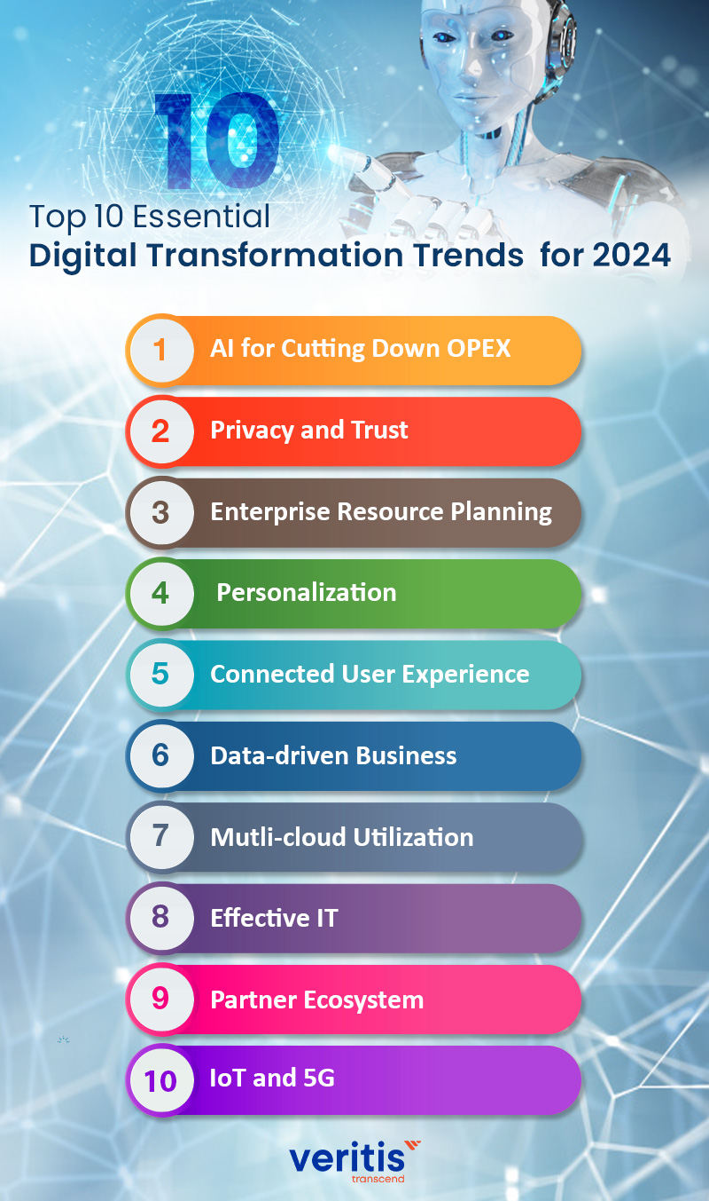
Current Market Trend in DX
  AI for cutting down OPEX
  privacy & Trust
  Enterprise Resource Planning
  Personalization
  Connected Customer Experience
Notes:
The current digital transformation landscape is evolving rapidly, with several key trends driving change. AI is playing a crucial role, particularly in cutting down OPEX by automating processes and optimizing operations. This has become a major focus for businesses looking to reduce costs while maintaining efficiency.
Another important trend is the growing emphasis on privacy and trust. With increasing concerns over data security, businesses are prioritizing data privacy measures to build trust with customers and comply with regulations.
Enterprise Resource Planning (ERP) is also evolving, as organizations are integrating digital tools to streamline their operations and improve efficiency across departments. This is coupled with a shift toward personalization, where businesses are using data to offer more tailored customer experiences, making personalization a key trend for enhancing customer satisfaction.
Lastly, a connected customer experience is becoming more vital. As shown in the image, trends like IoT and 5G are enabling seamless, real-time interactions with customers, enhancing the overall user experience and driving digital transformation forward.

Slide 21
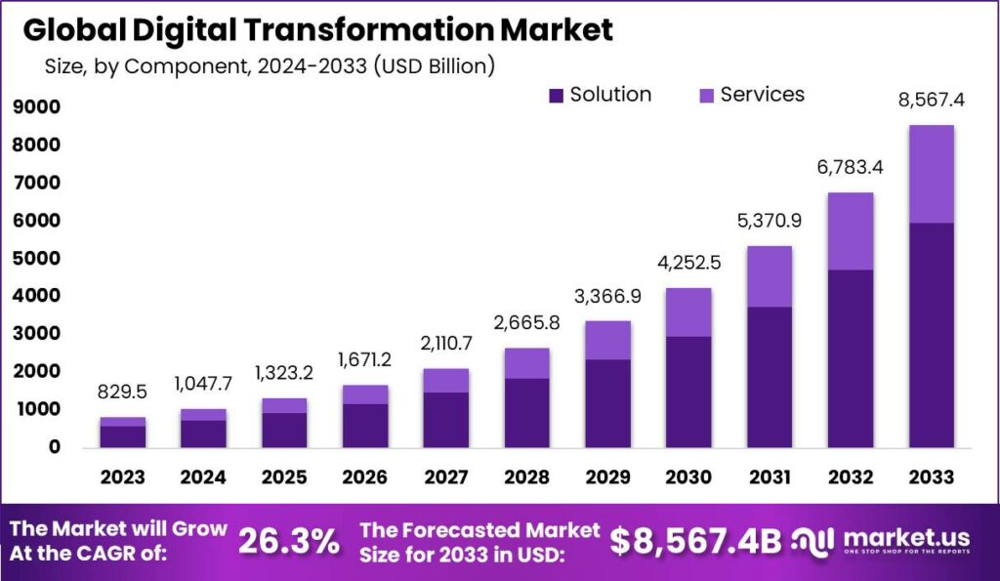
Global DX
Market Overview and Forecast
Notes:
The global digital transformation market is growing at a rapid pace. Currently, when solution and service are combined together, market is valued at $0.1 trillion in 2024, with strong growth projected over the coming years. By 2030, the market is expected to reach approximately $1 trillion, as more businesses and governments continue to invest in digital solutions and services.
As we can see from the graph, the market is forecasted to grow even further, reaching $8.5 trillion by 2033, with a 26.3% compound annual growth rate (CAGR). This growth is driven by a combination of solutions and services tailored to businesses' evolving needs.
Regionally, North America and Europe are leading this transformation, with Asia-Pacific (APAC) catching up quickly as businesses in the region adopt digital technologies at a fast pace.
The digital transformation market is reshaping industries such as healthcare, retail, and government, providing enhanced efficiency, better customer experiences, and streamlined operations.
In summary, digital transformation is not only growing rapidly, but it's also reshaping key industries and regions globally, with tremendous market potential for the future.

Slide 22
The process of Adapting
to current stage of DX
Continuous Evolution
Adoption Rates
Key Focus Areas
Call to Action
Notes:
Digital transformation is constantly evolving, and 77% of companies have already started their DX journey. To keep up, organizations must focus on cloud computing, AI, IoT, and cybersecurity, which are driving the market today.
It’s crucial for businesses, individuals, and governments to act now to remain competitive. Continuous learning and embracing these technologies will ensure they stay relevant and thrive in the future. Digital transformation is no longer optional—it’s essential for success in today’s fast-changing landscape.

Slide 23
Individual Adaptation
to Digital Transformation
Lifelong Learning
Personal Digital Presence
Adopting New Technologies
Notes:
For individuals to adapt to digital transformation, lifelong learning is crucial. Continuously upskilling in areas like AI, cloud computing, and data analytics is essential to stay competitive in a rapidly evolving market. Platforms like Coursera and Udemy offer courses that help individuals develop these digital skills.
It’s also important to improve your personal digital presence by enhancing your digital literacy. Many professionals have already embraced remote work models, using tools like Google Workspace and Microsoft Teams to collaborate efficiently from anywhere.
In addition, individuals must adopt AI-driven productivity tools in their daily workflows. For instance, freelancers are leveraging automation tools to streamline tasks, making their work faster and more efficient.
In short, adapting to digital transformation at an individual level means continuously learning, improving digital skills, and integrating new technologies into everyday tasks to stay ahead.

Slide 24
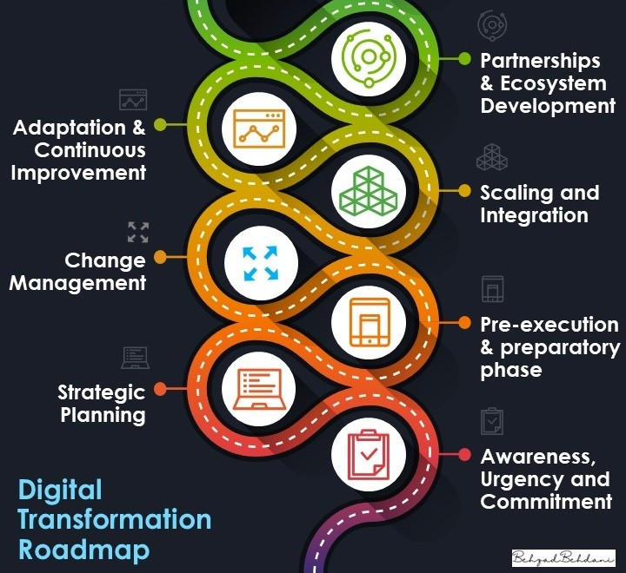
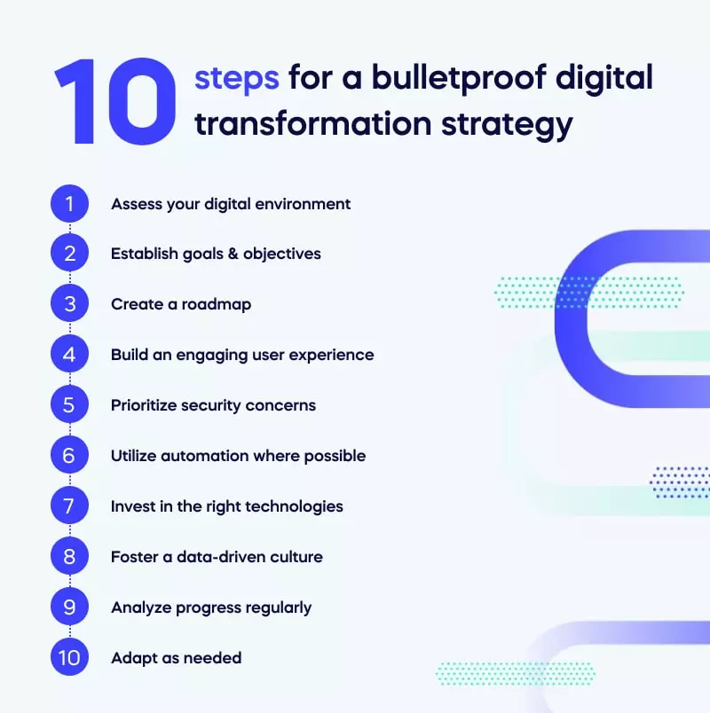
For Businesses
Agile Adoption
Digital Transformation Roadmap
Automation & AI Integration
Data-Driven Decisions
Notes:
Businesses need to adopt agile methodologies like Scrum for faster adaptation to changes. Tech companies, for example, use Scrum to drive innovation. A clear digital transformation roadmap is vital, with retailers embracing e-commerce to meet evolving consumer demands.
Automation and AI integration are key for streamlining operations, with manufacturers using AI for predictive maintenance. Lastly, data-driven decisions allow businesses to personalize customer experiences—airlines are already using data analytics to tailor offers and enhance satisfaction.
In short, businesses that embrace agility, automation, and data analytics will thrive in the digital transformation era.

Slide 25
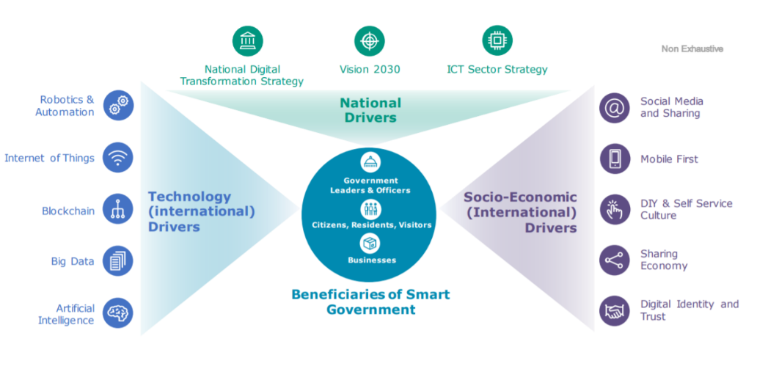
For Governments
Notes:
Governments are key drivers of digital transformation across several areas. They must create policies that promote innovation while ensuring cybersecurity and data privacy. Investing in infrastructure, such as 5G, broadband, and cloud systems, is essential for supporting transformation. Technologies like IoT, Blockchain, AI, and Big Data are crucial to this progress. Transitioning to e-governance can enhance public service efficiency, benefiting citizens and businesses. Governments also foster innovation by supporting startups and embracing emerging technologies, aligning with national strategies like Vision 2030. Additionally, trends like social media and mobile-first services shape citizen interactions, and governments must adapt to these changes to ensure smooth digital integration. Through policy, infrastructure, and innovation, they can significantly advance digital transformation.

Slide 26
What to Focus in preparation
of Future DX market?
AI and Machine Learning
Sustainability and Digital
Global Collaboration
Notes:
As we prepare for the future of digital transformation, three key areas stand out. First, AI and Machine Learning will play a central role in automating decision-making and improving operational efficiency across industries.
Second, aligning digital transformation with sustainability is essential. Businesses need to integrate green technologies and sustainable practices to ensure long-term growth and compliance with environmental regulations.
Finally, global collaboration is crucial. Businesses and governments must work together to harmonize policies and create a unified approach to digital transformation worldwide.
In short, focusing on AI, sustainability, and collaboration will be key to thriving in the future of digital transformation.

Slide 27
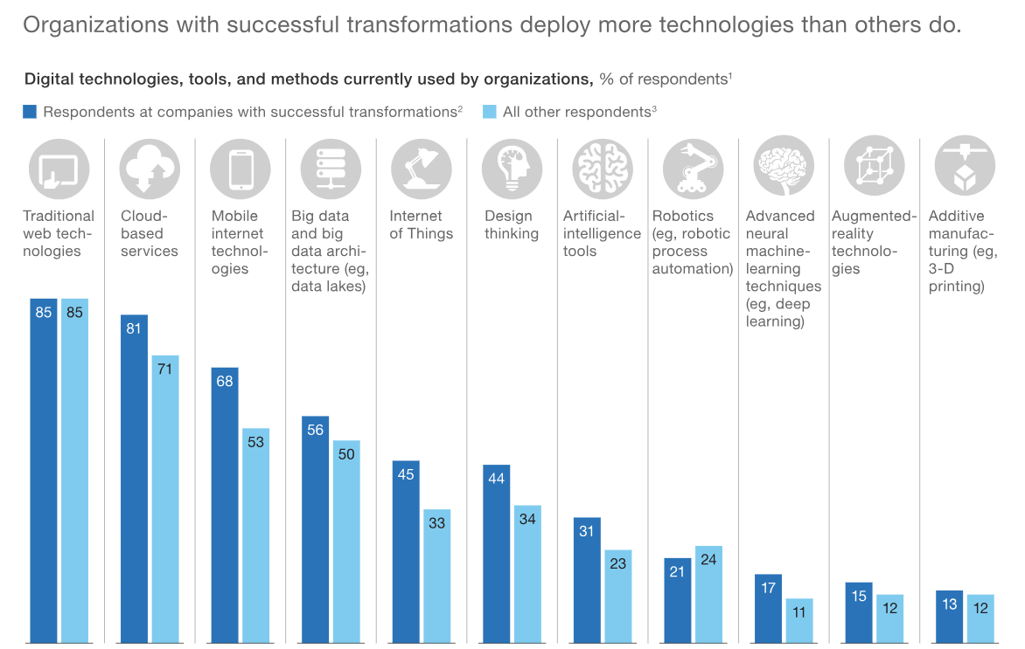
Try to deploy more technologies
to better adapt in future DX market
Notes:
If we narrow down to focus on preparation of future DX of organizations, the most important thing would be investing in emerging technologies. Prioritizing investments in areas like blockchain, quantum computing, and the Internet of Things (IoT) will be key to staying competitive. Along with newly emerging technologies, successful organizations maintain traditional web technologies as well. Adopting new technologies does not mean abandoning the old ones. It means combining both existing technology and new technology together. These technologies offer significant opportunities to improve efficiency, transparency, and scalability across operations.
The key to thriving in the future DX market is adaptability. Organizations that deploy more technologies will not only be more efficient but will also have the ability to adapt quickly to a fast-changing digital landscape. Those that fail to embrace these changes risk falling behind.
In short, investing in emerging technologies today is crucial for staying ahead and thriving in the digital transformation era.

Slide 28
Key Strategies
Notes:
Building long-term resilience in digital transformation requires organizations to focus on several key strategies. First, fostering an adaptive culture is essential—encouraging continuous learning, innovation, and collaboration will keep teams agile and ready to tackle challenges.
Next, workforce development should be a priority, providing opportunities for upskilling and promoting lifelong learning. Adopting agile methodologies, where projects are broken into smaller, manageable tasks, also helps organizations remain flexible in a fast-evolving landscape.
In terms of technology, organizations must invest in scalable IT infrastructure and robust cybersecurity. Additionally, strengthening data governance and expanding AI capabilities will ensure data-driven decisions that fuel success.
Collaboration is key, so building strategic partnerships with tech vendors and startups will keep organizations at the forefront of innovation. It's also crucial to stay customer-centric, continuously adapting to customer needs through feedback loops.
Finally, organizations need strong change management, with leadership and governance aligning strategies and clearly defining roles. Maintaining financial flexibility by budgeting for innovation while balancing short- and long-term investments will ensure sustainable growth.

Slide 29
End Of Document

Slide 30
DX in South Korea –
Digital Platform Government
미래 DX의 중요성

Slide 31
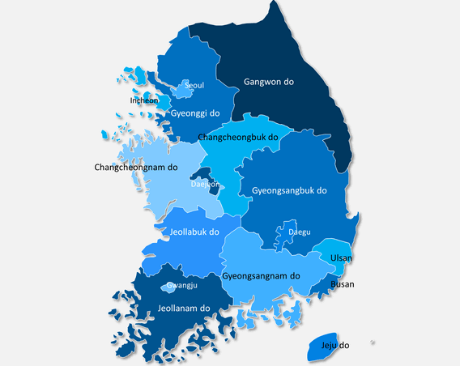
A Blueprint for Global Digital Governance
Notes:
we’ll explore how South Korea’s digital transformation policy has positioned the nation as a global leader in digital governance. This transformation is not just about technology, but about ensuring seamless, citizen-centric services, enhancing government efficiency, and driving economic growth. Through long-term vision and continuous innovation, South Korea’s approach serves as a blueprint for countries looking to modernize their own digital infrastructures

Slide 32
Global Digital Shift
South Korea’s Leadership
International Implications
Notes:
As DX has become global necessity, governments worldwide must embrace digital advancements to enhance governance and improve the delivery of public services. South Korea stands out as a leader in this space, consistently ranking among the top in e-government development. This leadership reflects decades of commitment to innovation and digital growth. Importantly, South Korea’s approach offers valuable lessons for other nations, demonstrating how long-term planning and investment in digital infrastructure can drive sustained success.

Slide 33
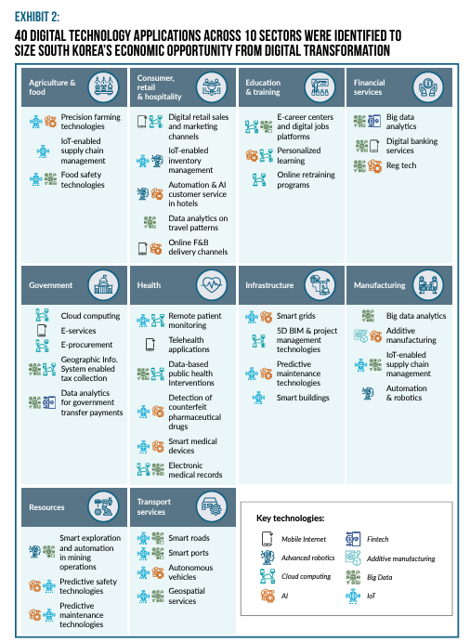
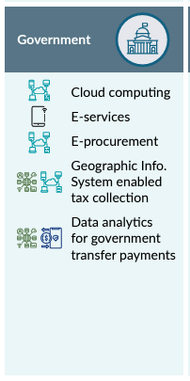
Notes:
South Korea’s digital leadership spans across 10 key sectors, leveraging 40 digital technologies to drive economic growth and innovation.
In agriculture and food, precision farming and IoT-enabled supply chain management ensure efficient production and food safety. Consumer, retail, and hospitality benefit from AI-powered inventory management and automated customer service, enhancing user experience and operational efficiency. Education sees advancements in personalized learning and retraining platforms, aligning with future job markets.
Financial services utilize big data analytics, digital banking, and regulatory technologies to secure and enhance services. The government focuses on e-services, cloud computing, and geospatial systems to streamline public services and improve transparency.
In healthcare, remote monitoring and AI-powered diagnostics redefine patient care. Infrastructure development is supported by smart grids and smart buildings, ensuring sustainability. Manufacturing advances with IoT supply chain management, robotics, and additive manufacturing.
Resources and transport services adopt predictive technologies and autonomous systems to lead in smart resource management and mobility solutions.
South Korea’s digital transformation across these sectors showcases its commitment to innovation and positions it as a global leader in the digital economy.

Slide 34
Milestone of
South Korea’s DX journey
Notes:
South Korea’s digital transformation journey spans several decades, with each phase building upon the previous one. In the 1980s and 1990s, the country focused on laying the foundation by investing in national data systems and creating an information superhighway, essential for connecting government services. The 2000s saw the introduction of integrated e-government systems, which streamlined public services, and the launch of Smart Government initiatives, aimed at improving government efficiency and transparency.
From 2017 to the present, South Korea has embraced Fourth Industrial Revolution technologies like AI, big data, and cloud computing, resulting in the Digital Platform Government. This new model of governance integrates diverse services into a single platform, offering personalized and proactive solutions for citizens. Through this long-term vision, South Korea continues its commitment to digital innovation, constantly evolving its systems to remain a global leader in smart governance.

Slide 35
Digital Platform Government
Notes:
The Digital Platform Government is a forward-thinking governance model that integrates various technologies, such as AI, blockchain, big data, and cloud computing, to create a seamless, citizen-centric experience. Its main goal is to connect systems and data across agencies via a digital platform, as seen in the image. Through public and private sector collaboration, it embraces innovation and utilizes cutting-edge technologies to deliver proactive and personalized services. This approach helps anticipate citizen needs while assisting policymakers in making scientific, data-driven decisions. Ultimately, the platform's core objectives are to enhance transparency, boost efficiency, and offer real-time services, leading to improved governance and stronger citizen engagement.

Slide 36
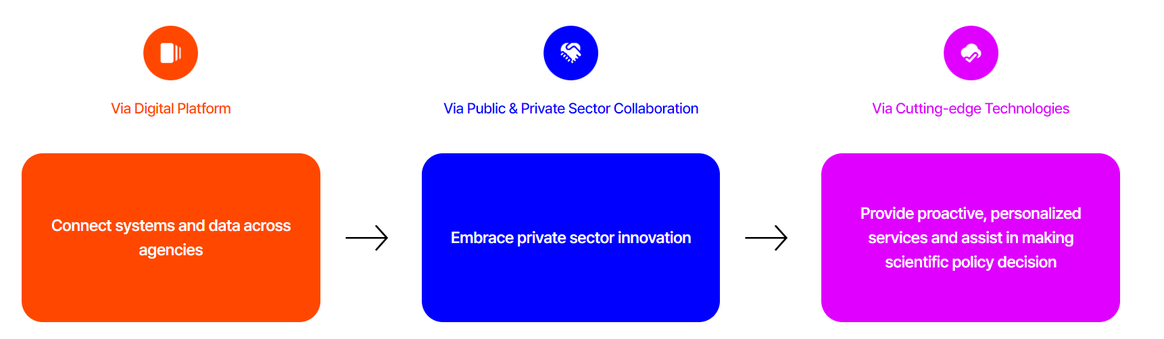
Original P.36
Notes:
South Korea’s future digital transformation holds immense economic potential, with projections indicating it could unlock KRW 281 trillion by 2030, contributing up to 13% of the nation’s GDP. The majority of this growth will be driven by technologies that enhance business operations, such as IoT, AI, and cloud computing. The image shows how DX has contributed in the economic recovery in post COVID era. The majority of the growth has been lead by technologies remarkably since COVID, and it will continue to lead the major growth as explained.
To fully realize these benefits, South Korea must focus on nurturing its technology ecosystem, promoting digital adoption among SMEs, and expanding into global digital export markets. These strategic steps will ensure long-term economic growth and innovation leadership

Slide 37
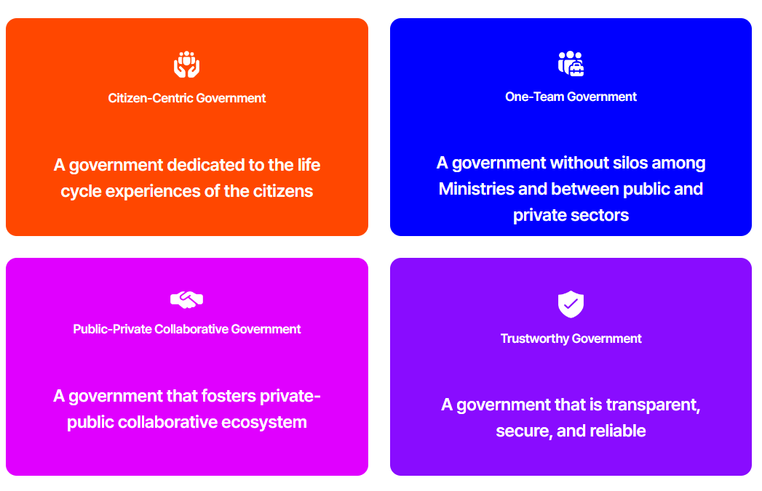
Key features of
Digital Platform Government
Notes:
The Digital Platform Government in South Korea offers several innovative features that ensure its effectiveness. At its core is the G-Cloud system, which centrally manages government services and data, providing scalability and robust security. Additionally, the integration of AI and big data enables the government to make data-driven decisions and deliver better public services. The platform’s commitment to cybersecurity is evident, with agencies like KISA actively safeguarding citizen data and maintaining the integrity of public systems.
The image illustrates four key principles of this platform: first, it's a citizen-centric government, meaning it is dedicated to improving the entire life cycle experience for citizens. Second, it operates as a one-team government, breaking silos across ministries and fostering collaboration between the public and private sectors. The third principle is public-private collaboration, where the government actively fosters an ecosystem that promotes innovation through partnerships. Finally, this is a trustworthy government that prioritizes transparency, reliability, and security. These features collectively ensure that South Korea’s Digital Platform Government remains at the forefront of modern governance, adapting to the needs of its people while maintaining trust and efficiency.

Slide 38
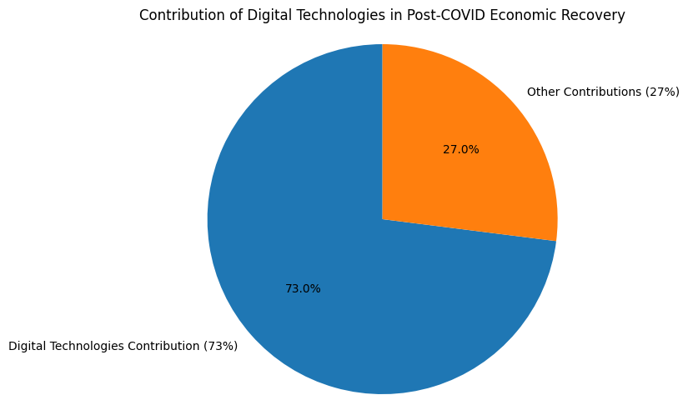
South Korea’s future DX goals
Notes:
South Korea’s future digital transformation holds immense economic potential, with projections indicating it could unlock KRW 281 trillion by 2030, contributing up to 13% of the nation’s GDP. The majority of this growth will be driven by technologies that enhance business operations, such as IoT, AI, and cloud computing. The image shows how DX has contributed in the economic recovery in post COVID era. The majority of the growth has been lead by technologies remarkably since COVID, and it will continue to lead the major growth as explained.
To fully realize these benefits, South Korea must focus on nurturing its technology ecosystem, promoting digital adoption among SMEs, and expanding into global digital export markets. These strategic steps will ensure long-term economic growth and innovation leadership

Slide 39
Lessons for Other Nations
Notes:
South Korea’s Digital Platform Government provides a robust framework that other nations can adapt to enhance their own public services. First, nations can create centralized digital infrastructures similar to South Korea’s G-cloud, streamlining government services and improving the efficiency of operations across different departments. By consolidating services, governments can reduce redundancies and enhance accessibility for citizens.
Next, leveraging AI and big data allows for personalized, proactive services. Governments can anticipate citizens' needs, providing tailored services like healthcare reminders or tax notifications, improving both engagement and public satisfaction. Finally, South Korea’s collaborative, whole-of-government approach, where silos between agencies are broken down, fosters better integration of services. This model encourages partnerships between ministries and even the private sector, enabling a more seamless and citizen-centric experience. Countries adopting these strategies can transform their governance models and ensure that digital infrastructure supports growth and innovation

Slide 40
Adapting Digital Infrastructure
Personalized Citizen Services
Collaborative Whole-of-Government Approach
Notes:
South Korea’s Digital Platform Government provides a robust framework that other nations can adapt to enhance their own public services. First, nations can create centralized digital infrastructures similar to South Korea’s G-cloud, streamlining government services and improving the efficiency of operations across different departments. By consolidating services, governments can reduce redundancies and enhance accessibility for citizens.
Next, leveraging AI and big data allows for personalized, proactive services. Governments can anticipate citizens' needs, providing tailored services like healthcare reminders or tax notifications, improving both engagement and public satisfaction. Finally, South Korea’s collaborative, whole-of-government approach, where silos between agencies are broken down, fosters better integration of services. This model encourages partnerships between ministries and even the private sector, enabling a more seamless and citizen-centric experience. Countries adopting these strategies can transform their governance models and ensure that digital infrastructure supports growth and innovation

Slide 41
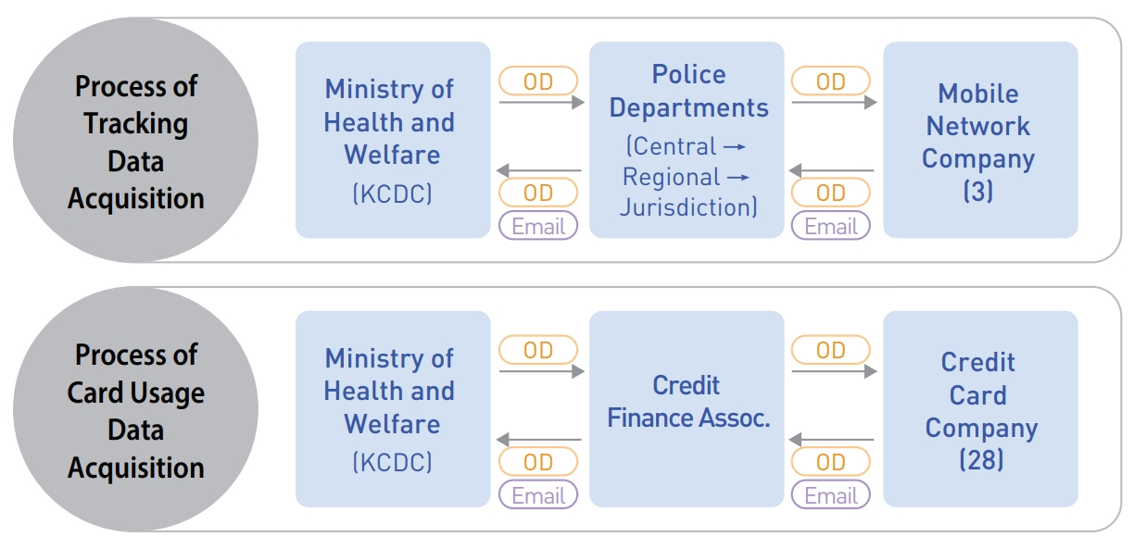
Case Study 1
Digital Health and AI
Notes:
One of the most impactful applications of South Korea’s Digital Platform Government is in the field of digital health. By integrating AI into healthcare systems, South Korea has improved diagnostics and created effective public health solutions, such as COVID-19 tracking. AI-driven health systems enable faster, more accurate diagnoses and personalized treatments, improving overall national health outcomes. This model offers great potential for other countries to implement similar AI-driven healthcare services, helping them enhance public health systems and better respond to both everyday health challenges and future crises

Slide 42
Case Study 2
Digital Platform Government
for Seamless Public
Integration of Services
Proactive Services
Global Adaptation Potential
Notes:
South Korea’s Digital Platform Government is a powerful example of how integrated public services can enhance citizen engagement and streamline government operations. By unifying various government services under a single, centralized portal, citizens no longer need to navigate multiple agencies to access services. This integration makes interactions with the government more efficient and seamless. Additionally, by leveraging AI and big data, the platform offers proactive, personalized services that anticipate and meet individual needs. For instance, it can send personalized reminders about healthcare, taxes, or social services. This model has significant global potential, as other countries can adopt it to integrate fragmented systems, increase transparency, and improve overall citizen satisfaction. By breaking down silos and centralizing services, governments worldwide can transform how they engage with their citizens and deliver more responsive, streamlined public services.

Slide 43
Case Study 3
Digital Identity and
E-Government Services
Digital ID Systems
Global Applicability
Notes:
One of the standout features of South Korea’s digital transformation is its highly efficient digital identity systems. These systems make it seamless for citizens to access a wide range of public services, from healthcare to taxation, and can serve as a model for other nations aiming to improve both accessibility and security. Moreover, South Korea’s e-government platforms provide a strong example of how to reduce bureaucracy and streamline service delivery. By adopting similar systems, other countries can improve public service efficiency and enhance citizen engagement.

Slide 44
Benefit
Adopting the Framework
Importance of Digital Infrastructure Investment
Learning from South Korea’s Cybersecurity Initiatives
Notes:
South Korea’s Digital Platform Government provides a roadmap for other nations to follow, offering flexibility to adapt its framework based on local needs. By adopting a centralized platform, countries can streamline public services and improve citizen engagement. However, to achieve this, significant investments in digital infrastructure, such as cloud computing, AI, and 5G, are essential. These technologies enable seamless service delivery, while cybersecurity is equally important. South Korea’s robust cybersecurity infrastructure, led by agencies like KISA, serves as a model for protecting data and ensuring the success of digital initiatives.
In conclusion, South Korea’s experience demonstrates how integrating technology into governance can deliver efficient, transparent, and personalized services. By investing in infrastructure and learning from South Korea’s proactive approach to security, nations can successfully navigate their own digital transformation journeys, creating more responsive and innovative governments that better serve their citizens. The lessons learned here today can be tailored and applied globally, guiding future digital transformations.

Slide 45
End Of Document

Slide 46
Korean Digital Transformation Policy:
Successes and Failures
of DX in Smart Cities, Retail, and Finance
한국 디지털 전환 정책:
스마트시티와 유통,금융업에서의 DX 성공 및 실패 사례

Slide 47
The Role
Of Smart Cities in DX
Notes:
Smart cities are a central pillar in South Korea's digital transformation strategy. But why do they matter so much?
First, they help address the growing challenges of urbanization. With more people moving into cities, there is an increasing need to ensure that resources like energy, transportation, and public services are used efficiently. Smart cities do this by integrating advanced technologies, such as AI and IoT, to optimize how cities operate.
These cities not only improve resource management but also enhance the quality of life for citizens. By using real-time data, they can create safer, more sustainable environments, with better access to essential services like healthcare, public safety, and transportation.

Slide 48
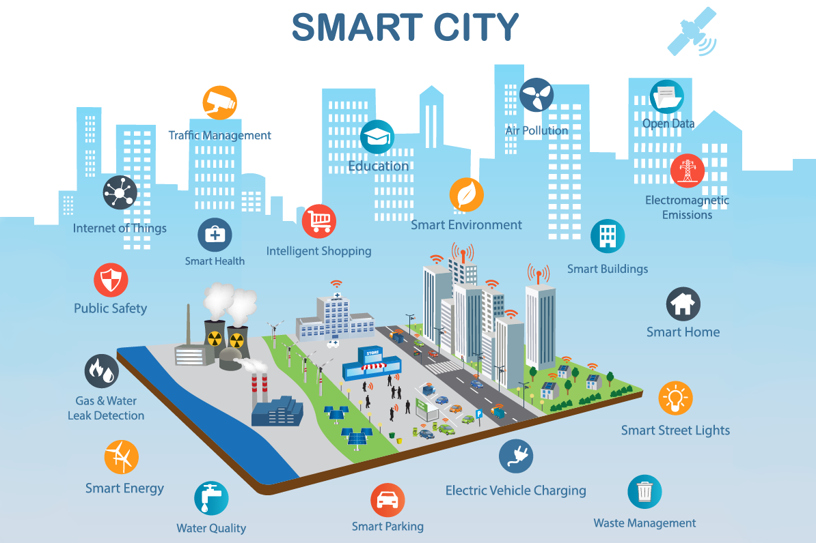
The Future
of Urban Development
Notes:
As for the reasons mentioned, smart cities therefore represent the future of urban development, playing a crucial role in creating sustainable and inclusive environments.
To expain more in detail, first, they align with the United Nations' Sustainable Development Goals, particularly Goal 11, which focuses on building inclusive, safe, resilient, and sustainable cities. Smart cities contribute to these goals by leveraging digital technologies to manage resources more efficiently, reduce waste, and promote green energy solutions.
Beyond environmental sustainability, smart cities also enhance social inclusiveness. They provide better access to public services and improve the quality of life for all citizens, regardless of their background or location.
Ultimately, the future of urban living will depend on the adoption of digital innovation and smart infrastructure. These cities will be driven by technology but designed with people in mind, ensuring a balance between progress and sustainability.

Slide 49
Evolution of Smart Cities
in South Korea
Notes:
South Korea’s journey towards smart cities began in the early 2000s with the 'u-City' projects. These early initiatives aimed to integrate information and communication technologies into urban development to create more connected cities. However, these projects faced significant challenges, particularly a lack of institutional and technical support, which limited their success.
In response, South Korea shifted its approach to developing cities as platforms rather than just technological products. This platform-based model focuses on strengthening governance frameworks, ensuring proper financial mechanisms, and fostering innovation.
Today, Sejong and Busan have been designated as national pilot cities. These cities serve as testbeds for advanced technologies and regulatory sandboxes, where the latest innovations can be tested and refined. Through these efforts, South Korea is building a strong foundation for the future of smart urban living.

Slide 50
Integration of AI, IoT, Big Data, and Blockchain in smart city infrastructures
Use of data-driven approaches to improve urban management and decision-making
Focus on sustainability, efficiency, and enhancing public services through technology
Notes:
The technological foundations of South Korea's smart cities are critical to their success. These cities rely on the integration of Artificial Intelligence, the Internet of Things, Big Data, and Blockchain to create interconnected infrastructures that are smarter and more efficient.
AI and IoT work together to gather real-time data from urban environments, allowing cities to respond dynamically to changing conditions. For example, IoT sensors placed throughout the city help monitor traffic, air quality, and energy usage. AI processes this data to optimize traffic flow or adjust energy consumption, improving both efficiency and quality of life.
Big Data plays a crucial role in decision-making, enabling city planners to analyze patterns and trends for better urban management. Blockchain, on the other hand, adds a layer of security and transparency to systems such as digital payments and identity verification.
Through these technologies, South Korea is building cities that are not only smarter but more responsive to the needs of their citizens, creating a model for the future of urban living

Slide 51
Successes and Failures
DX in Retail
Notes:
Digital transformation has had significant impacts on South Korea's retail sector, showcasing both successes and failures.
On the success side, e-commerce platforms like Coupang have revolutionized the retail landscape. These platforms have leveraged technology to offer faster delivery, a wide range of products, and personalized shopping experiences. Additionally, digital payment systems have greatly enhanced convenience for consumers, making transactions quicker and more secure, contributing to the rise of online shopping.
However, not all retailers have adapted well to this digital shift. Traditional brick-and-mortar stores, which were slow to embrace digital tools, struggled to compete. Many failed to integrate e-commerce or omnichannel strategies, leading to a decline in sales and, in some cases, permanent closures. This failure highlights the importance of embracing digital transformation early to stay competitive in a rapidly evolving market.
Overall, South Korea’s retail sector serves as a powerful example of how digital transformation can drive innovation but also poses challenges for those who resist change.

Slide 52
Successes and Failures
DX in Finance
Notes:
The financial sector in South Korea has also experienced both successes and challenges as a result of digital transformation.
On the success side, KakaoBank has emerged as a leader in digital banking. Its fully online platform offers seamless services that have reshaped the banking experience, from account creation to transactions, making banking more accessible and convenient. Another success is Klaytn, a blockchain platform that enhances transparency and security in financial transactions, showcasing how blockchain technology can improve trust and efficiency in the sector.
However, there have been challenges. Some financial digital transformation initiatives have faced regulatory hurdles and significant cybersecurity risks. The fast pace of technological innovation often outpaces regulatory frameworks, causing difficulties in compliance. Cybersecurity has also been a concern, with increased vulnerabilities in digital banking and blockchain systems.
The key lesson here is that while digital transformation can revolutionize the financial sector, maintaining a regulatory balance and ensuring robust security measures are critical for long-term success.

Slide 53
Applying Globally
Notes:
South Korea’s smart city development offers valuable lessons for other nations.
First, its strong legal frameworks and governance models can be adapted globally. These ensure that smart city projects are sustainable and well-coordinated, rather than solely technology-driven.
Second, public-private partnerships have played a crucial role in accelerating innovation. By combining the strengths of both sectors, South Korea has successfully implemented large-scale projects, a model other countries can follow.
Lastly, countries can adopt scalable solutions using IoT, AI, and blockchain—just as South Korea has done. These technologies help optimize urban management and improve public services, offering flexible solutions for cities worldwide.

Slide 54
DX in Retail Global Insights
Retail DX: Success and Failures
Notes:
South Korea’s experience in digital transformation also offers key lessons for the global retail sector.
One major success is the rapid growth of e-commerce and digital payments. Countries can learn from platforms like Coupang, which have revolutionized the retail experience through fast delivery, user-friendly interfaces, and seamless payment options. These innovations have set a new standard for customer convenience.
On the other hand, traditional retailers in South Korea that failed to embrace digital transformation faced significant challenges, including store closures. This shows the importance of avoiding the same pitfalls and investing in digital tools early on.
To remain competitive in today’s digital-first world, global retailers must adopt omnichannel strategies—integrating both online and offline experiences. By learning from South Korea’s successes and failures, other nations can enhance their retail sectors and ensure they are ready for the future.

Slide 55
Financial Sector DX
Applying Fintech Innovations Globally
Notes:
South Korea’s fintech innovations provide valuable insights for global finance. Digital banking platforms like KakaoBank show how building strong digital infrastructures can enhance financial services. Other nations can adopt similar models to improve accessibility and convenience.
Blockchain and digital payment systems also offer increased transparency and security, key factors that can be replicated globally to strengthen financial ecosystems.
However, a critical lesson from South Korea is the importance of addressing cybersecurity risks. Robust security measures are essential to support these advanced technologies in the financial sector.
By learning from South Korea’s successes, other countries can successfully navigate their own digital transformation in finance

Slide 56
The Future of Smart Cities and DX Globally
Notes:
The future of smart cities and digital transformation extends well beyond South Korea, offering insights for global urban development.
In South Korea, full-service smart cities are expected to be fully operational by 2035. This serves as a benchmark for other nations as they advance their own digital transformation initiatives. However, the focus should not just be on implementing technology, but on ensuring that these efforts are both sustainable and inclusive.
Digital transformation is ultimately about improving the quality of life for citizens. Governments worldwide should prioritize equal access to services, making sure that the benefits of smart cities are felt by all, not just the few. In this way, technology becomes a tool for creating more equitable and resilient urban environments.
By focusing on sustainability and inclusivity, countries can build a vision for the future that leverages digital transformation to benefit both society and the environment

Slide 57
overall
Notes:
In conclusion, South Korea offers a powerful blueprint for global digital transformation, not only in smart cities but also in retail and finance. The country’s diverse range of successful and failed cases provides valuable lessons that other nations can learn from and adapt to their own contexts.
Global collaboration is crucial as we share best practices and address the challenges that come with digital transformation. By working together, countries can accelerate innovation, overcome obstacles, and ensure that the benefits of digital transformation are accessible to all.
Ultimately, the future of urban living depends on international cooperation in digital innovation. By learning from each other, we can create smarter, more sustainable cities that improve the quality of life for citizens everywhere

Slide 58
End Of Document

Slide 59
Global Trends of DX
DX 의 글로벌 트렌드

Slide 60
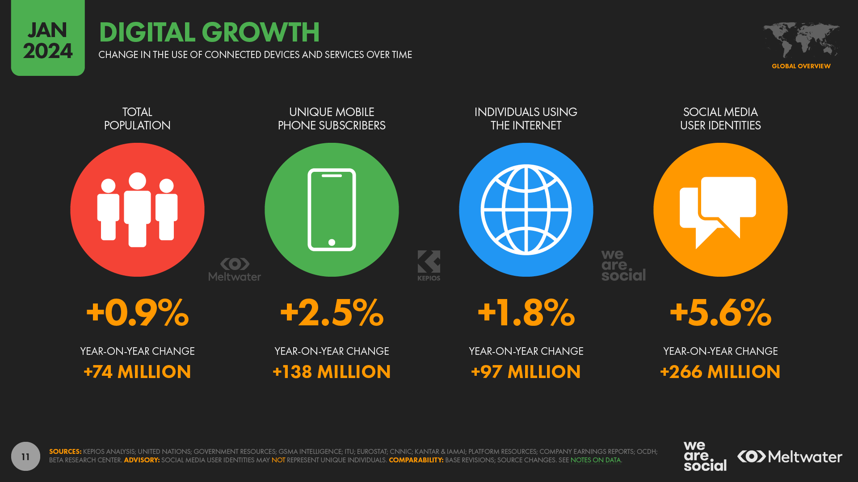
Global Digital Transformation:
A Necessity for Survival and Growth
Notes:
y 2024, the global digital growth shows significant changes across various sectors:
Total population has seen a 0.9% increase, adding 74 million more people.
Unique mobile phone subscribers have grown by 2.5%, which is an additional 138 million users globally.
Individuals using the Internet have increased by 1.8%, reaching 97 million more users.
The most notable growth is in social media user identities, which rose by 5.6%, accounting for 266 million new users worldwide.
This digital growth is shaping the future of global economies. Companies that adopt digital strategies could experience a 55% increase in productivity. However, those that fail to adapt risk losing their competitive edge, missing new growth opportunities, and falling behind in this rapidly evolving market.

Slide 61
Risks of Not Adopting DX
Loss of Market Share
Operation Inefficiency
Missed Growth Opportunities
Notes:
Failing to adopt digital transformation presents significant risks to companies. One of the biggest threats is the loss of market share. Competitors that embrace innovation can outpace businesses that stick to traditional models, leaving them behind. Additionally, companies that don’t transform face operational inefficiency. Digital strategies are faster, more adaptable, and far more efficient than outdated methods. Finally, there’s the risk of missed growth opportunities. Digital transformation opens doors to new business models, emerging markets, and customer needs. Without this shift, businesses may be unable to capitalize on these opportunities and will struggle to remain competitive in a rapidly evolving global landscape.

Slide 62
Key Global DX Trends
AI and Machine Learning
Edge Computing Expansion
5G Growth
Notes:
Several key trends are driving global digital transformation. First, AI and machine learning are transforming industries by significantly improving efficiency and personalization. From automated customer service to advanced data analytics, AI is helping businesses optimize operations and enhance customer experiences. Next, we have the expansion of edge computing, which moves data processing closer to devices. This reduces latency and allows for real-time responsiveness, which is critical for industries like healthcare, where immediate data access can save lives. Finally, the growth of 5G technology is accelerating connectivity, enabling the Internet of Things, or IoT, to flourish. This allows industries to operate more efficiently, connecting devices and systems in ways that weren’t possible before, driving innovation in areas like manufacturing, smart cities, and autonomous vehicles

Slide 63
Strengthening
Digital Infrastructure
Cybersecurity
Sustainable Technology
Green IT Initiatives
Notes:
As digital transformation accelerates, strengthening digital infrastructure has become a priority for businesses worldwide. First, cybersecurity is at the forefront, as companies must protect their online operations from growing threats. With more data being processed and shared, businesses are investing heavily in security measures to safeguard their systems and customer information. Secondly, there is an increasing focus on sustainable technology. The demand for eco-friendly IT solutions is rising, driven by both regulatory pressure and consumer demand for responsible practices. Finally, Green IT initiatives are being adopted by more organizations. These include energy-efficient data centers, reduced electronic waste, and overall sustainable practices within digital operations. As companies align with environmental goals, these initiatives not only reduce costs but also contribute to global sustainability efforts.

Slide 64
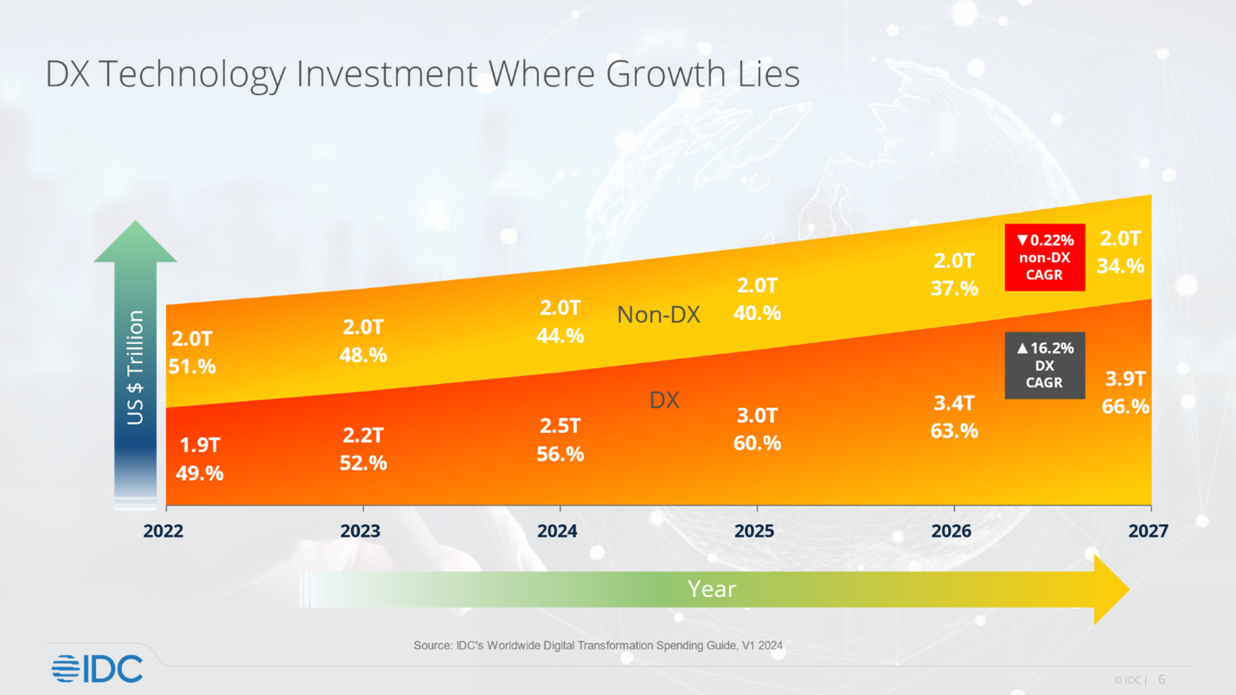
Future Trends and Market Projections
Notes:
The future of digital transformation is clear: it's where the majority of technology investments are heading. According to the latest projections, digital transformation (DX) spending is growing at an impressive rate, while Non-DX investments are declining. By 2027, DX investments are expected to make up 66.6% of total technology spending, reaching $3.9 trillion. This shift highlights the increasing reliance on digital tools and infrastructure across industries. Companies that embrace DX will benefit from increased efficiency, innovation, and competitiveness, positioning themselves for long-term success in a rapidly evolving digital landscape

Slide 65
Germany’s DX in Manufacturing
Smart Factories
Technological Integration
Notes:
Germany’s digital transformation in manufacturing, under the Industry 4.0 initiative, has set the standard for global innovation. At the heart of this transformation are smart factories, which have dramatically increased both productivity and product quality. These factories integrate advanced technologies such as IoT and AI to create highly automated and optimized production processes. This level of technological integration has enabled German manufacturers to reduce downtime, enhance precision, and respond faster to market demands. Through this approach, Germany has not only modernized its manufacturing sector but also strengthened its global competitiveness, demonstrating the power of digital transformation in traditional industries.

Slide 66
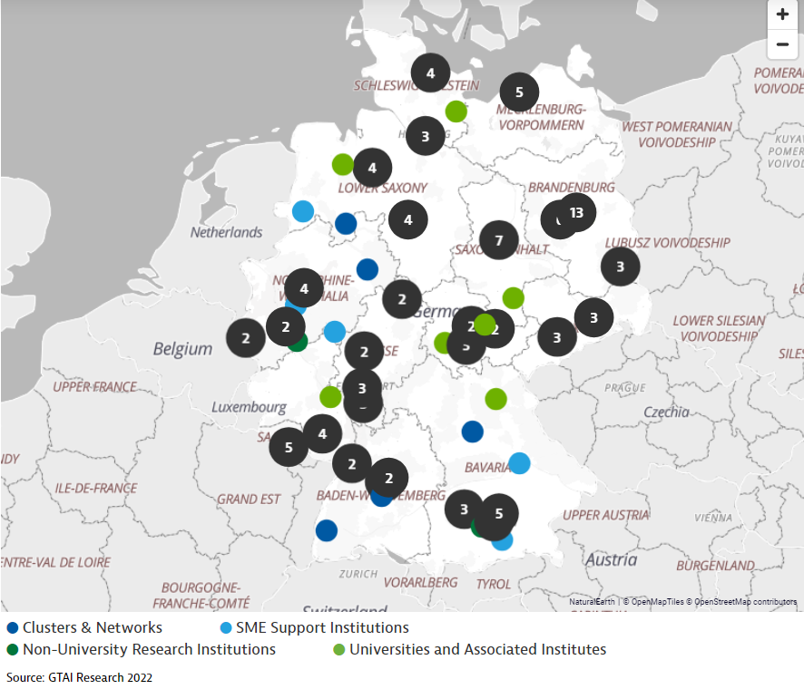
Supporting SMEs in DX
Notes:
Germany’s digital transformation efforts extend beyond large corporations to include small and medium enterprises (SMEs), which are critical to the country’s economy. Through SME support programs, the government has implemented policies and initiatives that help these businesses adopt digital tools and technologies. This support allows SMEs to modernize their operations, improve efficiency, and innovate more effectively. By ensuring that SMEs can participate in the digital revolution, Germany is not only strengthening its internal economy but also enhancing its global competitiveness. This commitment to innovation ensures that the manufacturing sector—both large and small players—remains competitive on the global stage, maintaining Germany’s position as a leader in industrial digitalization.

Slide 67

Japan’s National Digital Vision
5G Expansion
Digital Workforce Development
Smart City Initiatives
Notes:
Japan’s National Digital Vision under the Digital Garden City Nation initiative is a forward-thinking strategy aimed at driving national digital transformation. One of the key goals is 5G expansion, with Japan targeting 90% 5G coverage by 2024. This will significantly boost connectivity across the country, enabling faster data transfer and supporting technologies like IoT. Another critical component is digital workforce development—65% of employees in Japan identify digital skills as a top priority for future growth, showcasing the country’s strong focus on upskilling its workforce. Additionally, Japan is investing heavily in smart city initiatives to revitalize local economies through digitalization. These smart cities will integrate digital infrastructure to improve public services, enhance sustainability, and create more efficient, livable urban environments

Slide 68
Digital Garden City Nation
Inashi
Kamiyama
Notes:
Under Japan’s Digital Garden City Nation initiative, several regions are already showcasing successful digital transformation. In the city of Inashi, the implementation of remote medical services has greatly improved healthcare access and equity, particularly in rural areas. This innovation ensures that residents, regardless of location, receive timely and efficient medical care. Meanwhile, in Kamiyama, a small town facing population decline, the local government has successfully attracted IT companies and fostered a vibrant startup ecosystem. This has not only boosted the town’s population but also revitalized its local economy. These examples demonstrate how Japan’s digital strategy is not only enhancing urban centers but also revitalizing smaller, regional communities through digitalization.

Slide 69
Amazon’s
AI-Driven Innovations
Personalized Recommendations
Supply Chain Optimization
Notes:
Amazon’s transformation into an AI and IT powerhouse has been largely driven by its innovative use of AI technologies. One key example is its personalized recommendations. By using machine learning algorithms, Amazon analyzes vast amounts of customer data to offer tailored product recommendations, significantly enhancing customer engagement and increasing sales. Additionally, Amazon has optimized its operations through AI-driven supply chain optimization. By using AI to forecast demand and streamline logistics, the company ensures that products are delivered faster and more efficiently, reducing costs and improving the customer experience. These AI-driven innovations have been critical in transforming Amazon from a retail company into a leading AI and IT giant

Slide 70
Amazon’s
Strategic Expansion into IT
Alexa and AI Innovation
AWS
Lessons for Other Nations
Notes:
Amazon’s strategic expansion into the IT sector has been transformative. One major success is the development of Alexa and other AI-powered platforms, which have allowed Amazon to enter new markets and pioneer technological advancements in voice-activated systems. Alexa not only created a new product category but also opened doors for broader AI applications. Another key element of Amazon’s transformation is Amazon Web Services (AWS). AWS has become a global leader in cloud computing, offering businesses worldwide access to cutting-edge AI and IT solutions. These strategic expansions highlight Amazon’s forward-thinking approach, and there are important lessons for other nations. Governments and companies can learn from Amazon’s customer-centric approach, continuous investment in technology, and focus on AI-driven innovation to stay competitive in the digital age

