Slide 1
1
HOW TO SUCCEED IN MRBEAST PRODUCTION

Slide 2
2
HI
Hi, I’m Jimmy (MrBeast) and as the team is growing larger, I no longer get to spend as much time with everyone as I used to. The first dozen employees had unfiltered and unlimited access to me to learn as much as they could about my vision and what I wanted. Sadly, you don’t have that luxury. So, I thought it would be useful to try to braindump as much as I can into this silly little book to give new people to help bring them up to speed on everything we’ve learned over the past decade with this channel. We’ve been through a lot and chances are most of the problems you face we’ve dealt with. So I genuinely believe if you attently read and understand the knowledge here you will be much better set up for success. So, if you read this book and pass a quiz I’ll give you $1,000. Sorry in advance for all the run on sentences and grammar issues, I’m a youtuber not an author haha.
This is not a rulebook.
I need to kick this thing off by saying the purpose of this is not to give you a bunch of rules to follow. On top of that I want nothing in here to be taken literally. What we do is complex and changes based on the situation. I need you to repeat this in your head three times: “I will apply everything I read with a grain of salt.” This is not an inclusive list of everything, I hope this inspires you with questions and to come to us to learn more.

Slide 3
3
Prelude (idk what this means)
I could make a separate book for creative, a separate book for production, a separate book for editors, etc. but I think that’d be dumb. Everything we do here is interconnected and the more you understand about what others are doing and trying to accomplish, the better set up for success you will be. So this will be information about all parts of MrBeast productions and I advise everyone to read it in its entirety. A good example of this is James Warren. He understands every single part of this company at a deep level and as a result can make decisions faster than anyone else. The stuff you will be reading about he knows like the back of his hand. I’ve seen a team of 5 people work on a project for a week just to give up and James solve it in 30 minutes. I say this not to flex for him but to show the power that comes when you understand everything in this book deeply. The more you know about why we do things and what we are trying to accomplish, the better off you will be. So let's start off with some basic stuff.
What is your goal here?
Your goal here is to make the best YOUTUBE videos possible. That’s the number one goal of this production company. It’s not to make the best produced videos. Not to make the funniest videos. Not to make the best looking videos. Not the highest quality videos.. It’s to make the best YOUTUBE videos possible.
Everything we want will come if we strive for that. Sounds obvious but after 6 months in the weeds a lot of people tend to forget what we are actually trying to achieve here.
Idc how traditional media does things
Pardon the bluntness but this is not Hollywood and I do not want to be Hollywood. And if that sentence is a turn off to you then you’re probably at the

Slide 4
4
wrong job. I genuinely mean that. Youtube is the future and I believe with every fiber of my body it’s going to keep growing year over year and in 5 years Youtube will be bigger than anyone will have ever imagined and I want this channel to be at the top. Which is why I say we are not Hollywood. 99% of movies or tv shows would flop on Youtube. On top of that they'd be wildly unprofitable, have no flexibility, and long lead times that can’t adapt to trends. We arn’t here to make a small movie once or twice a year, I want to make one a week lol. Which is why you need to be nimble and produce content OUR way, not the way you were taught before. If you want the highest probability of success I beg you to learn why we do what we do at a deep level before you try to “fix” anything. We’ve done countless videos and invested hundreds of thousands of hours collectively building how we do things. I know it’s not perfect but we have a reason for how we do most stuff and it’s probably a decent one.
The Amount of hours you work is irrelevant
Before you get mad, recall the story about James solving a problem in 30 minutes a team of 5 couldn’t in a week. In that example does it really matter how many hours they worked? Obviously we want grinders that put in the hours and love you guys to death that do. But at the end of the day you will be judged on results, not hours. We are a results based company. Get shit done and move the goalpost!
I only want “A Players”
As I type this I realize it may not be the wisest to categorize everyone into 3 buckets but this is how I believe we should look at everyone a part of the production team. You’re either an A-Player, B-Player, or C-Player. There is only room in this company for A-Players. A-Players are obsessive, learn from mistakes, coachable, intelligent, don’t make excuses, believe in Youtube, see the value of this company, and are the best in the goddamn world at their job.
B-Players are new people that need to be trained into A-Players, and C-Players are just average employees. They don’t suck but they arn’t exceptional at what they do. They just exist, do whatever, and get a paycheck. They arn’t obsessive

Slide 5
5
and learning. C-Players are poisonous and should be transitioned to a different company IMMEDIATELY. (It’s okay we give everyone severance, they’ll be fine).
Chapter 1: What makes a Youtube video viral?
I spent basically 5 years of my life locked in a room studying virality on Youtube. Some days me and some other nerds would spend 20 hours straight studying the most minor thing: like is there a correlation between better lighting at the start of the video and less viewer drop off (there is, have good lighting at the start of the video haha) or other tiny things like that. And the result of those probably 20,000 to 30,000 hours of studying is I’d say I have a good grasp on what makes Youtube videos do well. The three metrics you guys need to care about is Click Thru Rate (CTR), Average View Duration (AVD), and Average View Percentage (AVP). Make sure you know those abbreviations because that's how most people will refer to them. Up first we’ll talk about CTR. This is important no matter what department you work in. CTR is basically how many people see our thumbnail in their feeds divided by how many that click it. If 100,000,000 people see our thumbnail and 10,000,000 click on it then that means 10% clicked and we have a 10% ctr. This is what dictates what we do for videos. “I Spent 50 Hours In My Front Yard” is lame and you wouldn’t click it. But you would hypothetically click “I Spent 50 Hours In Ketchup”. Both are relatively similar in time/effort but the ketchup one is easily 100x more viral. An image of someone sitting in ketchup in a bathtub is exponentially more interesting than someone sitting in their front yard. Titles are equally as important for getting someone to click. A simple way to up that CTR even more would be to title it “I Survived” instead of “I Spent”. That would add more intrigue and make it feel more extreme. In general the more extreme the better. “I Don’t Like Bananas” won’t perform the same as “Bananas Are The Worst Food On Earth”. Now if you’re in production or creative you might be wondering, why does the title and thumbnail matter to me? Expectations is why. The title and thumbnail on the videos you will be producing set the expectations for the viewer for your video. Imagine you clicked on a video titled “World’s Largest Bouncy Castle” and the thumbnail had a giant yellow bouncy castle beside a bunch of huge buildings. Then when the video plays it's not a yellow bouncy castle, it's red. It’s also not the world’s largest. It’s also in a field with no buildings like the thumbnail. You’d feel like you were lied to and click off because the video did not meet the expectations of the title/thumbnail. THIS IS WHY YOU MUST KNOW THE TITLE AND THUMBNAILS OF THE VIDEOS YOU ARE MAKING! How can you know how to

Slide 6
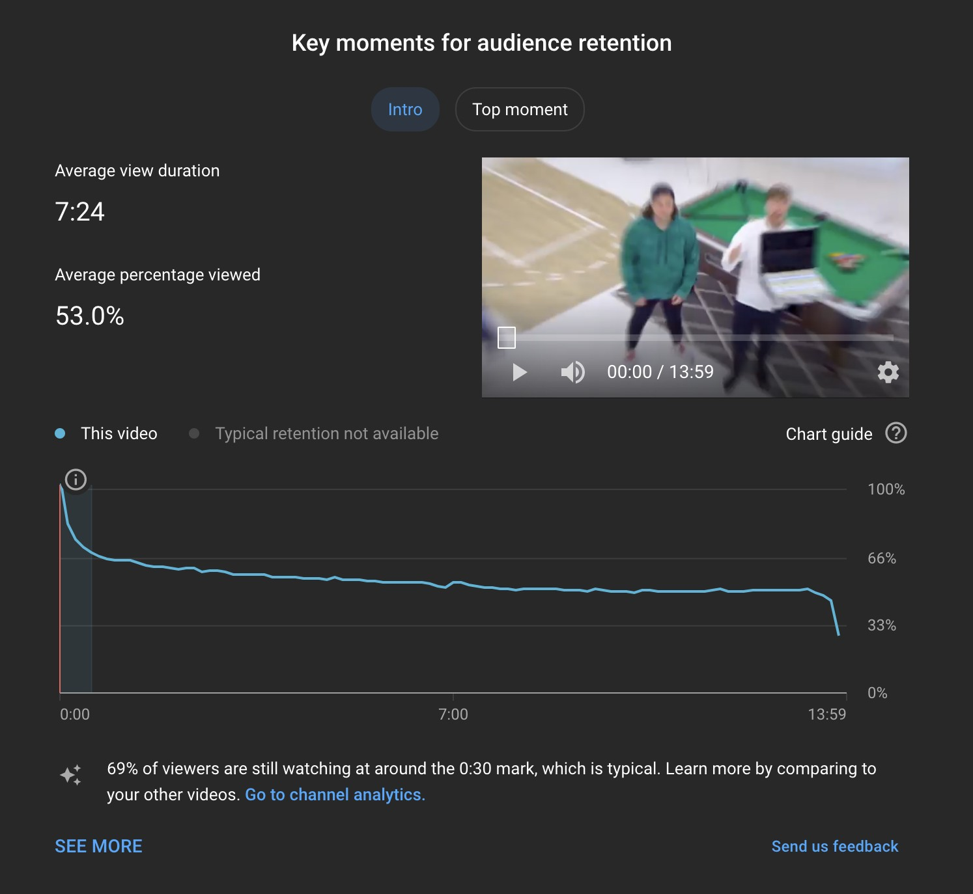
6
start your video if you don’t even know what expectations the viewers have of you?
Now let's jump over to the second metric that matters. AVD. This is how long on average people watch a given video. The cool thing about Youtube is they give us super detailed graphs for every video that show the exact second we lose a viewer on every single video.
See that blue line in the image above? That represents the attention span of the 60 million people that clicked on this video. It’s crazy but we can see exactly when every single person who clicked on this video clicks off. As with almost every video on Youtube, the first minute has the most loss (go look). This is why we freak out so much about the first minute and go so above and beyond to

Slide 7
7
make it the best we freakin can. On this particular video we lost 21 million viewers in the first minute of the video (which surprisingly compared to other channels is above average) and could have been much worse. Let’s say the start of the video wasn’t well-lit, I didn’t match the expectations of the clickbait, I didn’t pre plan what I’d say, and we didn’t front load some interesting stuff for the first minute of content, we would have lost much less then 21 million people. Because it wouldn’t have even got 21 million views lol. But if the views were hypothetically fixed then instead of still having 39 million viewers at the 1 minute mark it would be more like 20 million viewers. The first minute of each video is the most important minute of each video.
After the first minute of content you will have what we call minutes 1 thru 3.
This is where you have to transition from hype to execution (generally). Stop telling people what they will be watching and start showing them. An example of a 1 thru 3 minute tactic we would use is crazy progression. Let’s say we have 10 minute video about a guy surviving weeks in the woods. Instead of making the first 3 minutes of the video about his first day then progressing from there like a logical filmmaker would. We’d tried to cover multiple days in the first 3 minutes of the video so the viewer is now super invested in the story. They’ve seen this man survive multiple days in the woods and emotionally now want to see how much further he can go. We also want to do something around the 3 minute mark called a 3 minute re-engagement. A re-engagement can be described as content that is highly interested that fits the story and makes people genuinely impressed. Another way to look at this is it’s a segment that “only MrBeast can do this”. It’s important to re-engage the viewer around this time because they could get bored of the story and click off. These re-engagements are usually spectacles and sometimes need lots of time and money to perfect. A good example of a
re-engagement is when Karl was put in charge of watching Josh in the “$10,000 Every Day You Survive Prison” video.
Following the first minute, then minutes 1 thru 3, is obviously what we call minute 3 through minute 6 and is the next most important part of the video. This is where you plan out all the most exciting and interesting content that is also very simple. This includes lots of quick scene changes and highly stimulating simple content that reflects the story. The goal is to make them fall in love with

Slide 8
8
the story, the people in the video and the overall video itself. If we can get them to watch the first half of the video there’s a very high chance they’ll watch to the end. Usually at the 6 minute mark we will include another re-engagement that is highly interesting but needs a little more explanation and will push the story in the back half of the video.
And lastly, we have what we call back half content. I have to be careful writing this because I don’t want you to ever for a second think I am okay with content being subpar. Many videos have been killed because the back half content was ass lol. But in general once you have someone for 6 minutes they are super invested in the story and probably in what I call a “lull”. They are watching the video without even realizing they are watching a video. Typically the not as good content would be in the back half of the video. Don’t ever signal the end of the video unless it’s to build hype for the prize or payoff at the end of the video. This is also where long explanation bits can live and if something unexpected happens or things don’t go to plan that can be turned into content.
The above paragraphs are why you’ll hear us ask what minute mark in the video that you are working on is. Whether it is production, creative, or editing you must always know what minute mark the content you are working on is. If you don’t then you’re not doing it right. I just whipped out a calculator and the combined seconds of content of our last 100 videos is 81,801 seconds. Which divided by 100 means the average mrbeast video is 818 seconds or 13 minutes and 37 seconds. Some are shorter (like when we do a real time shoot or something more emotional and don’t want it dragged out) and some are longer (giant spectacles like giving away an island as an example) but 13 minutes is the average and you are expected to know when producing which minute of that 13 minutes you are working on.
And since we’re on the topic of retention graphs here is a cool visual

Slide 9
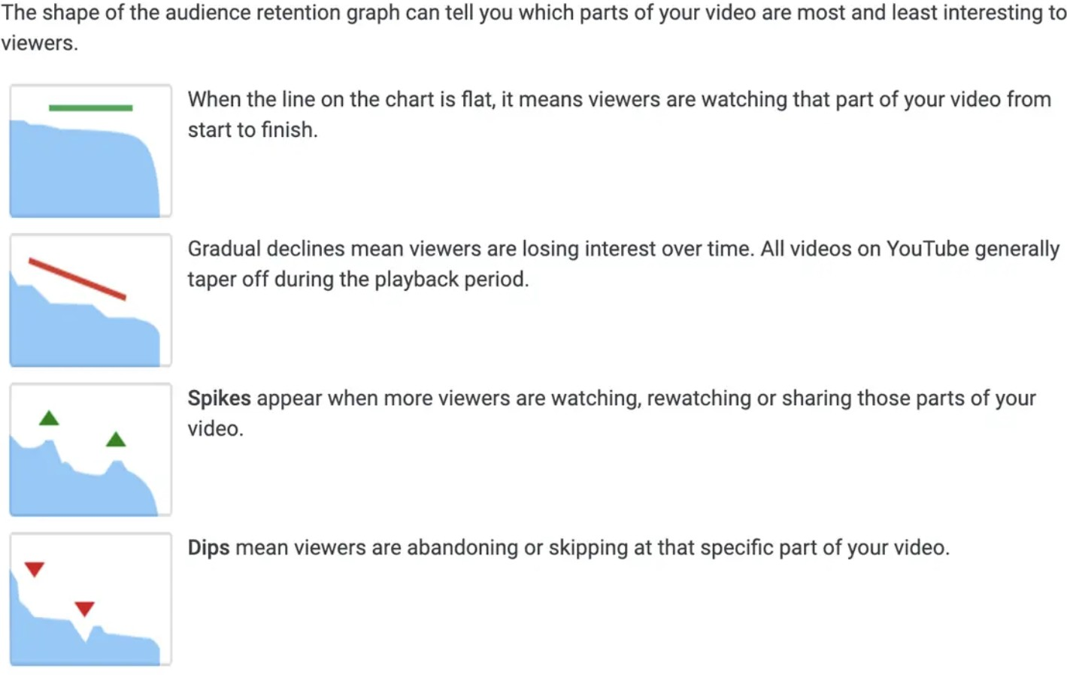
9
The last of the 3 trackable metrics that matters to virality is AVP and tbh this doesn’t matter as much to you. Usually the length of the video will be decided by me or Tyler. I just need you to make people watch as long as possible.
Another non trackable thing about virality I’d like you to know is what we call the “wow factor” and it’s definitely the most subjective. You can check all the above boxes for ctr and avd, but the video still do eh for us. An example of the “wow factor” would be our 100 days in the circle video. We offered someone
$500,000 if they could live in a circle in a field for 100 days and instead of starting with his house in the circle that he would live in, we bring it in on a crane 30 seconds into the video. Why? Because who the fuck else on Youtube can do that lol. The fact that we lifted a house on a crane didn’t add anything to the title and thumbnail. It obviously hooked the viewers and helped retention but there are millions of ways we could have done that easier. It’s arguably from a data standpoint illogical and a waste of time but the impression it leaves on the viewer is invaluable for us. Anytime we do something that no other creator can do, that seperates us in their mind and makes our videos more special to them. It changes how they see us and it does make them watch more videos and engage

Slide 10
10
more with the brand. You can’t track the “wow factor” but I can describe it. Anything that no other youtuber can do. And it’s important we never lose our wow.
CHAPTER 2: Creating Content
For this next part I want to write about actually creating content. I’m not going to talk about any production system in particular because the way we run this production changes almost every year haha. I just want to pass on things I see new people typically fail at and in general what I want. Our videos are hard and if you took the difficulty of our videos and trendlined it overtime, you’d see they are only getting harder. This is why I want the best in the world and people who are obsessed. If you’re not growing, eventually the difficulties of the videos will outgrow you. Whether it be production, creative, camera, or editing I want you to be obsessed with Youtube. Get rid of Netflix and Hulu and watch tons of Youtube, it will without a doubt in my mind make you more successful here. The more invested you are in our world on Youtube the more you’ll understand trends, how we can stand out and be more original, what we could do better, etc. You should also really try to watch every MrBeast video on all the channels. (sounds obvious but i’ve asked multiple people this week what they thought about last week’s gaming video and not a single person had seen it).
On top of learning from watching Youtube I'd love for you to read “The Goal” if you haven’t already. I used to make everyone read it. I know bottlenecks are obvious and it will sound like I’m talking to 10 year olds sometimes but just not knowing and understanding something as simple as bottlenecks has fucked tons of videos. You all should deeply understand the work stream from when a video hits the calendar to when it is filmed. I don’t have the best track record of making the video filming calendar super far out and sticking with it. Let’s say you’re in production and a video you’re assigned to is put up 45 days out. A lot of things need to happen before you can start working on it. The big things would probably be you need a thumbnail sketch and creative on your team to write the video. DO NOT just go to them and say “I need creative, let me know when it’s done” and “I need a thumbnail, let me know when it’s done”. This is what most

Slide 11
11
people do and it’s one of the reasons why we fail so much. I want you to look them in the eyes and tell them they are the bottleneck and take it a step further and explain why they are the bottleneck so you both are on the same page. “Tyler, you are my bottleneck. I have 45 days to make this video happen and I can not begin to work on it until I know what the contents of the video is. I need you to confirm you understand this is important and we need to set a date on when the creative will be done.” Now this person who also has tons of shit going on is aware of how important this discussion is and you guys can prio it accordingly. Now let’s say Tyler and you agree it will be done in 5 days. YOU DON’T GET TO SET A REMINDER FOR 5 DAYS AND NOT TALK TO HIM FOR
5 DAYS! Every single day you must check in on Tyler and make sure he is still on track to hit the target date. I want less excuses in this company. Take ownership and don’t give your project a chance to fail. Dumping your bottleneck on someone and then just walking away until it’s done is lazy and it gives room for error and I want you to have a mindset that God himself couldn’t stop you from making this video on time. Check. In. Daily. Leave. No. Room. For. Error.
For this next part I just want to braindump about random things and explain why we do/say certain things. If you understand all of this then you’ll be in a good spot. LIke seriously, these are cheat codes and you should take them to heart.
Video everything
I really want us to see producing as a team job, not a solo thing. Which is why it’s important you video everything critical (and also anything you think people would ask about). Let’s say you go to scout a set for a video in a month while the rest of your team is working on this week’s video. Most people just go to scout the set, maybe grab a photo, and walk around and try to grab a good mental model of it. Then a week later when you’re back, this video is now Tyler’s main focus and he starts asking questions about the set, and you can’t quite recall. The questions get more and more detailed and all you have to go off of is what's in your mind. The rest of your production team also needs to start planning bits but they don’t know what it looks like and it’s a shit show. This is why we say video everything. Which is more important, that one person has a good mental grip of something or that their entire team of 10 people have a good

Slide 12
12
mental grip on something? Obviously the team. And the easiest way to bring your team up to the same page is to freaken video everything and store it where they can constantly reference it. A lot of problems can be solved if we just video sets and ask for videos when ordering things. Especially because I personally am a visual guy and I always ask to see what things look like so even for me videos are valuable. Video Everything.
SAY THE NEGATIVES
Title says it all. Don’t just tell people on your team or me why something is good. It’s infinitely more valuable to tell us why it’s not good. I FOUND THE CASTLE WE NEED FOR THE VIDEO! But it’s booked all year, overbudget, and someone died in it last week.
It’s your fault, track the contractor
I know I already talked about this but if there is one thing I'd really love to impose on you from all this writing, it's that you can’t just dump and forget your projects. I can’t stand when people dump and forget their project on a contractor and then the day before the shoot blame them when it’s not ready. That’s on YOU, not the contractor. Let’s say we are building the world’s largest water balloon and you need someone to make a giant wooden stand for it to sit on.
Most people here would just call someone like JB and have him do it and tell him to be done by filming day. Instead, you should really have it done a certain time frame in advance (you need to use your own intelligence based on the project to determine that) in case something is off we can make changes. And you need to then decide whether or not it’s a critical component. If it is, you should also begin working on a backup and while working on a backup you should check in with JB every single day. Ask him to send videos everyday to spot problems early, hell maybe talk to him twice a day. I don’t care just don’t leave room for error. No excuses, stop leaving room for error. Check in daily, receive videos, and know weeks in advance if you’re fucked. Not days.
I am not always right

Slide 13
13
Shocker, I know. I’m young and I'll be the first to admit I'm not perfect. I promise not a single person on this planet wants us to succeed more than I do and no matter how much you work you’ll never invest more time into this company then I will, but I can’t promise i’ll always be right. Having said that, there are ways you can help me be right more often. For starters you need to understand the world I’m in and how my mind works. This book in particular is for our production company (which by the way is the most important company and allows everything else to succeed, without the videos everything else dies) but it’s not all I have going on. I have to be the main talent for every Gaming video, every reacts video, every philanthropy video, every tik tok, insta post, and every main channel video. Which is basically 3 full time jobs all by itself, little things like sending videos to people for birthdays, attending events, networking, etc. all add up because i’m the face of the channel. On top of being the main talent I have to work with each channel to make sure the creatives are always evolving and not getting stale and in general be a visionary for them. Basically running 4 channels at a high level better then anyone else in the world can run one. We also have a Beast Burger and Feastables and I still have to set the vision and be the lead creative. On top of that we dub our channels in other languages and we run a translation company that works with other channels as well. I also multiple times a week have to call other youtubers and see what they are testing/doing so I can always stay up to date and make sure we arn’t missing anything. Aka you need me networking a lot. What i’m trying to say is I have to run 4 channels, 3 businesses, a charity, and network/maintain our image all at the same time. So when you need something from me you have to understand that i’m probably not as knowledgeable about a video as you. Whatever you don’t tell me, I don’t know. When getting an answer from me it’s ideal you do the research and come to me with context and options. Instead of saying “In a coming up video we are giving away a car, what do you think of this lexus it’s only $10,000” which is how 99% of questions are asked towards me. Do this instead “We have a coming up would you rather video. One of the bits at the 6 to 9 minute mark we will be giving away a car. We are still on budget and the budget for this car is $10,000. I checked with PM. It could go up another $5k if you really wanted. I searched all of NC for cool ass cars around that price point and here are 5 i found that I got preapproved by creative all on budget. I also got 5 other backup options that are less “cool” looking and more avg if you’re going for that. Here is a picture of all 10 cars, the miles on the cars, and all the information you'd want. Which of these cars do you think is best or should I get other options?” If you want to look like

Slide 14
14
you’re doing your job and don’t care about the success of the video, ask me questions like the first example. If you want to take accountability and make your videos happen with a higher probability of success, do the second option. (This doesn’t just apply to me, it applies to anyone high up you expect to make a decision)
Critical Components
Critical components are the things that are essential to your video. If I want to put 100 people on an island and give it away to one of them, then securing an island is a critical component. It doesn’t matter how well planned the challenges on the island are, how good the weather is, etc. Without that island there is no video. Hence it is a critical component. Another example of a Critical Component would be the title and thumbnail. Remember that bouncy castle story from earlier? How the thumbnail had a yellow bouncy castle but the video a red one? The thumbnails of the videos you’re producing can also create critical components. A third example of a critical component would be if the creative on your team pitched me a video of 10 challenges and I said “I like the video but mostly because of challenge 3 and 7, i’d hate the video without them”. Challenge 3 and 7 are now essential to your video and thus critical components. Critical Components can come from literally anywhere and once something you’re working on is labeled as such, you treat it like your baby. WITHOUT WHAT YOU’RE WORKING ON WE DO NOT HAVE A VIDEO! Protect it at all costs, check in on it 10x a day, obsess over it, make a backup, if it requires shipping pay someone to pick it up and drive it, don’t trust standard shipping, and speak up the second anything goes wrong. The literal second. Never coin flip a Critical Component (that means you’re coinfliping the video aka a million plus dollars) and always bring in me or James earlier rather than later.
Communication Lines
It’s very important as a company we maintain proper communication lines.
On set and off set. There is always someone responsible for everything on the video and if multiple people are responsible for the same thing, then that’s a problem and needs to be fixed immediately. Ideally when communicating across departments you go up and then over. If you skip and just go below you

Slide 15
15
prizemust then call and let the people in charge know. Let’s say you’re a production coordinator and you call a writer and tell him you need some bits about a sandwich being cooked with lava, seems harmless. Except now Tyler (head of creative) has no idea what his writer is working on and worse doesn’t know that’s an option when he directs the video. Will (head of production) also has no idea this has been set into motion and when planning and tracking the progress of the video doesn’t know to account for this.Wlli later finds out about it and assumes tyler approved the bit and starts planning on how to make lava and then wastes 3 days making lava until tyler catches wind and then tyler askes her why she is making lava and she has no idea and everyone is confused. This is what happens when you don’t follow proper communication lines. If when this bit was requested tyler and ali were called first, days of bullshit would have been saved. Seems simple but it happens dozens of times a week and causes tons of double and triple work.
Creativity Saves Money
I don’t think it comes as a surprise when I say we don’t have unlimited money here. We can’t have every video constantly going over budget because the money has to come from somewhere but you’re in a tough spot because I constantly want better and better videos. A lot of people who work here have definitely thought before “If jimmy wants us to be on budget why does he keep asking us to do so many expensive things” or “I know jimmy won’t like this so I need to spend more money”. People always assume money is the answer and if we just spend more money we can give Jimmy what he wants. Which is wrong, creativity is the answer. Here is an example I use all the time with our gaming team. They love to give away money every video. But. Which sounds cooler to you as a prize for a gaming video. $20,000 or a year’s supply of doritos? To me doritos is so much funnier and I think our audience would find it fucken hilarious. So lets say we define a year’s supply of doritos by 5 packs of doritos a day for 365 days. That’s 1,825 packs of doritos and a quick google search shows you can buy a pack of doritos for less than a dollar but we can round up and just say a dollar per a pack of doritos. Our prize for the video just went from $20,000 down to $1,825 because we didn’t just throw money at the problem and we used creativity. This applies to everything every single one of you do. Whether it be finding a crane for a video, deciding prizes, picking locations, finding critical

Slide 16
16
components, or doing the most miniscule thing, use creativity to save money. Because every dollar we save allows me to give you guys more stability and hire more people to make your life easier. If you want to succeed here say this 10x in your head “Creativity Saves Money”
Always have a backup day
No one will ever have a 100% success rate when it comes to filming our videos on time and on budget. It’s impossible. But you still can do certain things to increase the probability of success and one of the easiest but most overlooked is having a back up day. When you’re spending hundreds of thousands of dollars securing a set, renting a tank, etc. make sure you have the ability to extend them in case something goes wrong. (it might not even be your video. Something might go wrong on gaming and now I need to slide your video a day to make up for it.) I’d also rather have a hypothetical 90% cool looking tank with a dope owner who is making life easier on us, letting me do whatever I want, and the ability to pay extra to add a day. Then a 100% cool looking tank but the owner micromanages what we do, and there is no backup day. This example is obvious, just throwing it out there to inspire you. Always check with creative before you do something like this but back up days are necessary and ideally we work with people that see the value in us and love us so they will be even more flexible.
Don’t take anything at face value, always dig
One of the common themes you’re probably seeing is accountability and this doubles down on that. Don’t take anything at face value, always dig. This is particularly important when dealing with people outside the MrBeast Production team. If someone says something too good to be true, find out why. If it’s fishy, investigate. If you need 10,000 pillows by next week and you’ve called 10 pillow companies and none have more than a few hundred in stock but then the 11th company magically has 10,000 pillows, investigate. Are they drop shipping? Are the pillows shitty? Why the fuck does no one want your pillows? Push and get answers. What tends to happen is people think their job is done by finding the 10k pillows and just order them only for us to find problems with them when the arrive but it’s too close to the filming window to fix it. Do not overly trust people

Slide 17
17
outside the company. Investigate and verify what they say or it is your fault if they don’t pull through.
Higher form of communication
If you spend any amount of time with James you’ll hear him bring up higher forms of communication a lot. Because it’s important and somehow very overlooked by most people. The worst thing you could ever do when you need something for your critical component is email someone at the company. The best is to talk to them in real life. It’s very important you know when to call people for stuff, grab them in real life, and when to text them. The lower the form of communication the more miscommunication you will face. As i’m typing this you have no idea if i’m laughing, smiling, happy, mad, or sad. You can’t read my body language or my face and because of that it’s not guaranteed that you’ll understand what i’m conveying. Need more toilet paper in the bathroom? A text is probably fine. One week out from a video and the thing you are working out just went south? Minimum a multi way call with the heads of the video. Ideally grab them in real life if you can. The more complex what needs to be said is, the higher the form of the communication you should use. Call first then text if they don’t answer.
Since we are on the topic of communication, written communication also does not constitute communication unless they confirm they read it.
Own your mistakes
I hate excuses and I despise with my entire soul when people just try to save face instead of learn from how they messed up. Mistakes are okay!
Genuinely they are and I expect you to make a lot. That’s perfectly fine. Every veteran here has cost me a million dollars at one point or another, and you can go ask them yourself if I ever held it over their heads. The reason i’m okay with fuck ups is because I know that’s how you learn. I see it as me investing in you and your brain. (hence why I have 0 tolerance for C-Players and they must go immediately. Those fuck ups could be done by an A-Player that will retain the information learned). I just beg you that you learn from every mistake and try not to repeat it, that’s when it gets annoying. I’ve never ever ever once fired someone on the spot for messing up, you have nothing to be afraid of. Own shit so we can address how to fix it and then move on.

Slide 18
18
Nothing Comes Before Your Prios
When you’re being assigned tasks you should have what we call a prio list.
If Ali says your prios are to
1.) Get a lamborgini under $200k
2.) Get it wrapped in anime characters 3.) Make a custom steering wheel
Then nothing on this freakin planet is allowed to come between you and getting those prios done. If the other team asks for your help and you spend two days helping them and fall behind on getting your lamborghini secured, THAT’S YOUR FAULT. If the studio is burning down and you stop working to put out the fire and don’t get the lamborghini, THAT’S YOUR FAULT. (jokes haha) but seriously don’t let anything come before your prios.
USE CONSULTANTS
Consultants are literally cheat codes. Need to make the world's largest slice of cake? Start off by calling the person who made the previous world’s largest slice of cake lol. He’s already done countless tests and can save you weeks worth of work. I really want to drill this point home because I’m a massive believer in consultants. Because I've spent almost a decade of my life hyper obsessing over youtube, I can show a brand new creator how to go from 100 subscribers to 10,000 in a month. On their own it would take them years to do it. Consults are a gift from god, please take advantage of them. In every single freakin task assigned to you, always always always ask yourself first if you can find a consultant to help you. This is so important that I am demanding you repeat this three times in your head “I will always check for consultants when i’m assigned a task”
Math Science Vision Approvals Budget
Everything you need can be solved by one of these 5 things above. Use Math, Science, Vision, Approvals, or Budget.

Slide 19
19
NO DOES NOT MEAN NO
When dealing with people outside MrBeast Productions never take a No at face value. If we need a store to buy everything inside of and you call the local Dollar tree and the person that answers says “No, you can’t film here”. That literally doesn’t mean shit. Talk to other employees and see if any are fans or if any have kids that are fans, try talking to their boss, their bosses boss, have me dm them on twitter and try their social team, etc. If after all avenues are exhausted you are left with a no, that doesn’t mean don’t try the other dollar trees because the manager of those could be huge fans and willing to bend the rules. Basically what I’m trying to convey is what we call “pushing thru no”. Don’t just stop because one person told you no, stop when all conceivable options are exhausted. This is one of many tools that when combined dramatically improve your probability of success when producing here.
Work on multiple videos EVERYDAY
Please do not come in and only work on one video during a workday. That’s how you fall behind on future videos and create a nasty cycle that i’m trying to stop. If you drop everything and go all in on a video for 3 days then that’s 3 days your other videos will fall behind and eventually you’ll have to drop other videos to focus on those videos and it will snowball into you can’t do anything but focus on what’s right in front of you because you murdered any lead time you had. If you ever only work on one video during a day, you failed as a MrBeast employee that day.
Be able to hold a camera
Obviously everyone has their roles in the company and tbh if you can consistently lead and produce videos for me with a 90% success rate idc if you piss in the sink everyday i’ll still love you. But having said that it’d be nice if at some point you got training on our style of holding a camera. When we do a big shoot not local it’d be nice to not have to bring 10000000 production people and 100000 camera people. If for example there are only a few scenes that need a couple extra camera men I’d love for us not to have to fly, house, transport, and baby more camera men when we could just have a few people from production

Slide 20
20
or creative help for those overflow scenes because typically the more cameramen we have filming the less important each shot becomes.
1 out of 10 good. 10 out of 10 bad.
Youtube has a feature that compares a new upload’s performance to the previous 9 videos and tells you how the views rank in the first hour, two hours, three hours, 4 hours, etc. This is what it looks like

Slide 21
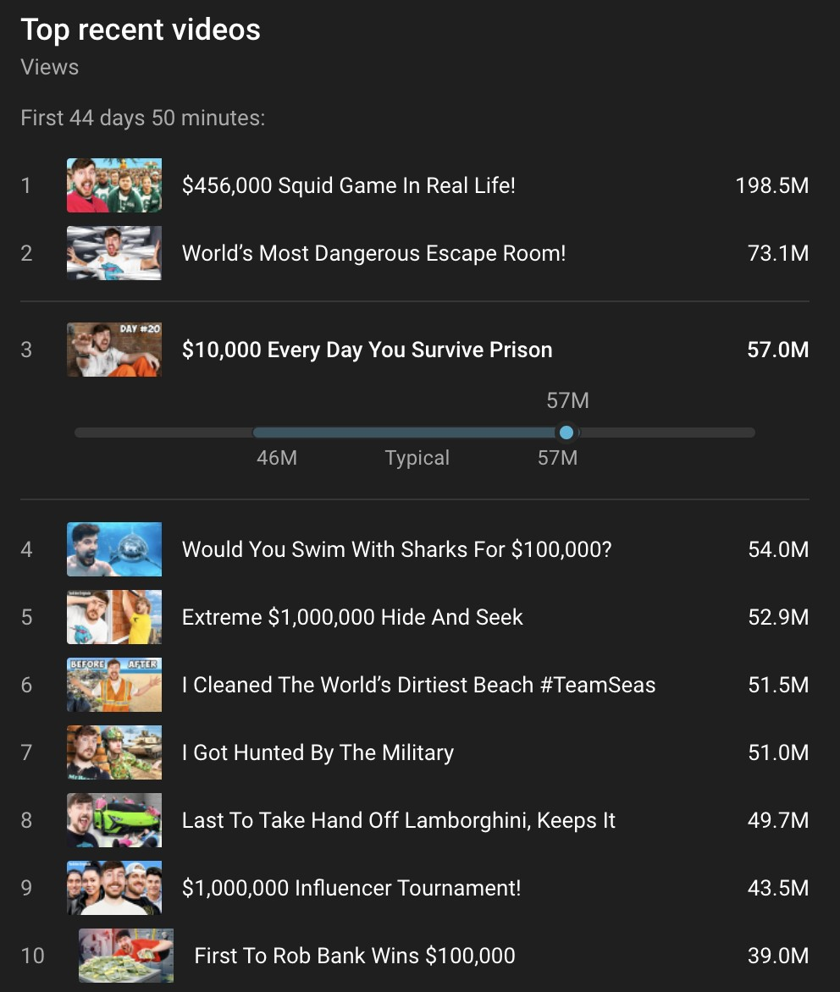
21

Slide 22
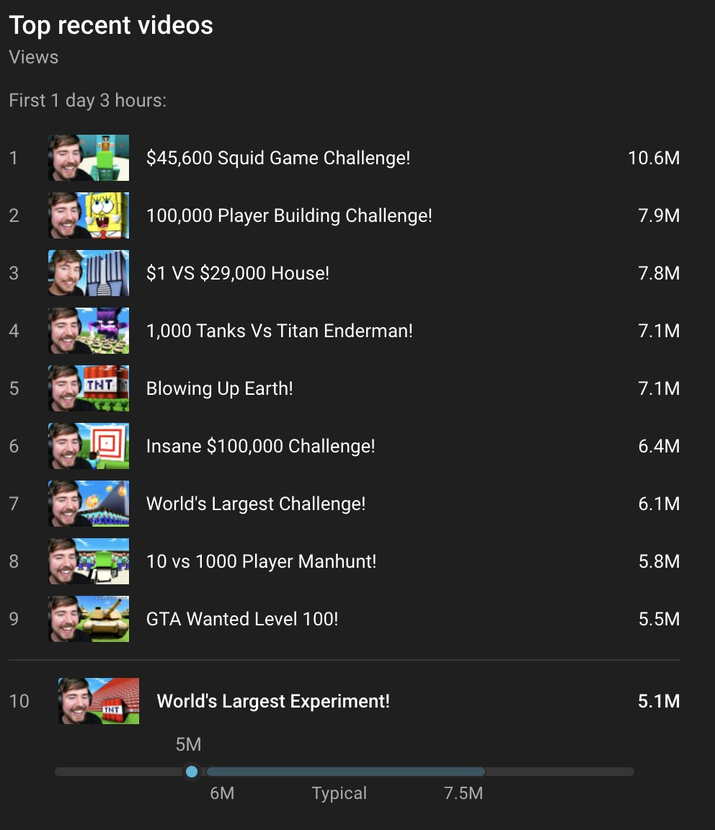
22
So if you hear someone ask what a video was out of 10, this is what they are asking for.

Slide 23
23
Random things you should know
I’m almost done with this chapter and then we can move on to creative but before we do I still have tons of notes around producing content that I can’t really break into their own sections so I want to rapid fire them here so you at least hear them once before starting your journey.
Do not leave consteatants waiting in the sun (ideally waiting in general) for more than 3 hours. Squid game it cost us $500,000 and boys vs girls it got a lot of people out. Ask James to know more
Spectacles are videos that only the MrBeast channel can do. Not every video should be a spectacle and we realize these videos are hard but that’s the point.
I hate having tons of people on set. If someone is necessary, then that’s fine but if not, kick them off set or go have them watch from behind a monitor. Create an environment where the contestants also feel natural.
I’d rather you be honest with eachother then nice to eachother.
Do not talk down to talent or do anything to make them feel like shit. I need them to be happy and in good moods and those boys are special to me. Ideally most talks with talent (Chris, Karl, Chandler, Nolan) go thru me, Ali, or Tyler to avoid confusion amongst them.
Me like simple. The simpler the better (APPLY WITH A GRAIN OF SALT)
We pivot a lot, be ready to have everything flipped on its head at a moment's notice lol
I want money spent to be shown on camera ideally. If you’re spending over $10,000 on something and it won’t be shown on camera, seriously think about it.

Slide 24
24
Work with intensity
Push outwards, not inwards.
Pull all nighters weeks before the shoot so you don’t have to days before the shoot.
If something goes wrong on shoot always check to see if it can be made into content. A tree fall over on your car and breaks the 100 vases we needed to give away? THAT’S FUCKEN HILARIOUS AND WE SHOULD MENTION IT IN THE VIDEO LOL
Feasibility is working to see if the critical components of a video are actually possible. Example would be if I wanted to play hide and seek in the world’s largest building. If you did feasibility on this, that basically means you’re trying to see if it’s possible to get that building. If you do then we have a video and it should go into production. If you can’t then that’s why it was in feasibility so no one else wasted time.
Never do anything that could make us look bad from a pr perspective. We often do renderings of sets to see what they look like beforehand,
which is amazing and helps a lot cause i’m very visual and gets the whole team on the same page. When doing these renders though, I want to make sure you know the difference between a “Pre Vis” and a “Concept”. Please do not refer to a render as a “Pre Vis” unless that is actually what we plan on building. If it’s just a render for inspiration and is not building locked, call it a concept. This will greatly help with confusion in my opinion. Many people wave around a concept but call it a Pre Vis and people see it expecting that to be what’s built only to find out later that was a concept and the actual set is much different.
Chapter 3: Creative

Slide 25
25
We are a creative first production company. Because when creative leads the vision of the shoot, the product is always better. So I think it’s important you all understand creative. It is what drives everything we do and is the heart of our content. Being creative and understanding what makes good content is like cheat codes when in production, camera, and obviously editing. Let’s take production for example. Let’s say you are tasked with finding us a castle to live in for 50 hours and while doing research you find a castle and a number to call for the owner. So you do call, and he answers. Only problem is he says he quit the castle renting business to pursue his dream of building a 100 foot tall lego catapult. You can obviously tell where i’m going with this. Ideally you’d recognize that’s badass as fuck and try to convince him to let us use it when we do find a castle. This is a bad example because it’s so obvious but if you’re doing your job right you will be doing an absurd amounts of calls and data collecting. While trying to complete your prios and prepare for the video you should always be on the lookout for new things you can bring to your creative team to inspire them.
Because just like me, they don’t know what they don’t know and you can’t just say “i’m in production and i’m not very creative” because that’s literally the equivalent of saying I suck at what I do. You also need to apply this same mindset when problem solving because many people lose sight of this stuff when in the weeds. If a problem appears, always always always ask yourself if your new plan is whats best for creative, not just the easiest bandaid.
What is the goal of our content?
To excite me. The goal of our content is to excite me. That may sound weird to some of you, especially if you’re new but to me it’s what’s most important. If I'm not excited to get in front of that camera and film the video, it’s just simply not going to happen. I’m not fake and I will be authentic, that’s partly why the channel does so well. And if i’m not excited by the video, we’re fucked. Luckily, I'd say I'm a pretty predictable guy. (at least in this regard haha) What excites me is what I believe will make the audience happy. That’s what it always has been and always will be. I’m willing to count to one hundred thousand, bury myself alive, or walk a marathon in the world’s largest pairs of shoes if I must. I just want to do what makes me happy and ultimately the viewers happy. This channel is my baby and I've given up my life for it. I’m so emotionally connected to it that it’s sad lol. But this is the one thing I will never compromise on, I have 0 issues throwing away a multi million dollar video if I don’t think it’s up to my

Slide 26
26
standards and is good for the audience. We must always be improving and innovating. The camera angles need to always get better, the pacing, the story, the jokes, the color, the lighting, the music, the props, the people, our framing, our ideas, literally everything must always be improving and innovating. Because that is what excites me. That’s literally what I live for, to see these videos get better and better and ultimately make the viewers happy.
What Makes Good Content
This is where things get subjective and my brain is probably going to turn into moosh. The problem with what I’m writing here is that good content is limitless. Literally anything can make good content. Let’s take a baby doll for example. You can see who can throw it the farthest with their left hand out of a group of 5 people. Watching them throw a baby doll with their bad hand and funny sound effects is fucken hilarious. You can also go the opposite route and have 1,000 baby dolls and see how many it takes for someone to throw it in a crib 200 feet away. Or you can see how many baby dolls it would take to break a two by four in half. The point I'm trying to convey here is that even something as simple as a baby doll has an infinite amount of ways you can turn it into amazing, original, and funny content. That’s one of the secret weapons of MrBeast Productions, we aren't stuck in any old ways of thinking and you can literally turn anything into content. Good content can be anything, always have an open mind and never stop innovating. Having said that, this is youtube and there are constraints. You know the video can’t be a minute so you’re obviously going to need a story to hold the viewers and there are rules to storytelling. Our audience is massive and because of that you have to be simple, for 50 million people to understand something it must be simple. Content can be anything but there is structure and rules that we must mold it into that I want to teach you about, because virality doesn’t just happen. Every frame of our videos will be seen by 10s of millions of people.
How to measure the success of content
Like I said at the start of this the metrics you care about in regards to virality are CTR, AVD, and AVP. If you want to know if the contents of a video are good, just look at the AVD and AVP of a video after we upload it. Because based

Slide 27
27
on how long people watch and what percentage of the video they watched, you can clearly see if they enjoyed it. To show this in action
below is the retention data for two separate videos of almost identical length from the channel. (All avd and avp data I share will be first day data to make it apples to apples, if you don’t know what this means that’s okay it’s mostly incase mario gets his hands on this haha). One video has 120 million views and the other only 45 million. Look at these retention numbers and see if you can pick which one got triple the views.

Slide 28
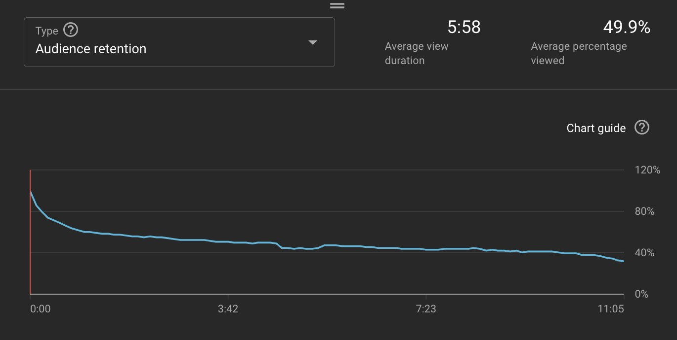
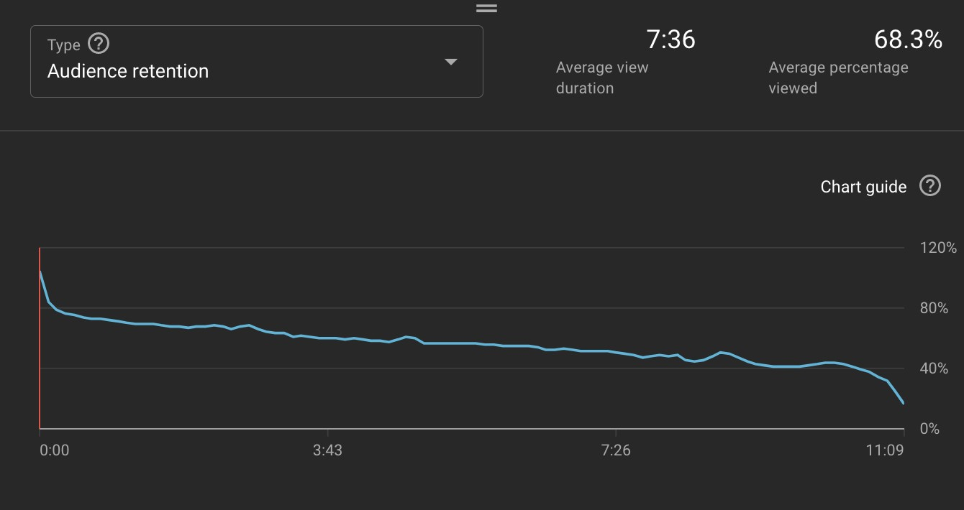
28
The answer is the lower image. People on average watched this video a minute and 38 seconds longer than the other video of the same length!! OF COURSE IT GOT TRIPLE THE VIEWS, IT’S CLEAR AS DAY FOR YOUTUBE THAT
PEOPLE LIKED THIS VIDEO MUCH MORE! For your videos to do well you must get their AVD and AVP as high as possible. The longer people watch, the better a video will do. This is why I’m such a stickler about every single second of

Slide 29
29
content. Hook people at the start of the video, transition them to an amazing story that they are invested in, have no dull moments, and then have a satisfying payoff at the end of the video with an abrupt ending.
Formats
One way to boost retention on a video is to have a good format for the video to follow. Let’s use our popular “last to leave” series as an example. These videos have many reasons why they do well but one in particular is the payoff at the end. You see once you start watching a last to leave, you get invested in the progress and the challenge. You really want to see who leaves the circle last and wins the $100,000. Luckily the winner isn’t revealed until the end of the video so as long as we don’t make the video boring as hell people are very likely to stick around until the end. Strong payoffs at the end of videos boost retention. But obviously last to leave isn’t our only format. Another example of a format is what I like to call stair stepping. A good example of this is “I Bought The World’s Largest Firework” this video opens with us showing all the fireworks and then lighting a
$1 firework, then a $10, then $50, then $375, then $1,000, then $10,000, then we did some content, then $40,000, $100,000, and then the world record. As you get deeper in the video the stakes get higher. The payoff of the world record is at the end and It’s such a beautiful format that allows you to deviate if you want as long as things progressively get cooler. I fucken love stair stepping. Another format would be the ones where I get chased like bounty hunter, military, FBI. Just like the last to leave challenges you don’t know until the end of the video what the result is. Will they catch me? Will I get away? Gotta watch until the end.
Throughout the history of this channel we’ve been through many formats. A big one back in the day was “donating to twitch streamers” and people loved them. I’d go into random streams and donate $10k to a streamer to see how they’d react. All in all we did like 12 of them and when I stopped people still begged for more and that’s because like Steve Job’s says, people don’t know what they want. The viewer may think they want a format forever, but they don’t. They want new and fresh things (this is evident because every channel that rehashes formats for years always dies). This is why I’m constantly ditching formats in exchange for new ones. Ideally two videos from the same format are not back to back, i’d like multiple different videos in between them if possible.

Slide 30
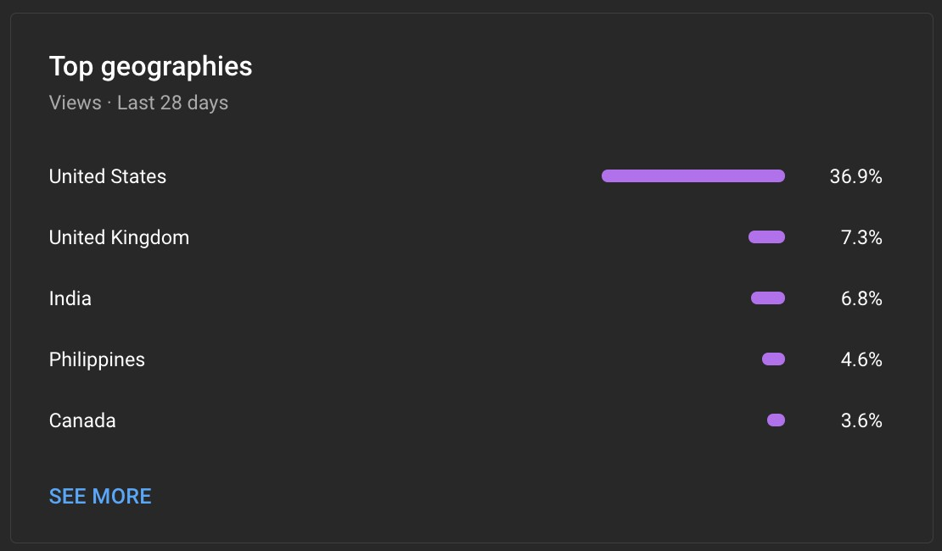
30
Who is our audience?
Here are screenshots from the backend. (Europe is a big % but it’s broken up into countries so it doesn’t seem like it)

Slide 31
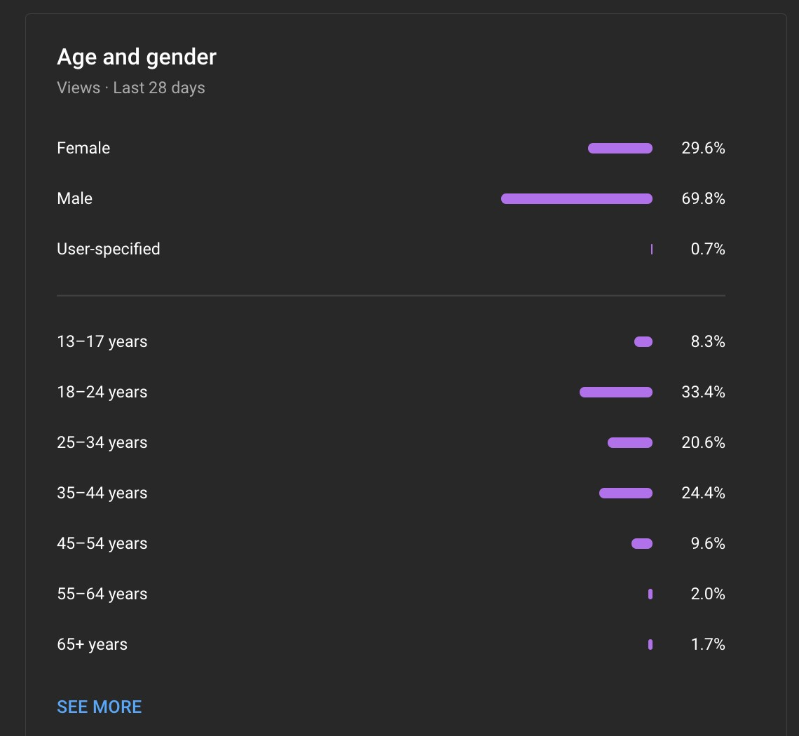
31
Our content is consumed by everyone at this point. Kids watch the videos with their mom, even though our female viewership is only 30%. That's still 9 figure views a month from women, and it’s worldwide (but not to worldwide, 50%+ is still America and europe.) But despite saying all that, at its core if I had to describe it, I'd say the average MrBeast viewer is a teenage memer that likes video games.
You Should Watch Our Videos
If you’re going to be working for the Beast brand you should be a fan of the Beast brand. A lot of very valuable knowledge comes with watching vast amounts of our videos. I feel silly for having to write this but all the time I talk to

Slide 32
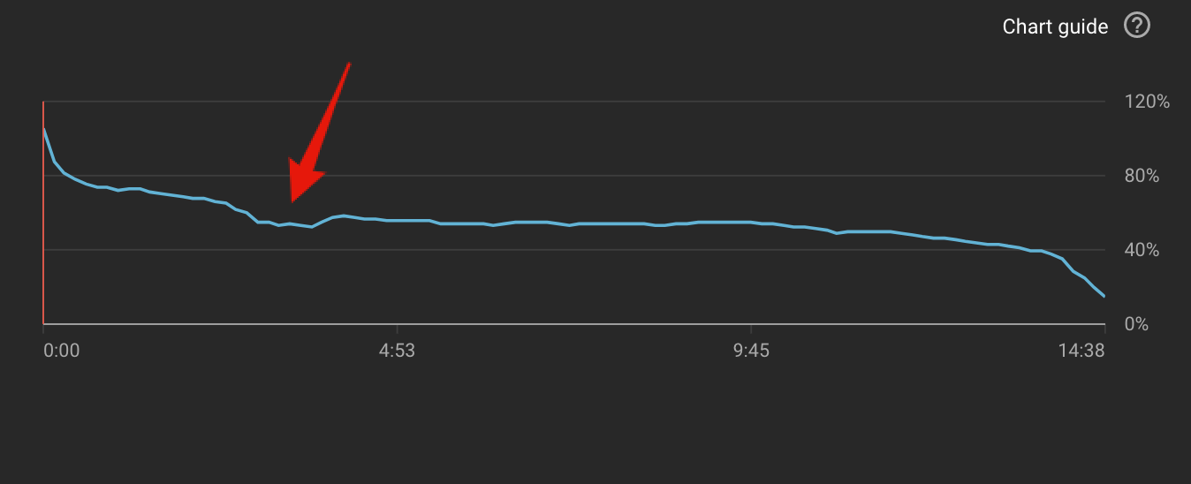
32
new people that have at most seen like 5 or 6 of our videos and it’s mind blowing that they don’t see a problem with that lol. As I said earlier I’d love for you to watch all the channels but especially the main channel seeing how you’re working on it. To get 60% up to speed I'd watch our last 50ish videos, if you’re a monster and really want to understand the history of the company and the innovations we’ve been through, I'd recommend you watch every video back until you hit the 10 million subscriber special. (anything before that is a waste of time in my opinion) If you’ve seen every video we’ve made since 10 mil then you will have a lot of context and information others don’t and it will make you that much much much more valuable.
Brand Deals Are Content
If you watch a lot of youtube you’ll probably notice that when someone does a brand deal it’s boring and sounds like they’re reading a script. We take a different approach to brand deals, we like to integrate them into the content so it doesn’t nuke our retention and boosts conversion. Remember that I told you we could see the exact moment when viewers click off our videos? Here is a retention chart for when we used to do brand deals the old way.
Notice the crater where the brand deal is, that means people skipped it and also clicked off the video. Now here is a retention chart with a new style brand deal in it.

Slide 33
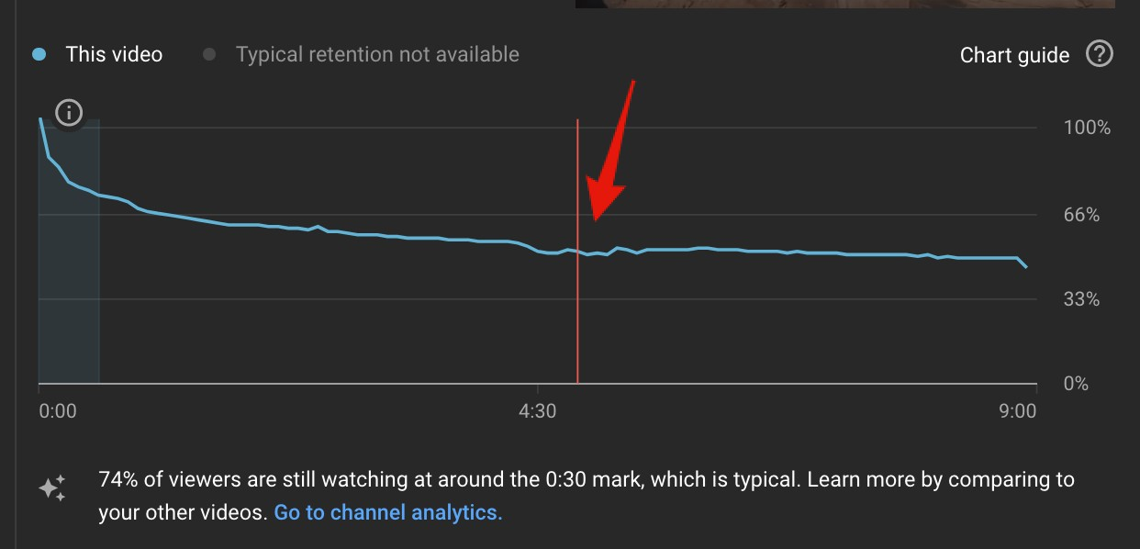
33
The dip is way less dramatic and for the most part something I can live with to help fund the videos. BRAND DEALS ARE CONTENT! And when treated as such boosts retention. We need to make them in entertaining. Also, fun fact, the last CEO that sponsored a video said that the return was 1.7x the return they get on a NFL championship game ad. He said with an NFL commercial you get a giant spike of customers day one and then it disappears forever after that where as a brand deal with us you get a huge spike for a few days and then it settles down and then a respike when we upload again (because after they watch the new video they go back and watch the video before it) and even after that our videos typically get a million views+ a month for years. Aka tons of residual customers.
UNDERSTAND CULTURE
What you consume on social media, when you watch youtube, tv, the games you play, etc. are what I like to call your information diet. Chris Tyson (our first subscriber and the guy in the videos) is a wonderful example of an information diet being used to perfection. The dude is funny as fuck. I’ve never met anyone in my entire life that can make people laugh like he can and I never understood why he was so good at it until I lived with him for a few years. The dude watches an obscene amount of cartoons and stupid shit. His eyeballs exsist to inhail copious amounts of just goofy, dumb, and brain numbing content. And as a result he can quote almost any line from any episode of spongebob. He’s able

Slide 34
34
to draw from so much stupid shit in his head as inspiration to make jokes and be quirky. As a result he is fucken hilarious. But let’s imagine a different Chris, let’s say instead of cartoons and stupid shit, his information diet was stocks and investing advice. And for 5 years that’s all he consumed. Do you think he’d be just as funny as he currently is? No. He in my opinion wouldn’t even be 20% as funny. If you’re a writer or director you really need to monitor and perfect your information diet. If your diet is not correct, you won’t have a good pulse on culture. I don’t want you to be a chris, in fact, I think that would probably do you harm. Talent needs to inhale cartoons so they can be funny, writers need to inhale inspiration. Let’s say there is a purple fruit in the middle of Australia that when eaten makes you 2 feet taller. If it truly did exist, you wouldn’t have known that until just right now. But now that you know of it, you can draw on it for inspiration for every piece of content you write going forward. That’s beautiful, it can now sit in the back of your mind waiting for that one video where it is needed. It might take 10 videos or even 100 but eventually you’ll be brainstorming a bit and think of the right one to use the fruit for. Apply this to everything on this fucken planet. You. Can’t. Get. Inspired. By. Things. You. Don’t. Know. Exist. So how do you learn more about what's out there in the world? How do you stay up to date on the latest memes? How do you know what’s going on with celebrities? What’s trending on youtube? What other creators are doing? What’s popping on tik tok? Your information diet. Consume things on a daily basis that help you write better content.
It’s okay for the boys to be childish
If talent wants to draw a dick on the white board in the video or do something stupid, let them. (assuming they know all the risks and arn’t missing context on why it’s not safe) People like when we are in our natural element of stupidity. Really do everything you can to empower the boys when filming and help them make content. Help them be idiots.
We don’t fake things.
Make sure to prep contestants and try to create an environment where they feel comfortable talking.

Slide 35
35
If you wrote a banger piece of content but it is a 50/50 chance of working, write another piece of content. Content is unlimited, don't be lazy.
Run your content by as many people as possible for inspiration on how you could make it even better.
I want famous people in our videos.
Don’t ever put me in a situation where I have to lie, because I won’t and it will screw the video.
No dull moments in videos
You can’t fake intensity in videos
The video endings must always be abrupt to protect retention.
This isn’t really a creative thing but in general when on set be attentive and engaged. Filming days are stressful enough, be useful please.
Chapter 4: Your Career
If you’ve made it this far you are probably at least semi interested in this being your career. So I wanted to chat about it. Because if you're ambitious and want to dedicate your life to work, you picked the best company in America to do it at. I really don’t care to hoard a bunch of money and I deeply believe in rewarding the people that help this business get where it needs to be. But before I get into that, let’s talk about the future. As I write this we have 2 teams, that will grow to 4 in the next year. (and possibly 8 in the next 2 years but I can’t talk about that cause james will kill me haha). We need more leaders in the company. We need hard working, obsessive, coachable, intelligent, grinders that can step up and take some of these leadership spots over the next 2 years. Every single department has an opportunity for you to grow in and you’re in luck because we don’t do yearly reviews. We do whenever the fuck you want reviews. If you want to become a production manager, tell james your intention and ask him why you

Slide 36
36
suck and how you can become better. Seriously. He will give you a list of things that you need to improve to become what we need and if you actually listen and master those things, we will give you a shot at the role. (only problem is most people think they are better than they really are and don’t take seriously when we give them things to improve and then wonder why they never move up). This isn’t a bureaucratic corporate company. You don’t have to do something for 5 years to get a promotion, I hate the word promotion. The more responsibility, risk you help us navigate, and overall bullshit you deal with, the more you make. And if you want more of that we will gladly help train you to receive it haha. There is infinite room for you to grow here. This isn’t a stepping stone, this is your final destination. We will win and we are going to build something amazing. I see a world where this company is worth billions and one day 10s of billions. And those of you that help build this will be rewarded. I want nothing more then for you to go all in, obsessive all day everyday, and become so god dam valuable this company can’t operate without you. And in return for becoming so valuable I hope to give you incredible experiences, a fun place to work, and of course, more money then you could ever dream of making at any other company. Now read this all over again because I guarantee you didn’t retain enough.

